Slide 1
Volunteer social media tips and examples
Version 1.1
January 2023

Slide 2
WELCOME
parkrun social media accounts are where a lot of people will hear about the event you support and get a feeling for what parkrun is all about. It’s a great way to promote volunteering and how people can contribute and benefit through it. Please see this guide to help generate volunteering social media posts.
Posting regularly on Facebook and other social media platforms is a proven way to grow your parkrun community. This includes run, walk, jog and volunteer participants. If you are pressed for time during the week, scheduling posts at the beginning of the week is a quick and easy way to ensure you reach your local community on social media without the need to go in each day to post something.
It’s important that anyone posting on parkrun event social media accounts are familiar with and read through the following guidance and policies.
Social media guidance
Photography policy

Slide 3
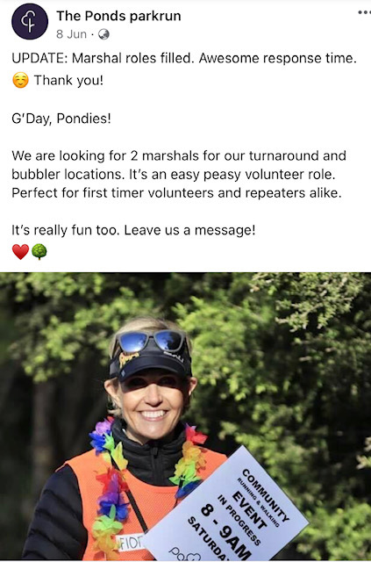
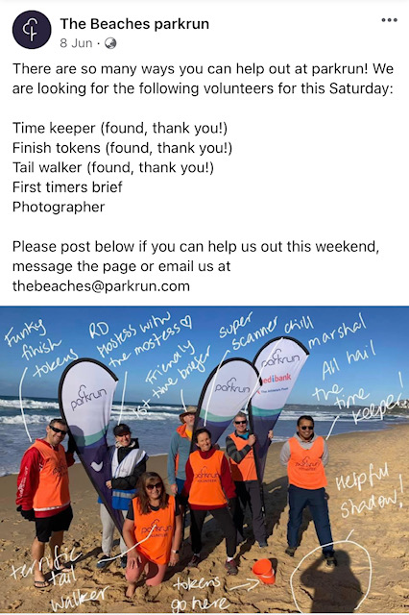
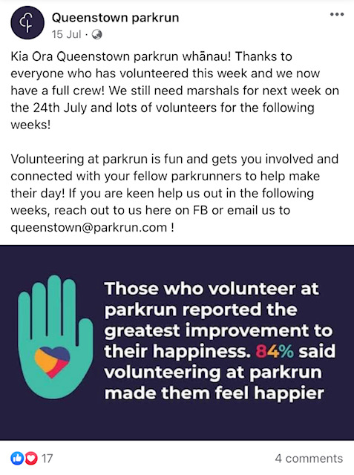
Promote volunteering as fun

Slide 4
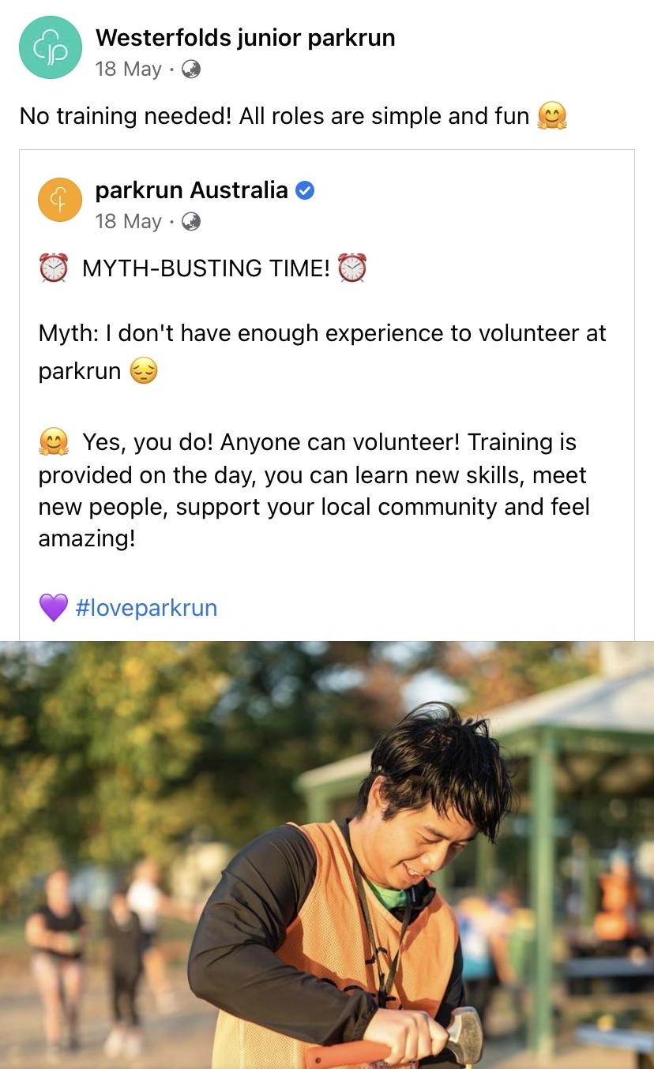
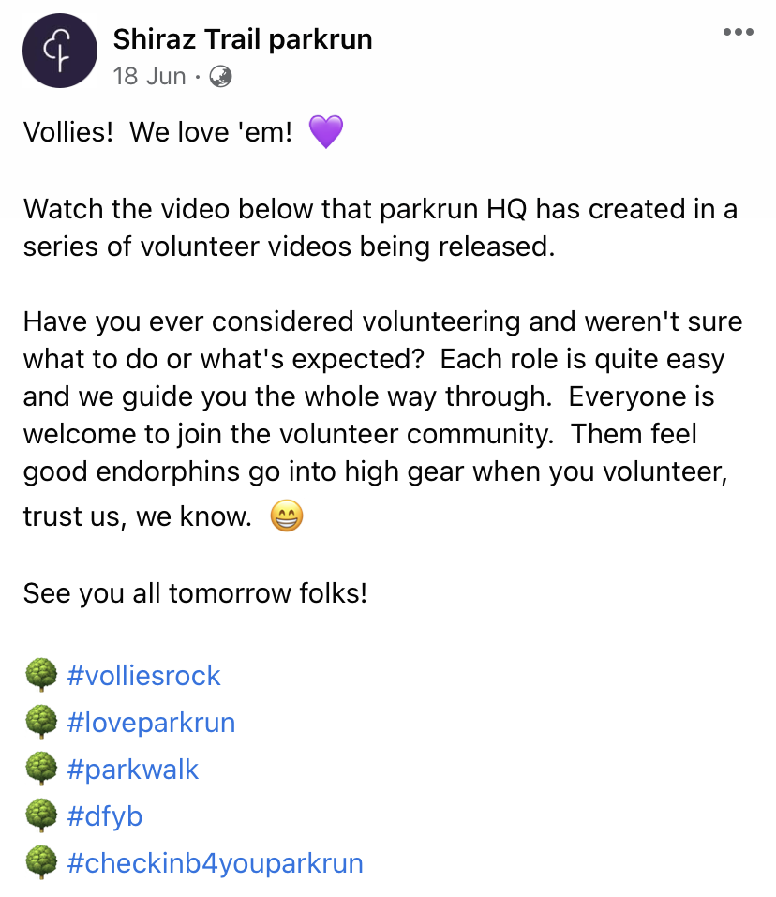
Let your community know how easy volunteering is

Slide 5
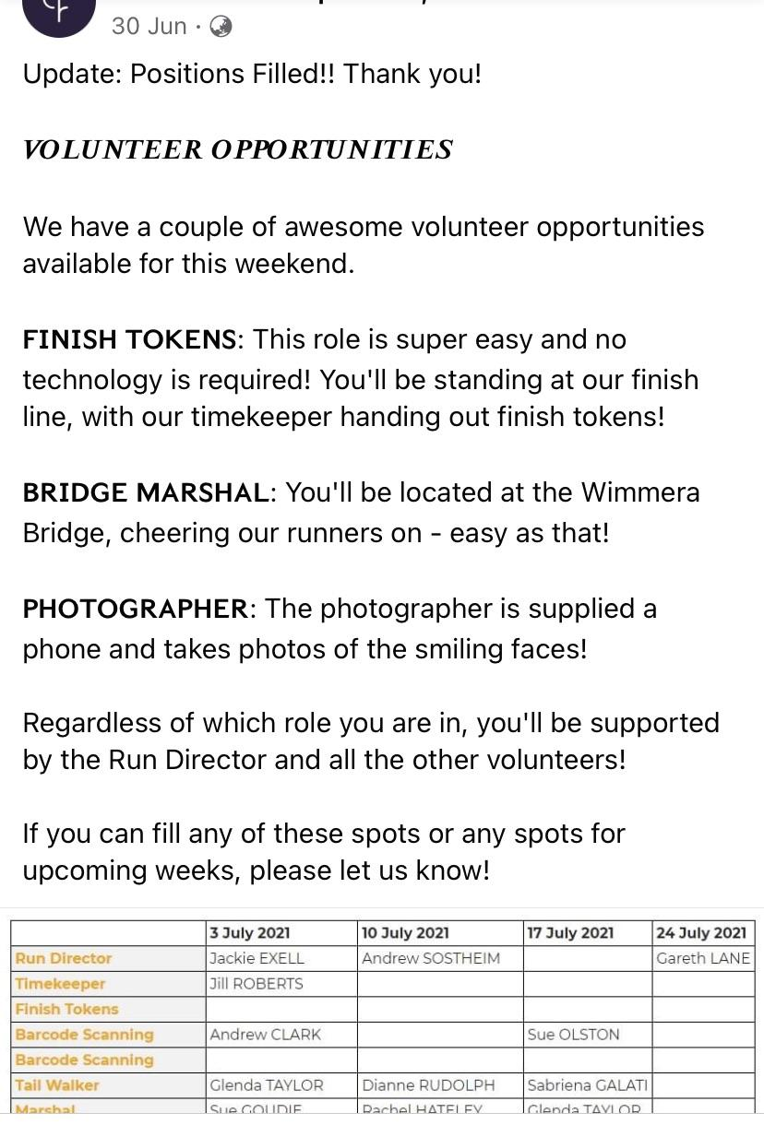
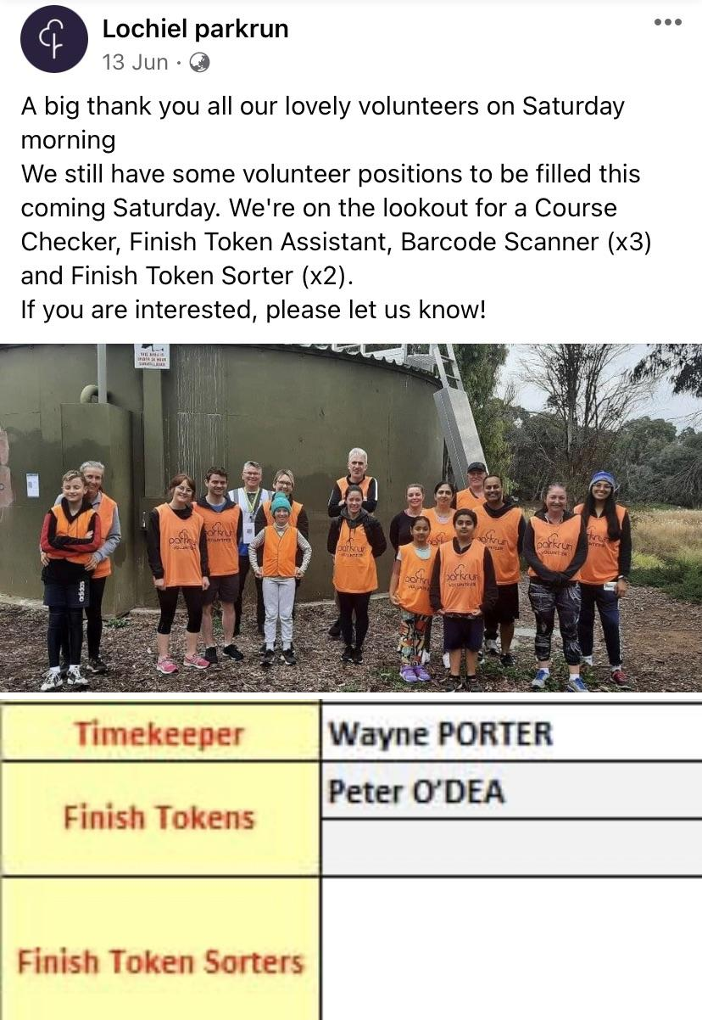
Share the Hi Viz roster for all to see

Slide 6
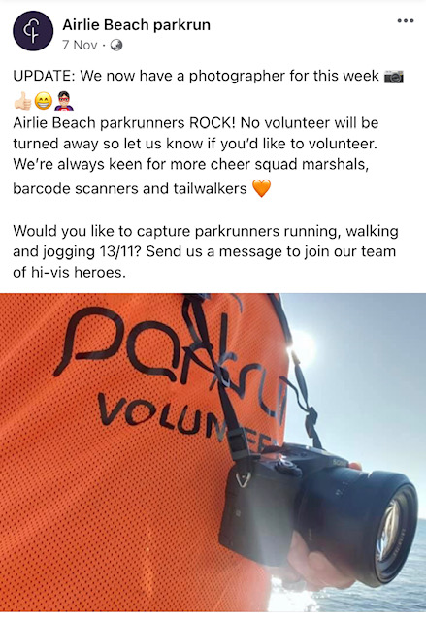
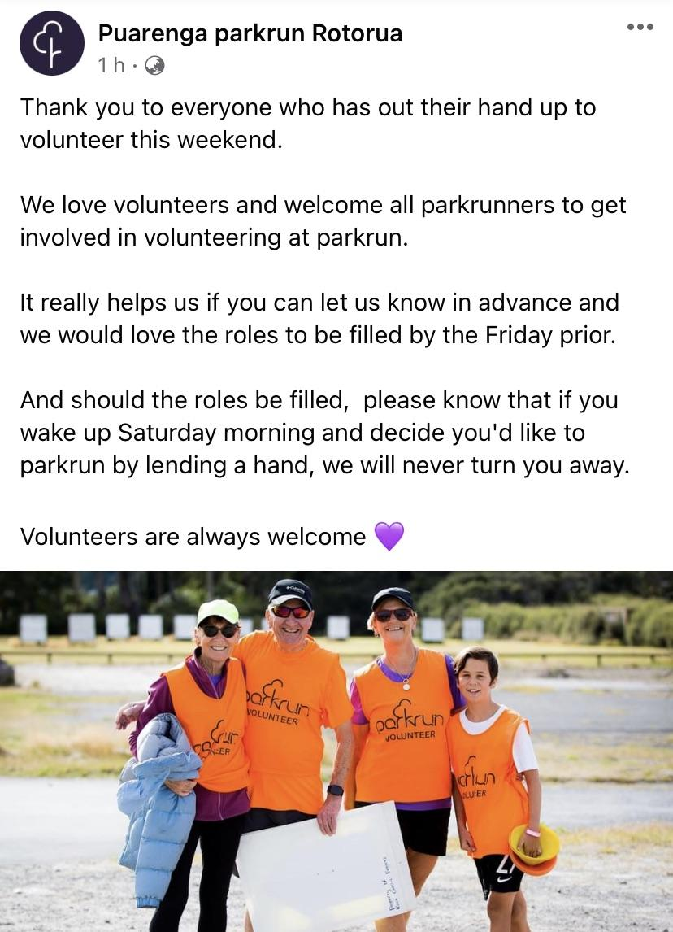
Everyone is welcome, there is always room for more

Slide 7
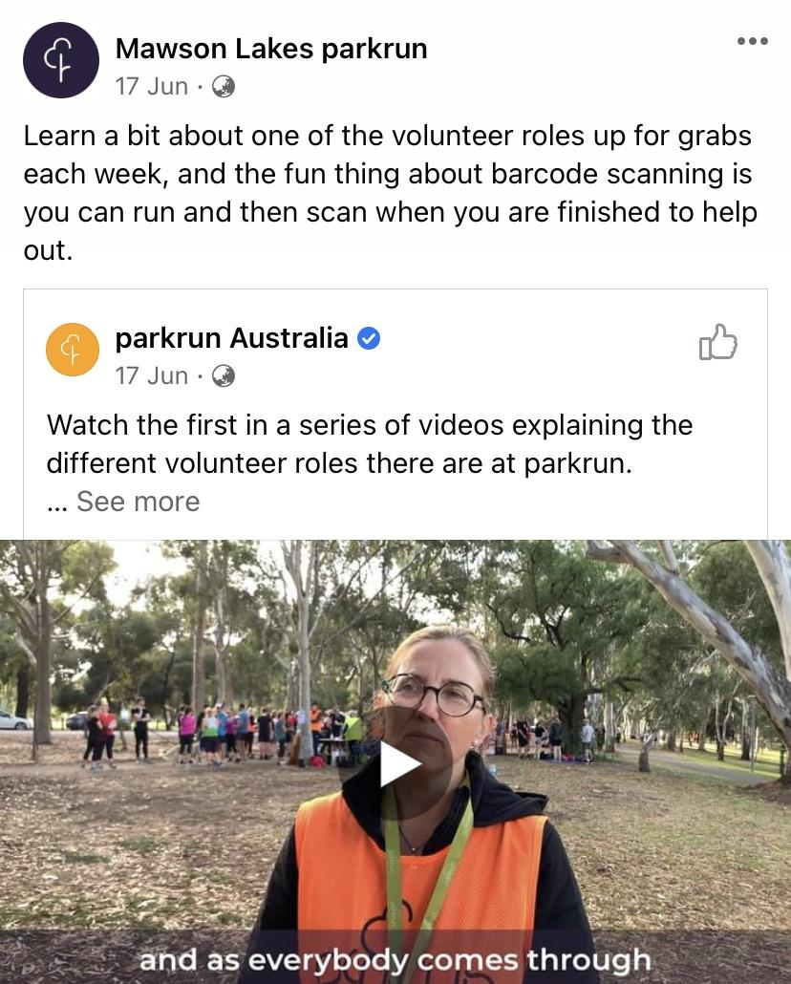
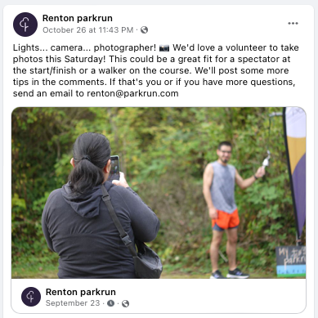
Remember you can walk/run and volunteer

Slide 8
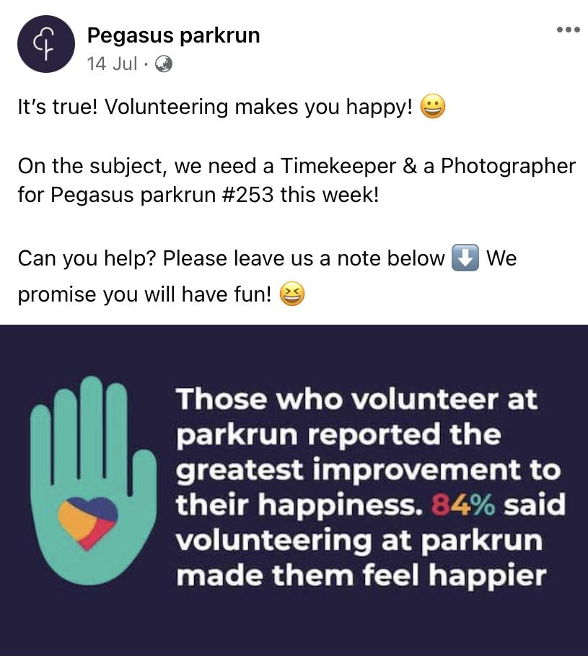
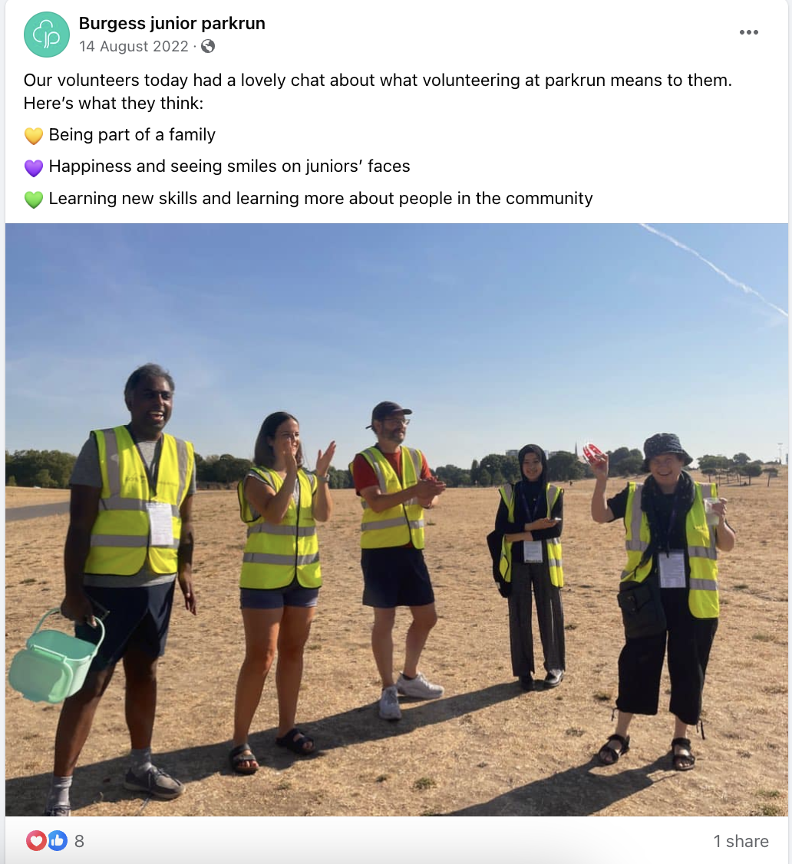
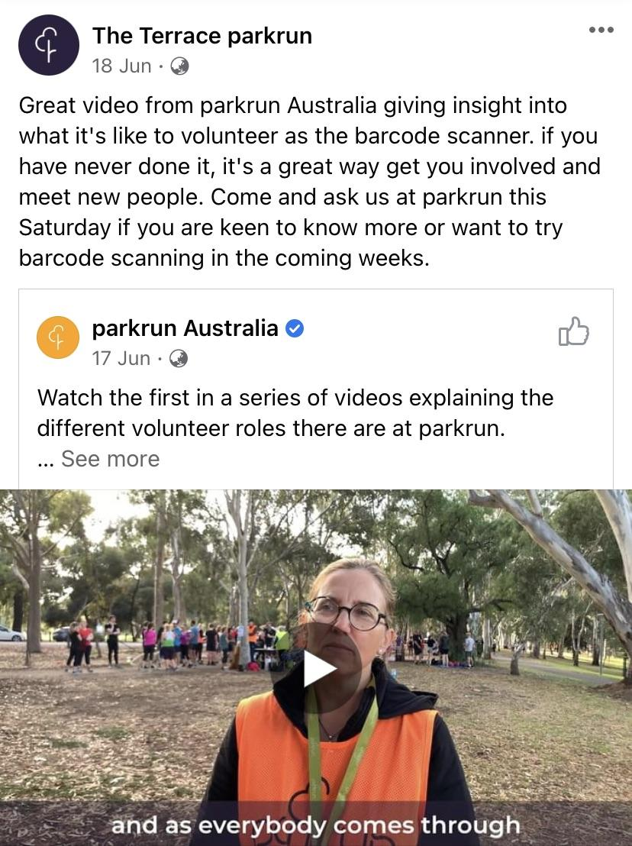
Promote the benefits

Slide 9
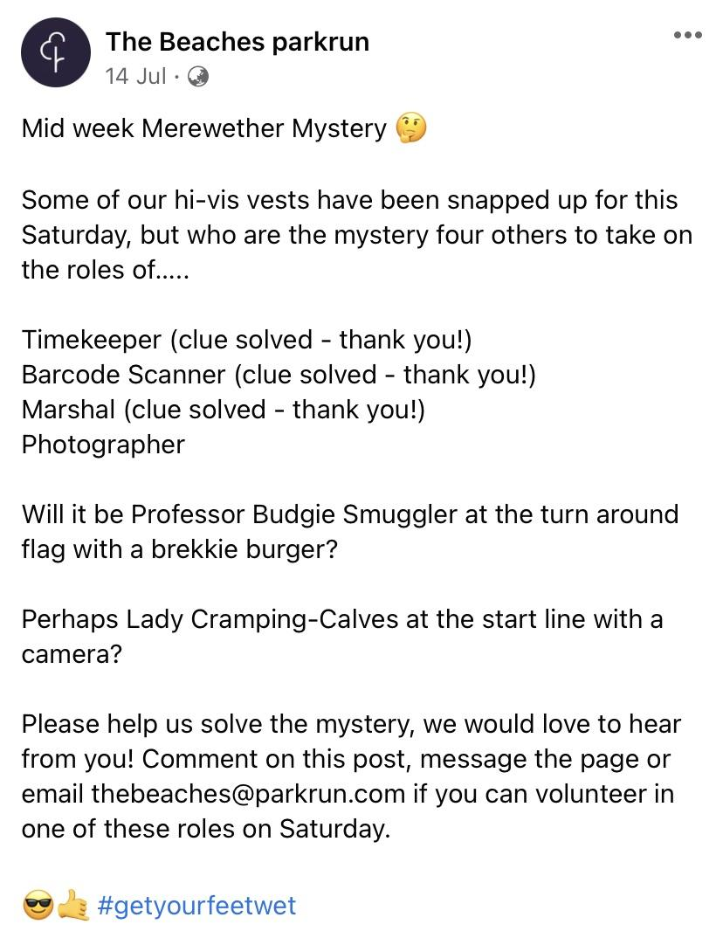
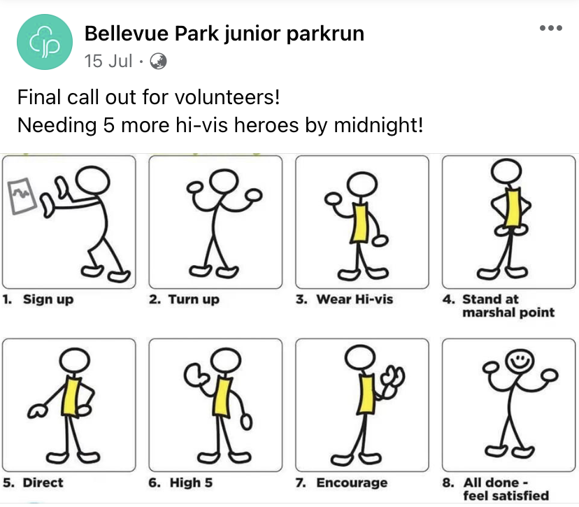
Make people laugh

Slide 10
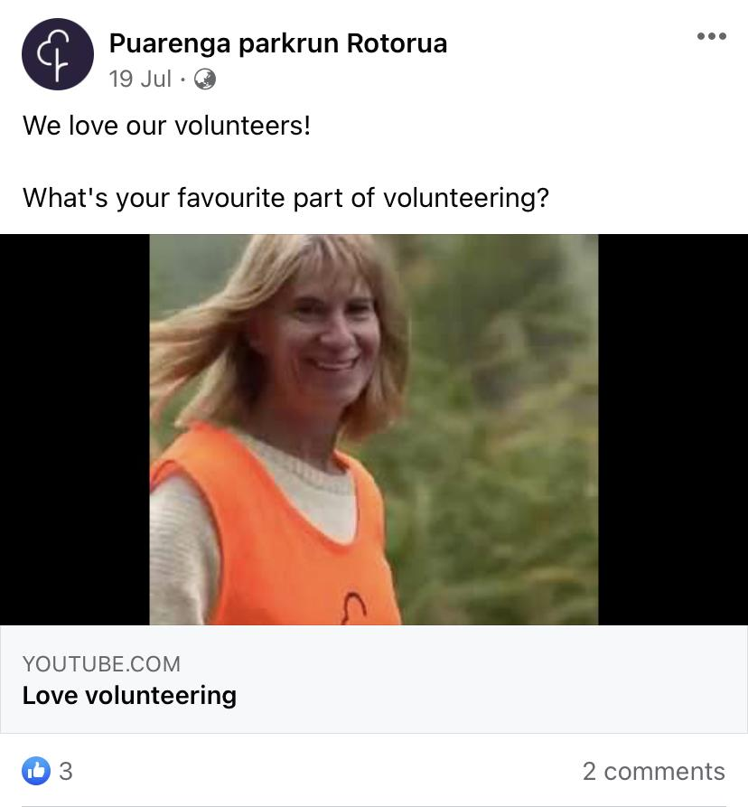
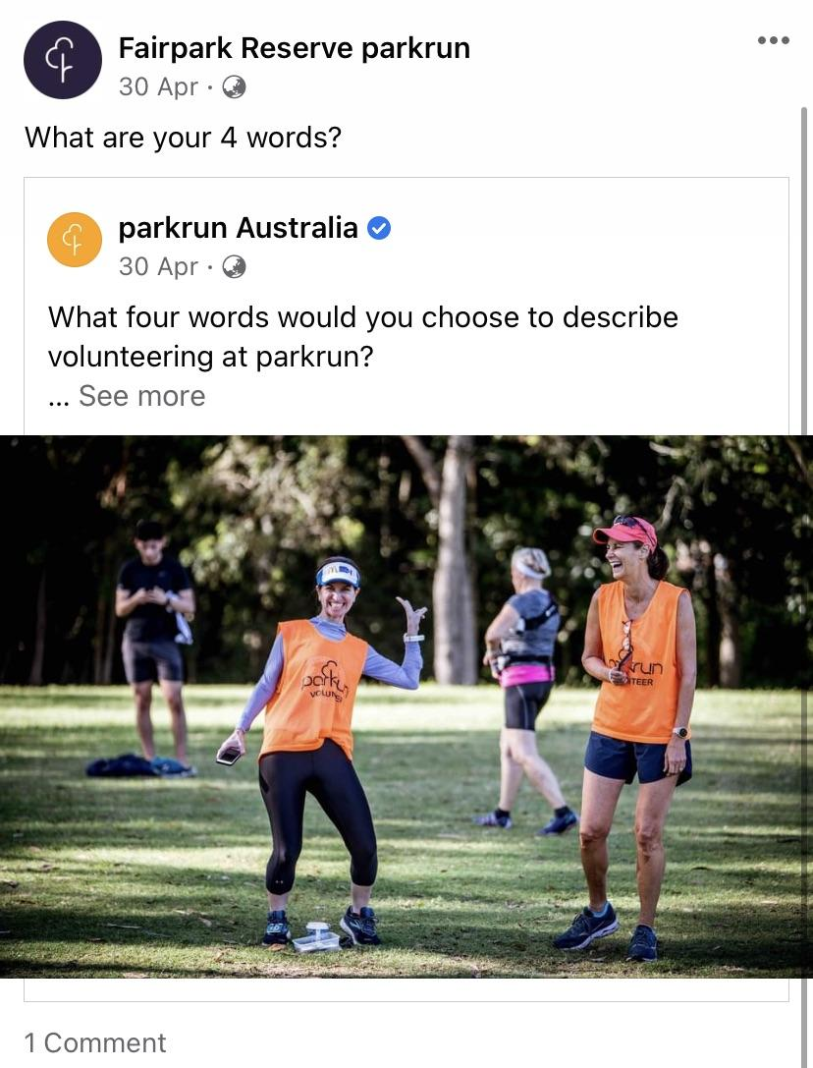
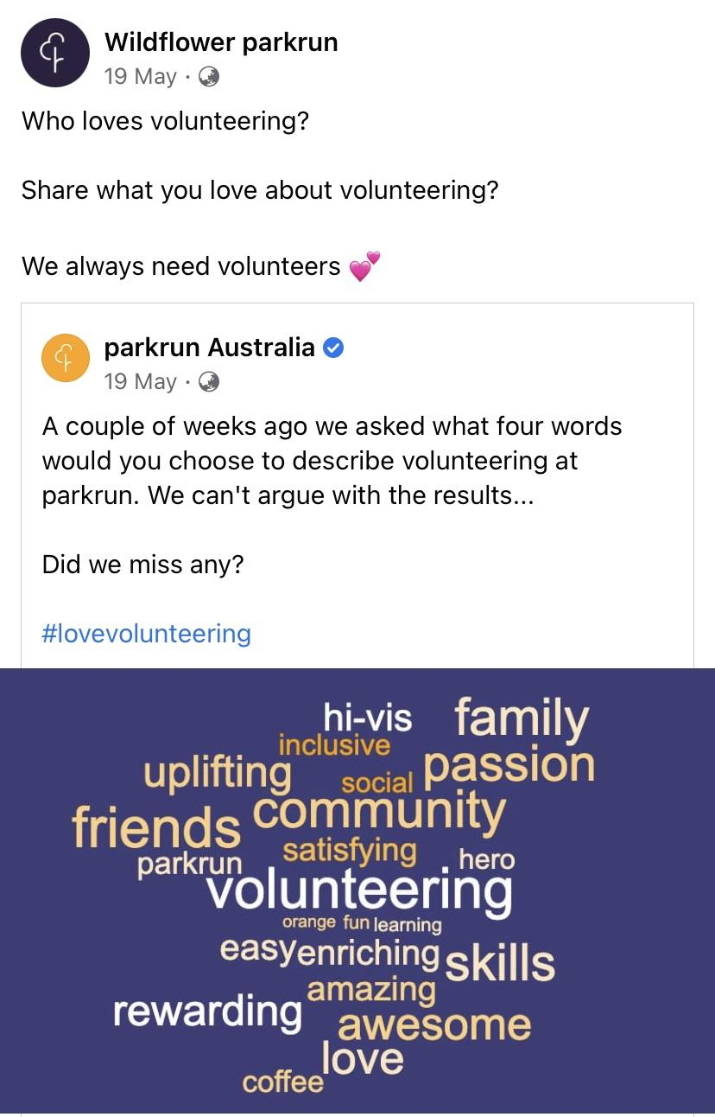
Ask your community a volunteering question

Slide 11
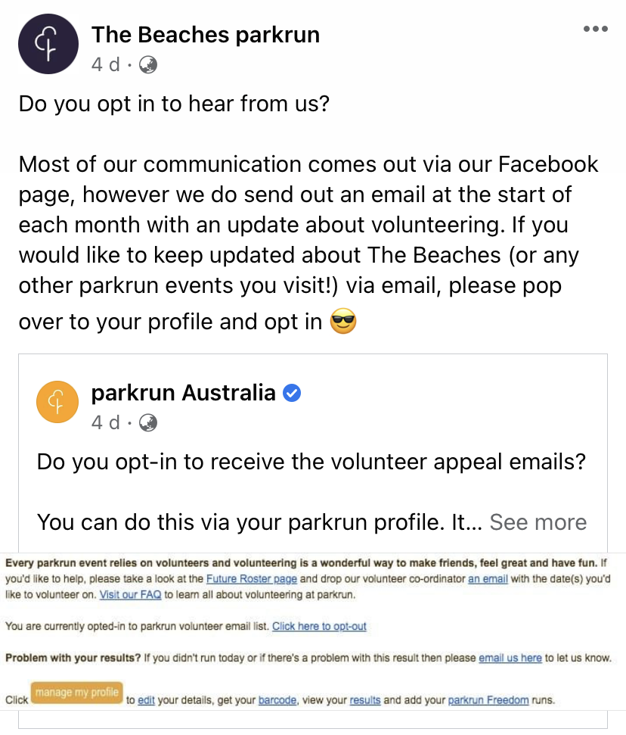
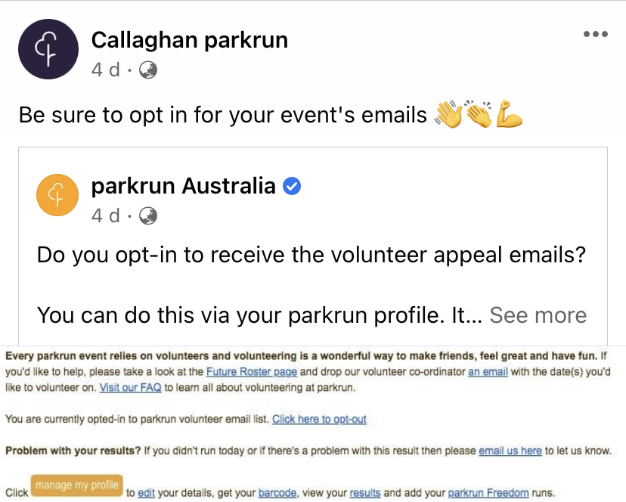
Remind people to opt into the reminder emails

Slide 12
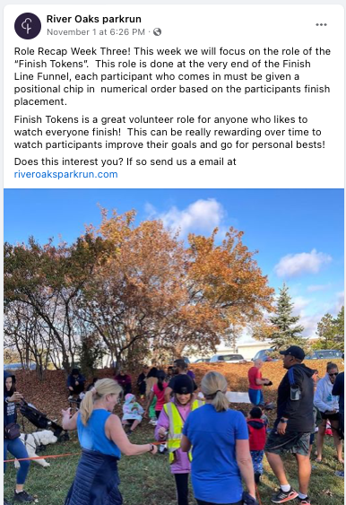
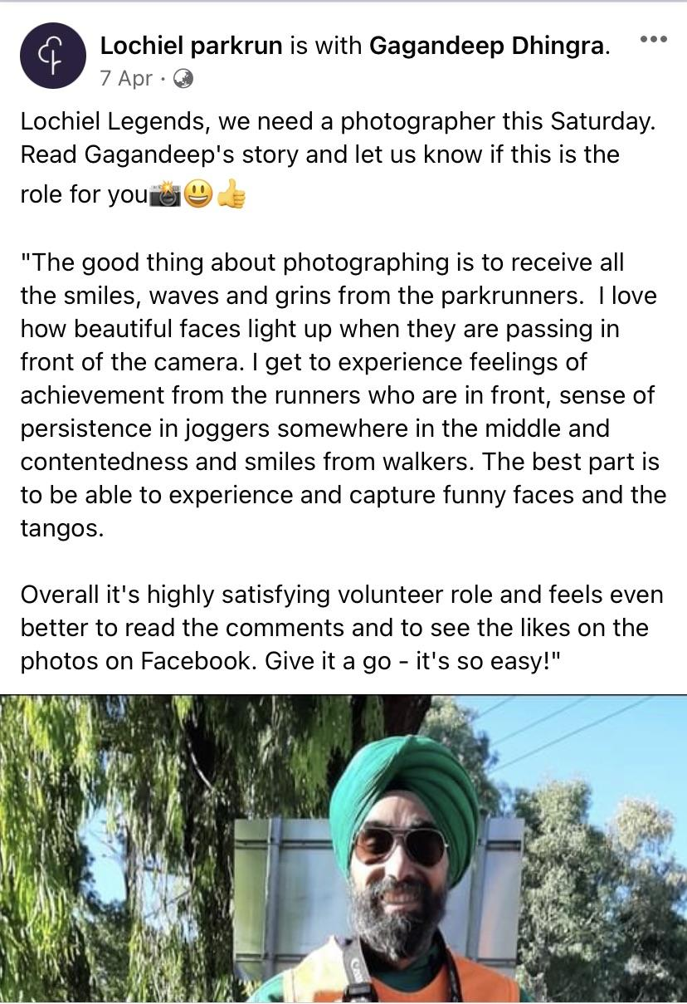
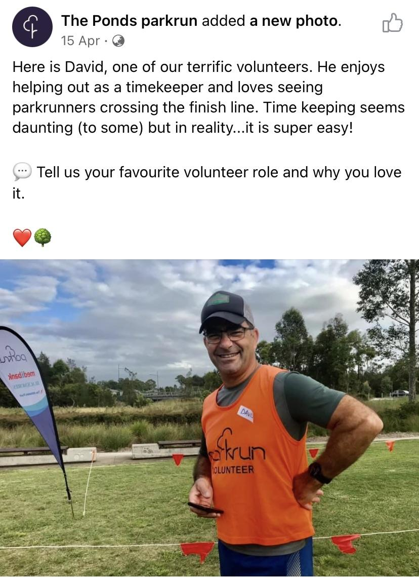
Promote specific roles

Slide 13
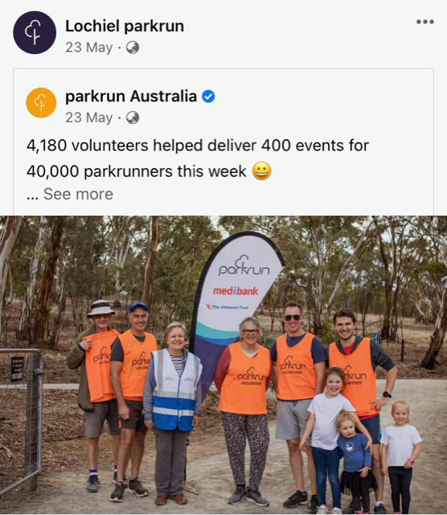
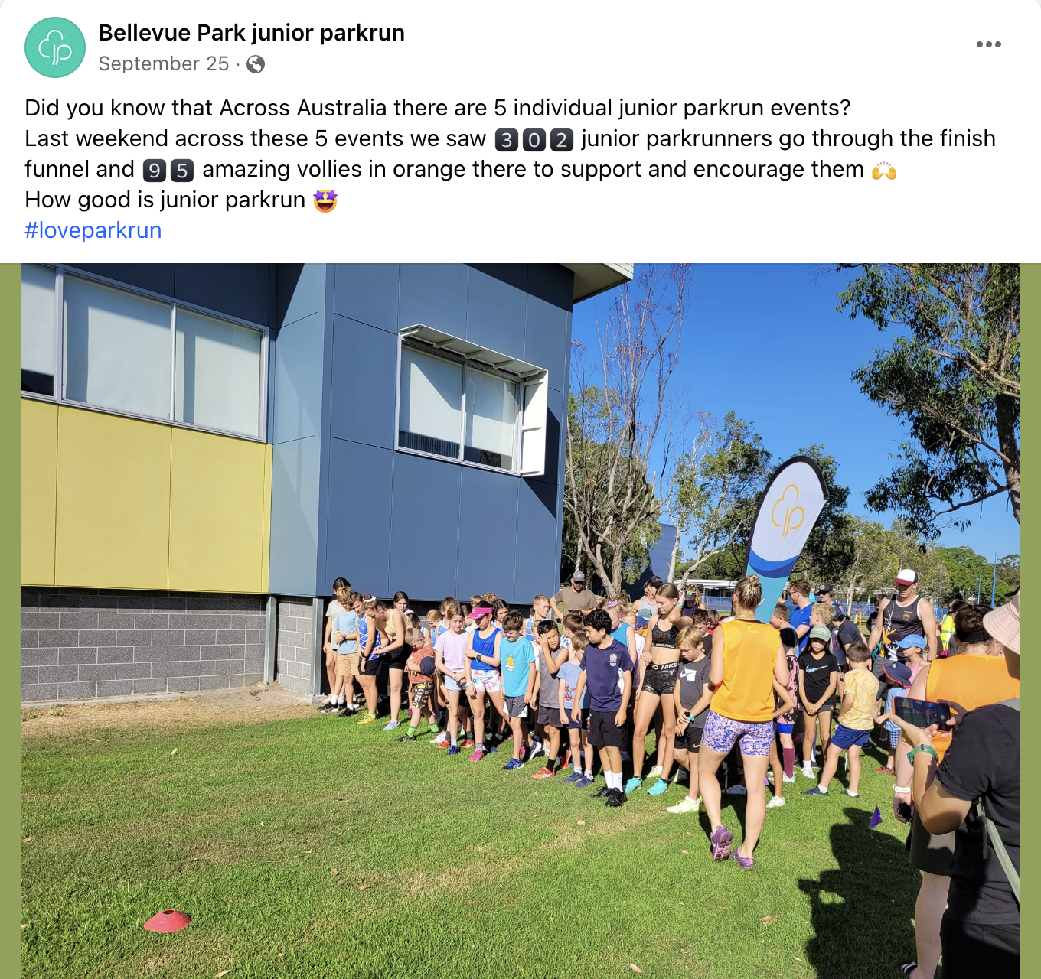
Share some facts and statistics

Slide 14
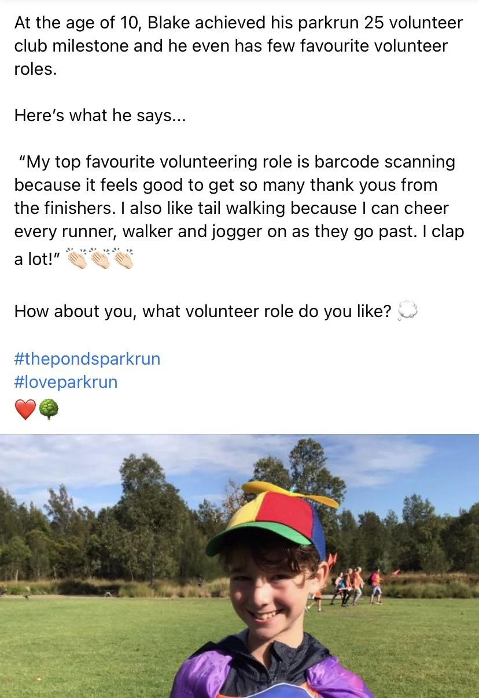
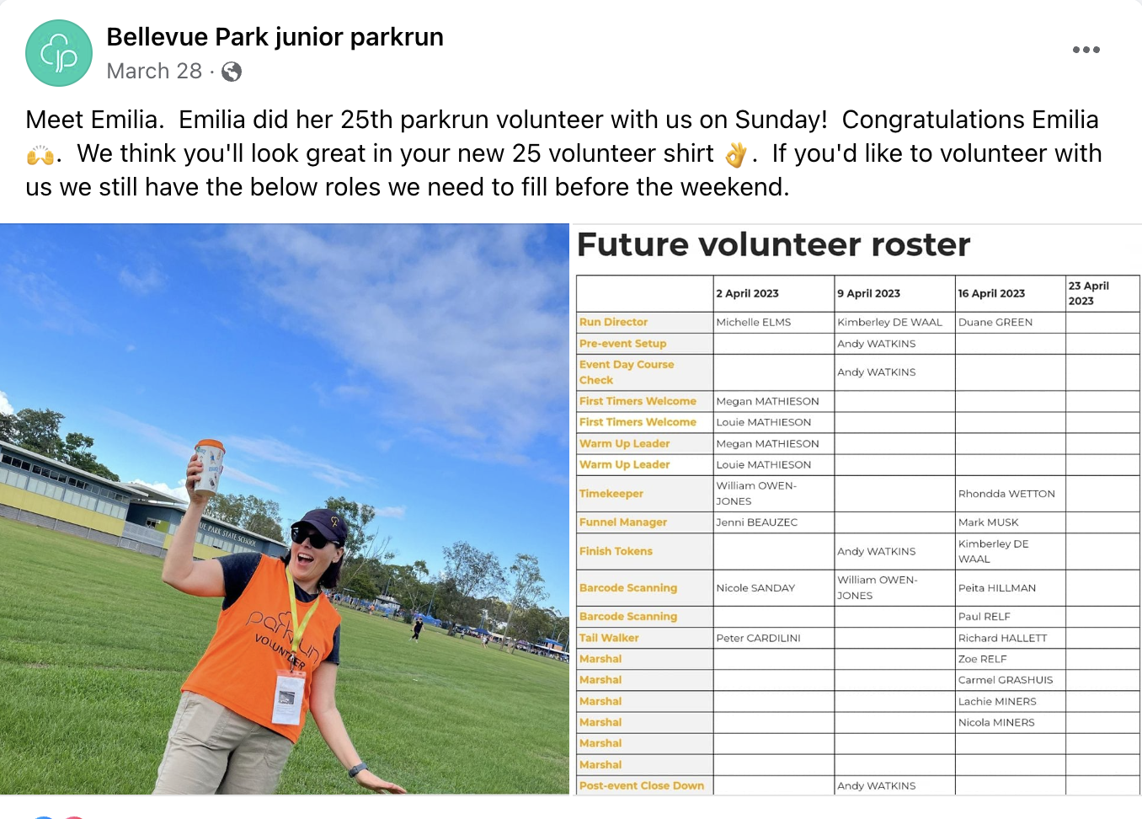
Show them the bling

Slide 15
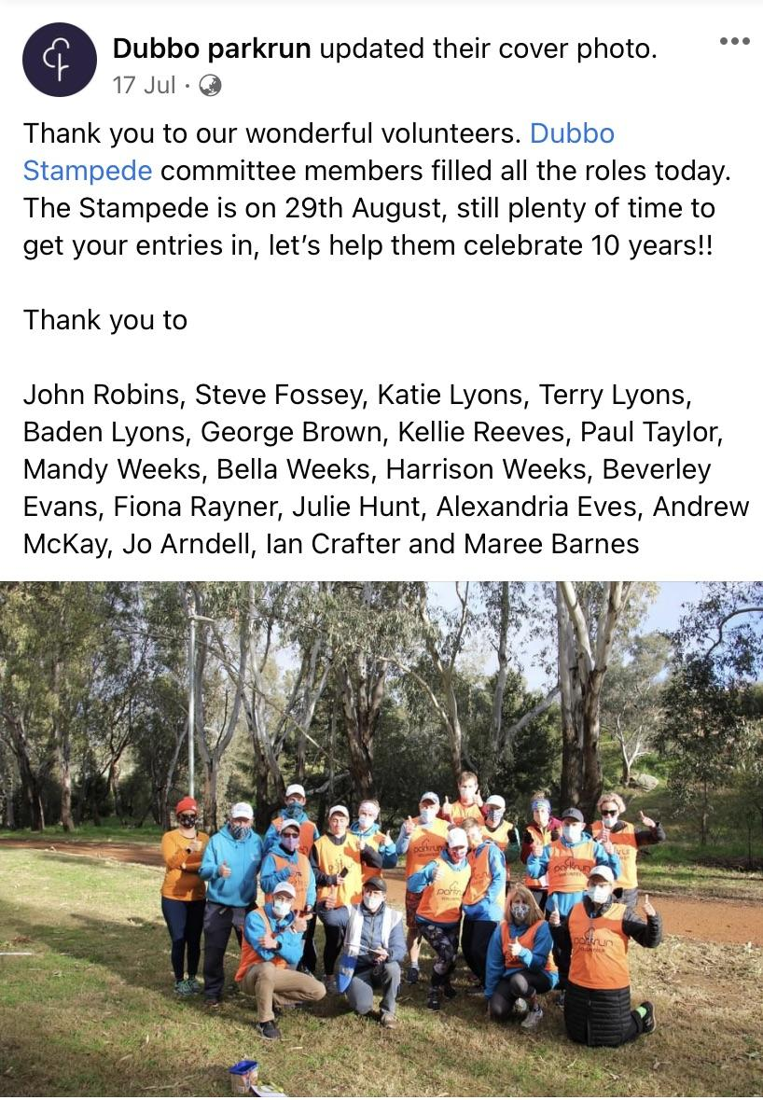
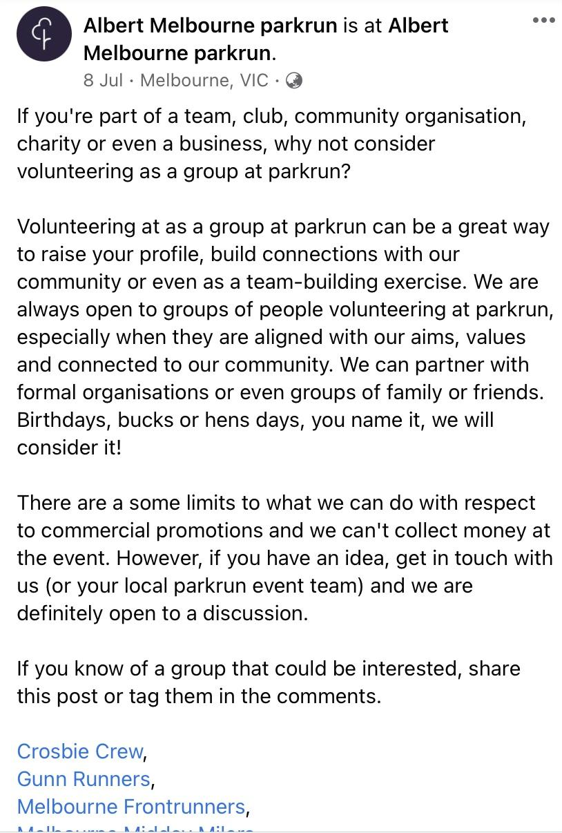
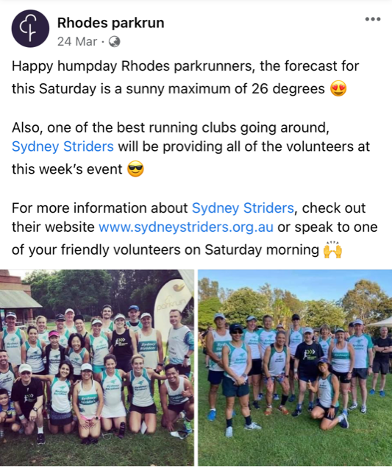
Promote your local community clubs parkrun volunteer days

Slide 16
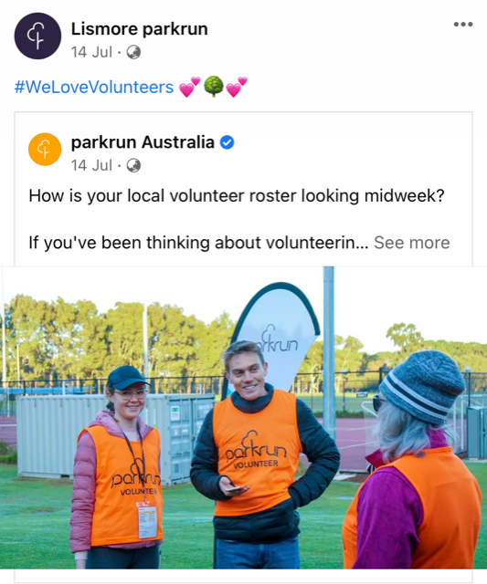
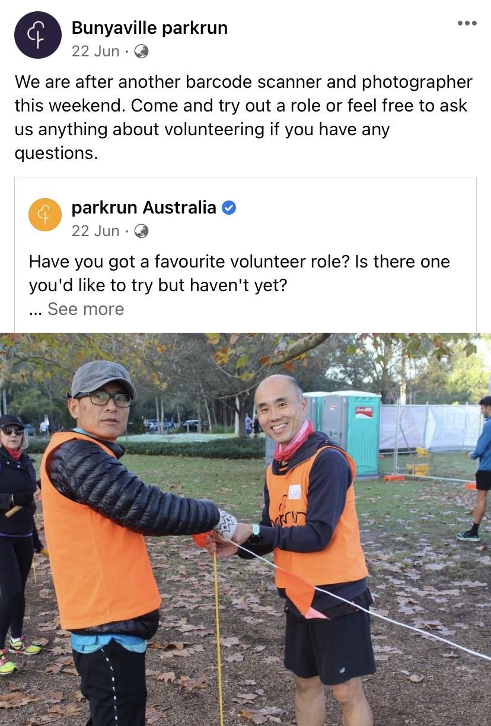
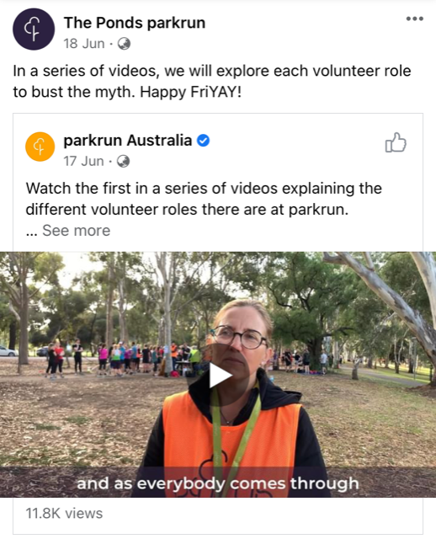
Share posts off the main national parkrun pages

Slide 17
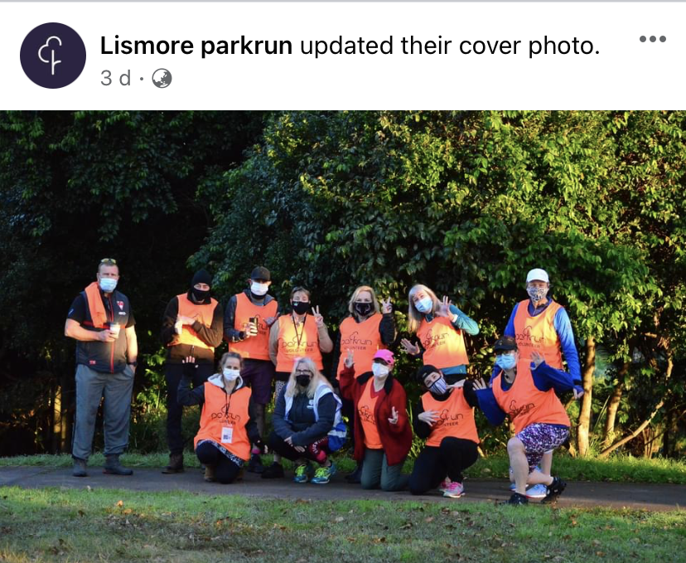
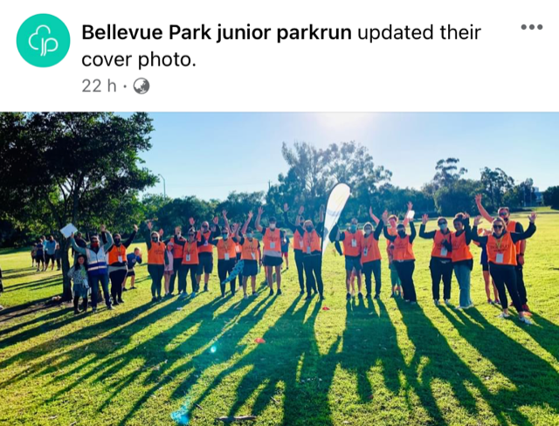
Promote volunteering on your cover photo

Slide 18
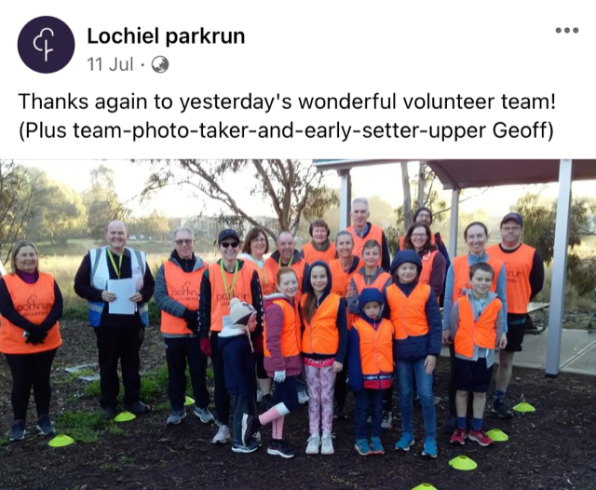
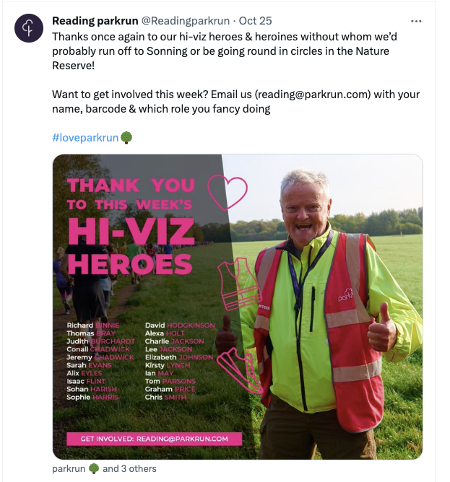
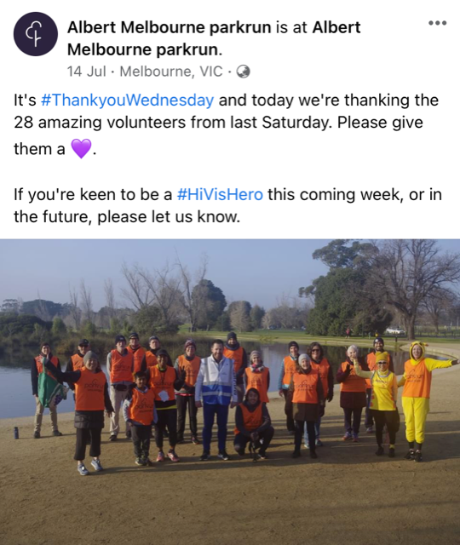
Make your volunteers feel special with a specific thank you

Slide 19
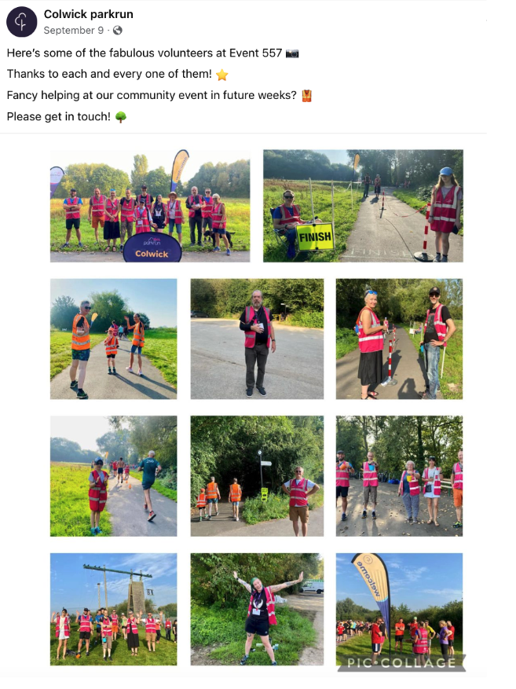
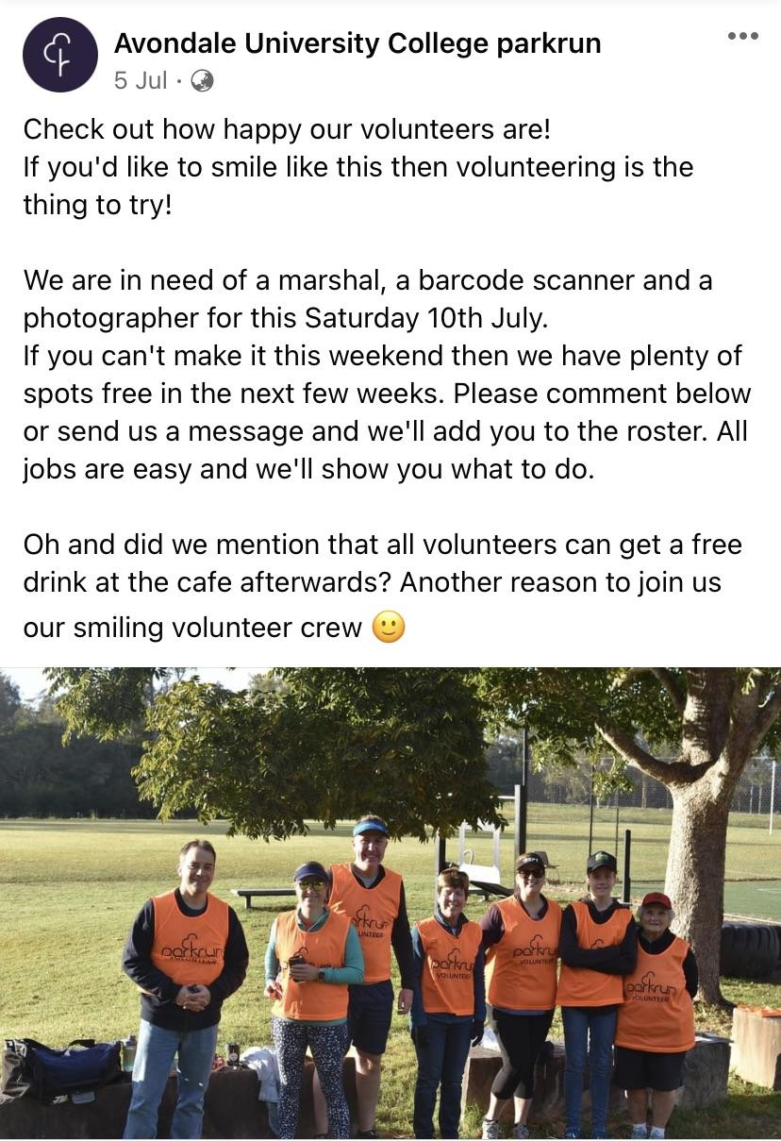
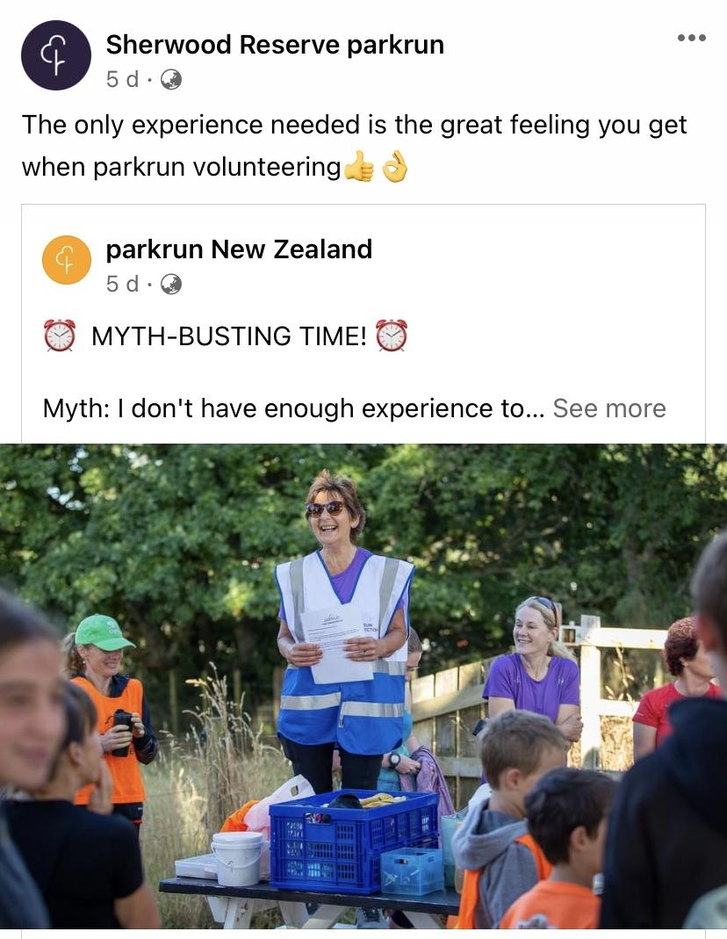
And remember again volunteering is super fun and easy peasy

Slide 20
#lovevolunteering💜

