Slide 1
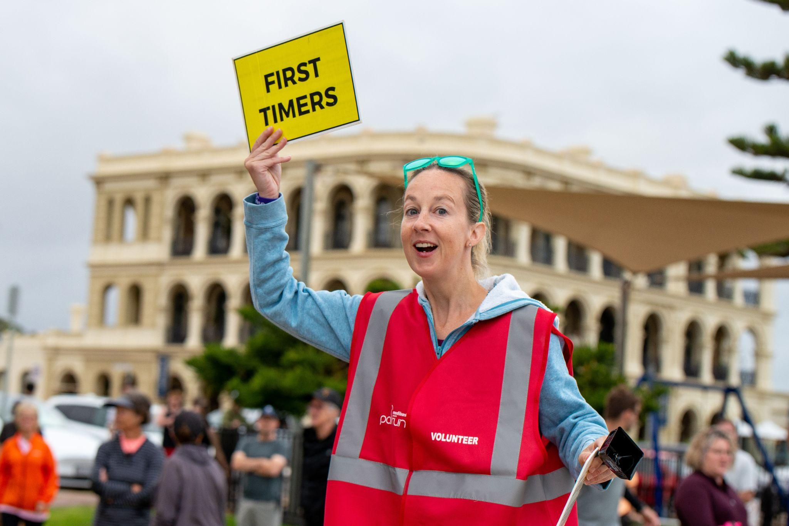

Slide 2
How to use this template presentation:
Save a copy of the entire presentation to your device
Edit using Google Slides, PowerPoint or Keynote
Don’t forget to “delete” “skip” or “hide” this instruction slide

Slide 3
Title and name of presenter
DATE

Slide 4
In the beginning…

Slide 5
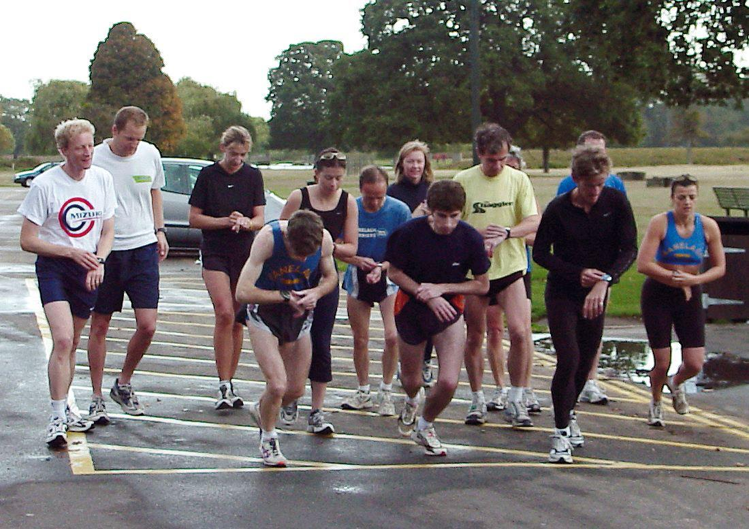
Notes:
This was the start line of the first parkrun in London in 2004: 13 runners supported by five volunteers followed by a coffee in the park cafe. 18 years later the model hasn’t changed.
What also hasn’t changed is the fundamental reason people come to parkrun.
Paul, who conceived the idea, was in his forties and going through a bit of a midlife crisis. He’d been sacked from his job, his marriage had broken down, and he’d suffered an injury that would keep him away from running club competitions for a couple of years. Paul had become disconnected from his neighbourhood and recognised he needed to bring his friends to him. Paul decided to hold a free 5km event, open to everyone, every Saturday at 9am in his local park, with the caveat that people would join him for a coffee afterwards. Nobody could have imagined what happened next though…

Slide 6
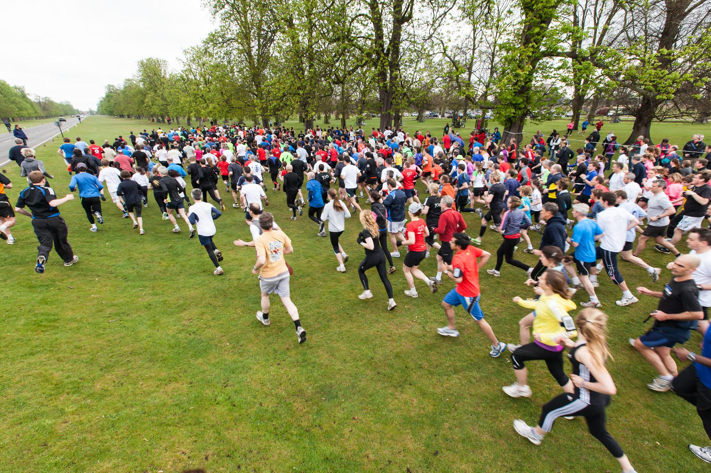
Notes:
Within two years more than 600 people were coming along to this one parkrun event.
Not just locals, but people from around the world who had heard about this simple idea and recognised that it could work in their community.
Paul agreed to support other communities to implement their own parkrun providing it was in line with the ‘parkrun principles’:
Free
5k
Every Saturday morning in a public open space
For everyone
Forever

Slide 7
What does a parkrun look like?

Slide 8
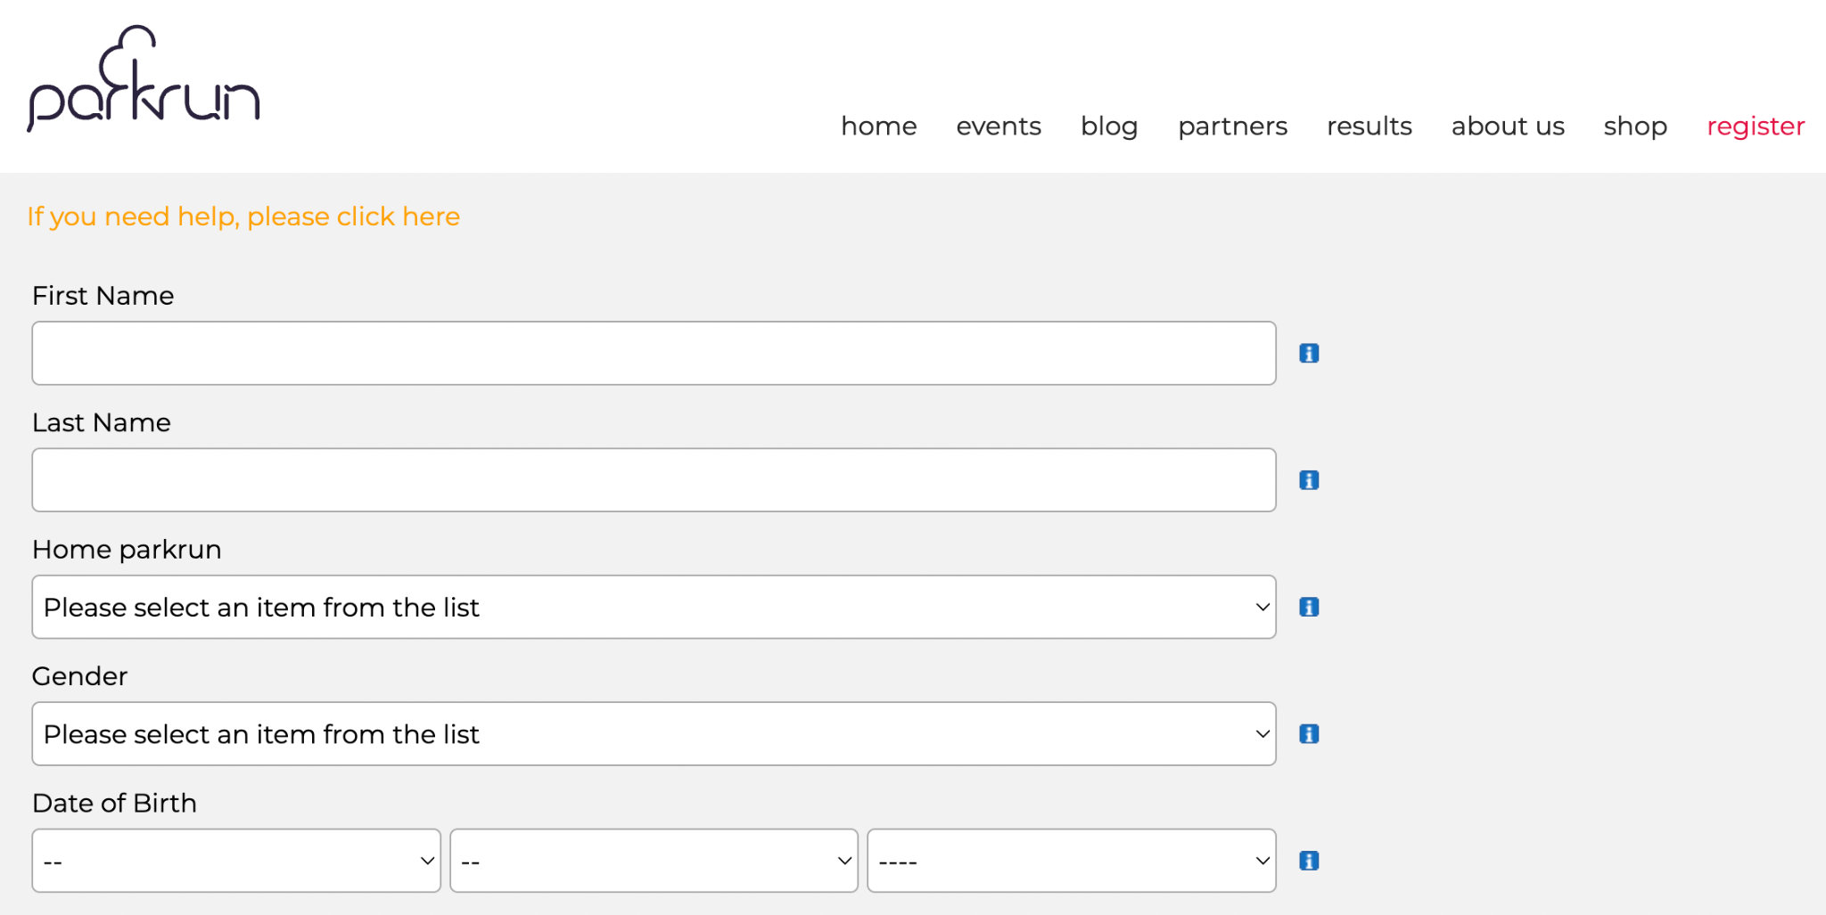
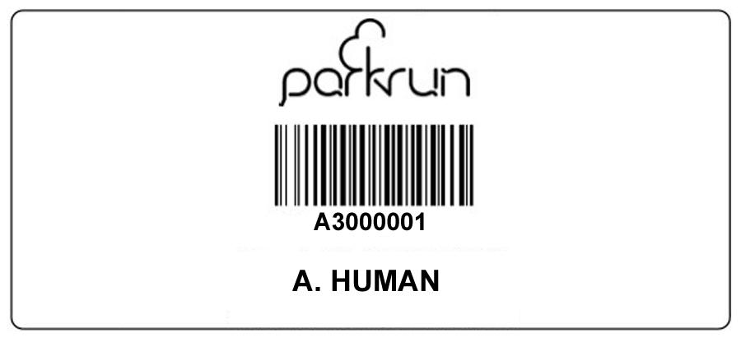
Notes:
Sign up for parkrun before your first visit and then you never need to register again! Your personal parkrun barcode becomes your passport to any parkrun in the world every Saturday morning - just come along whenever you feel like it! You can print your barcode or simply keep it on your phone.

Slide 9
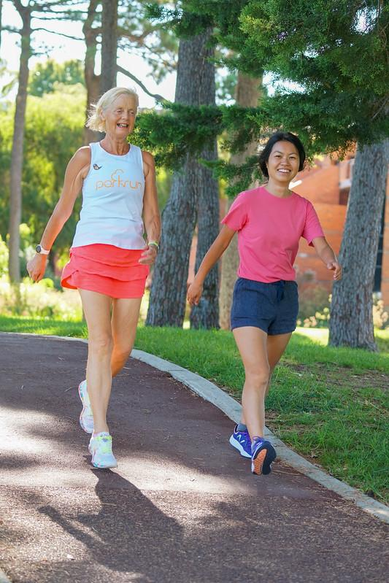
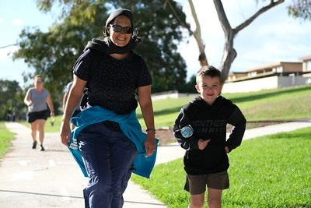
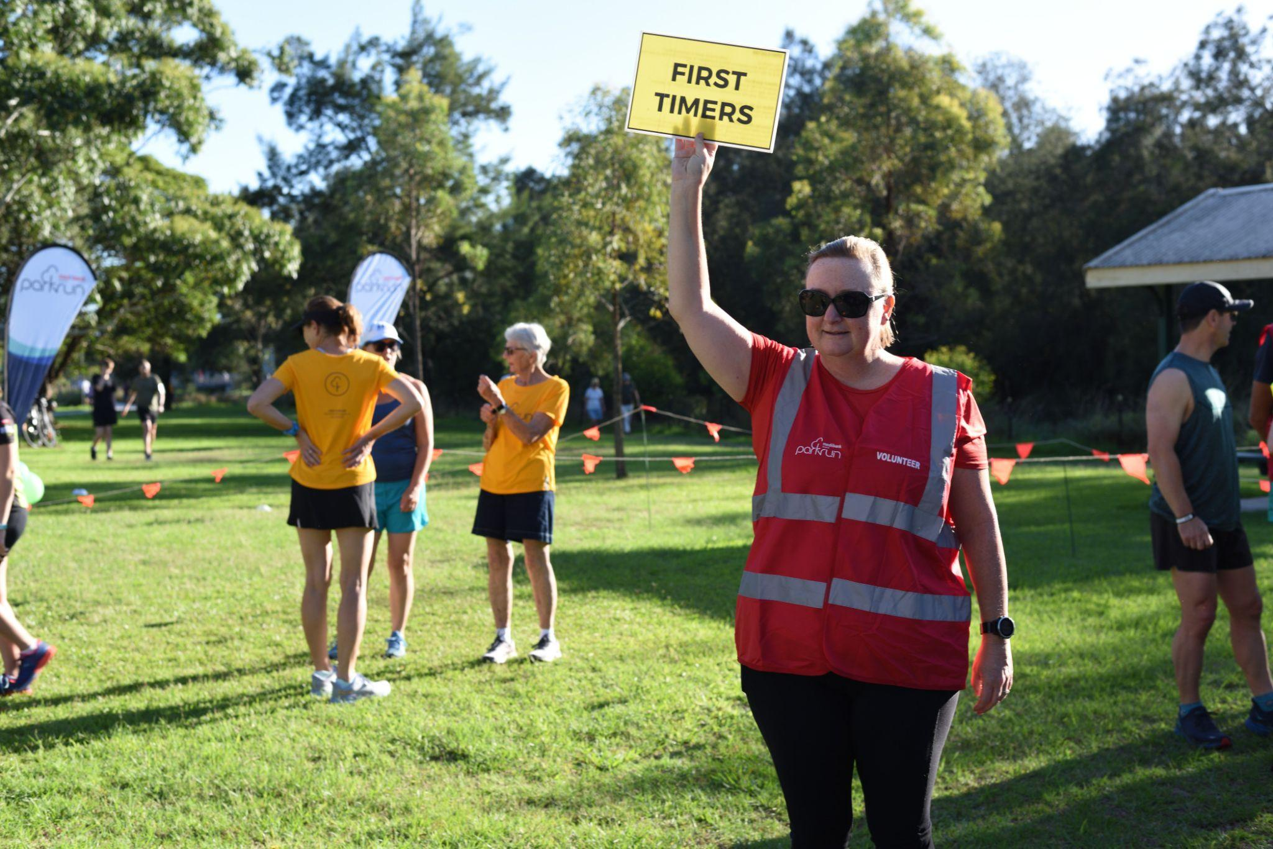
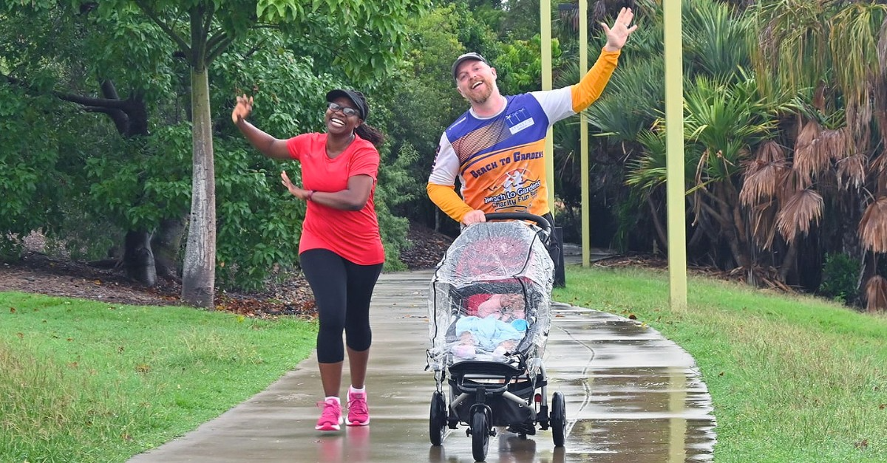
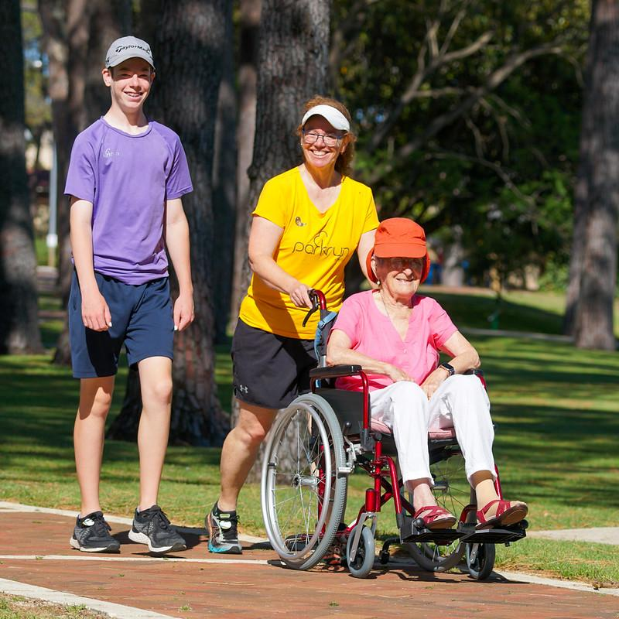
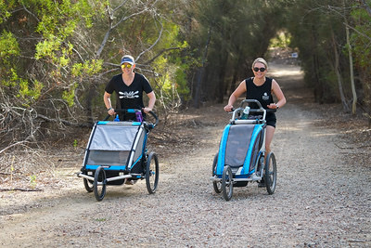
Notes:
Each parkrun has an Event Welcome and many will have a First Timers Welcome too! Look for the volunteer vests and signs. Walkers and runners start at the same time but go at their own pace and you are most welcome to bring the pram or one dog on a short handheld leash.

Slide 10
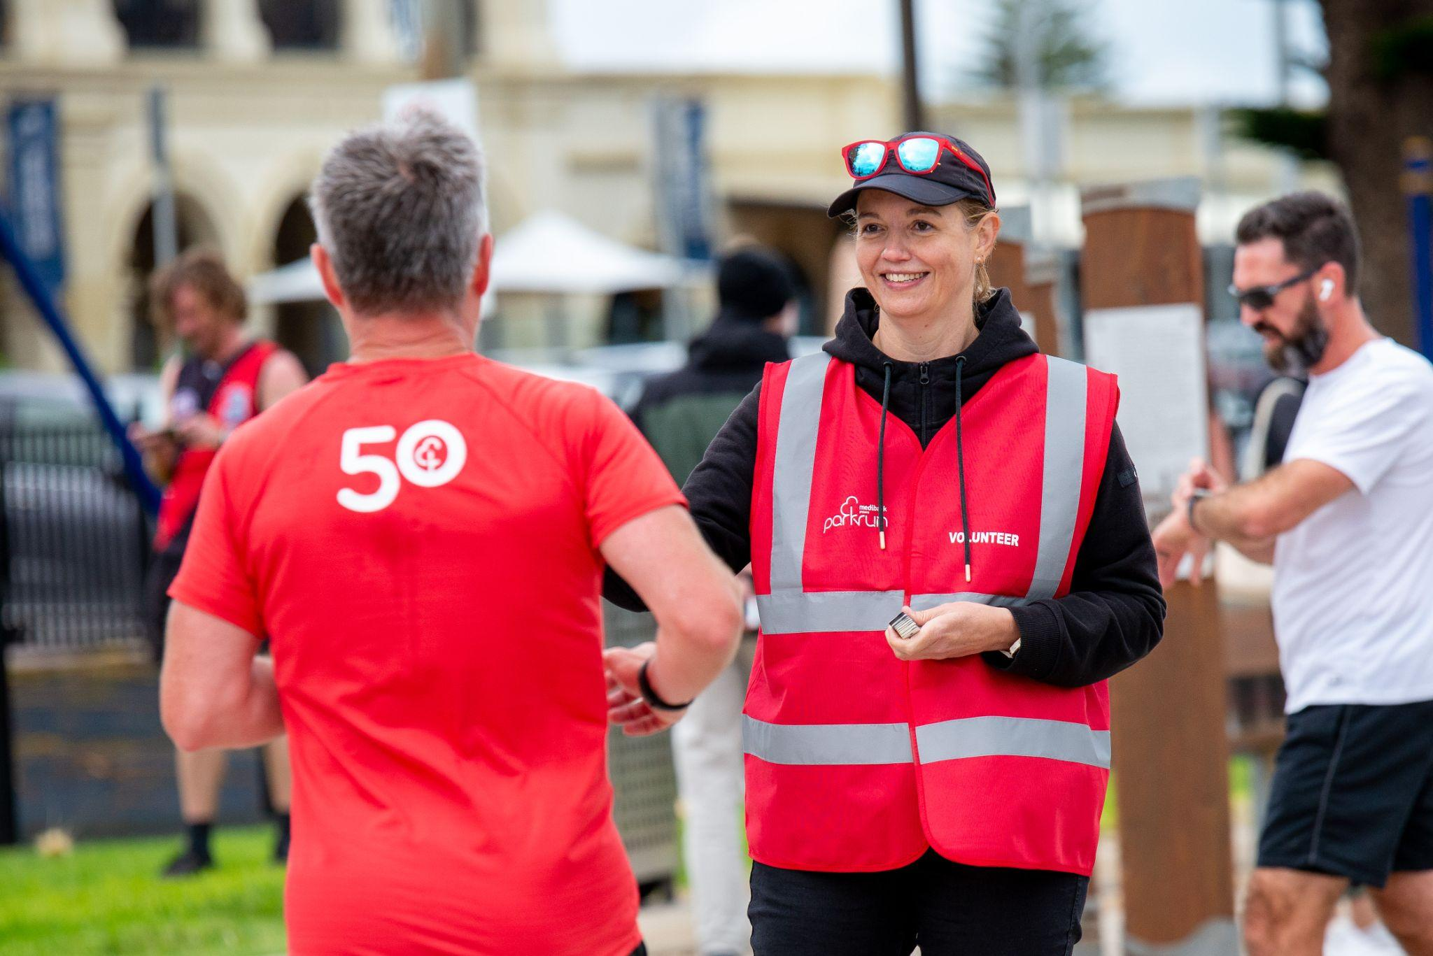
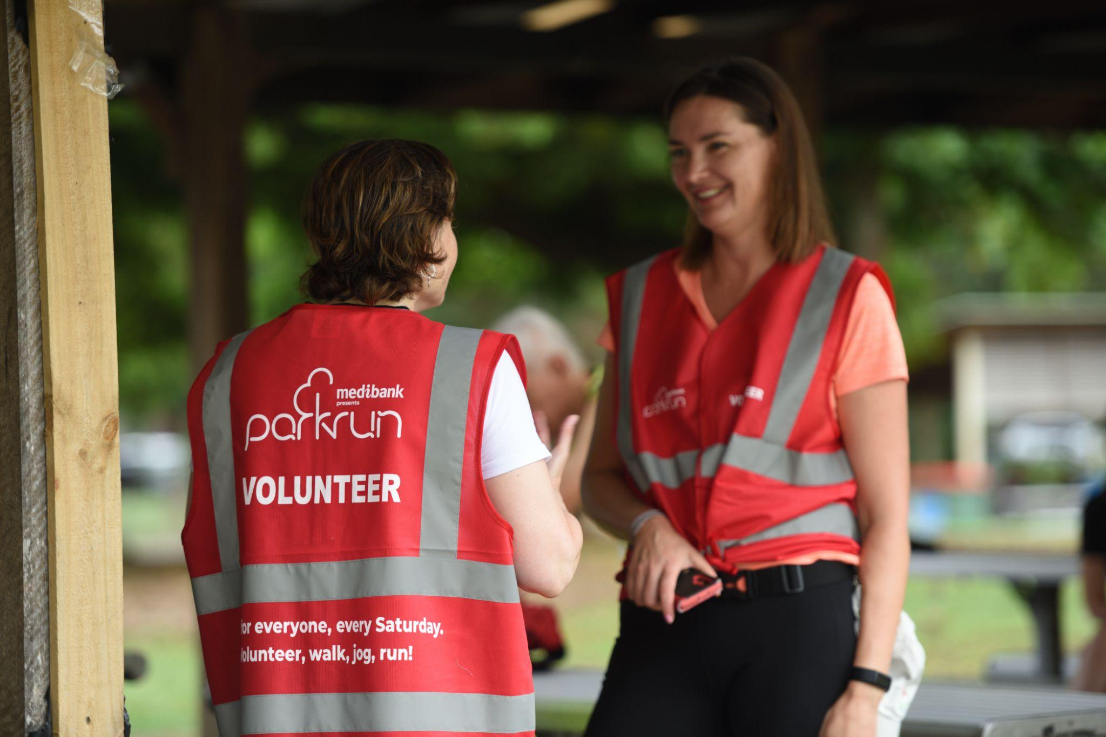
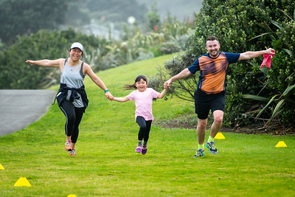
Notes:
parkrun is coordinated each week by volunteers. People of all ages are invited to volunteer and there are a wide variety of roles to try. Speak to a friendly volunteer if you are interested. You can also email the event team directly or respond to their social media posts requesting volunteers. Volunteering is a great way to meet new people, learn new skills, build confidence, have heaps of fun and is one of the best ways to improve your health and happiness.

Slide 11
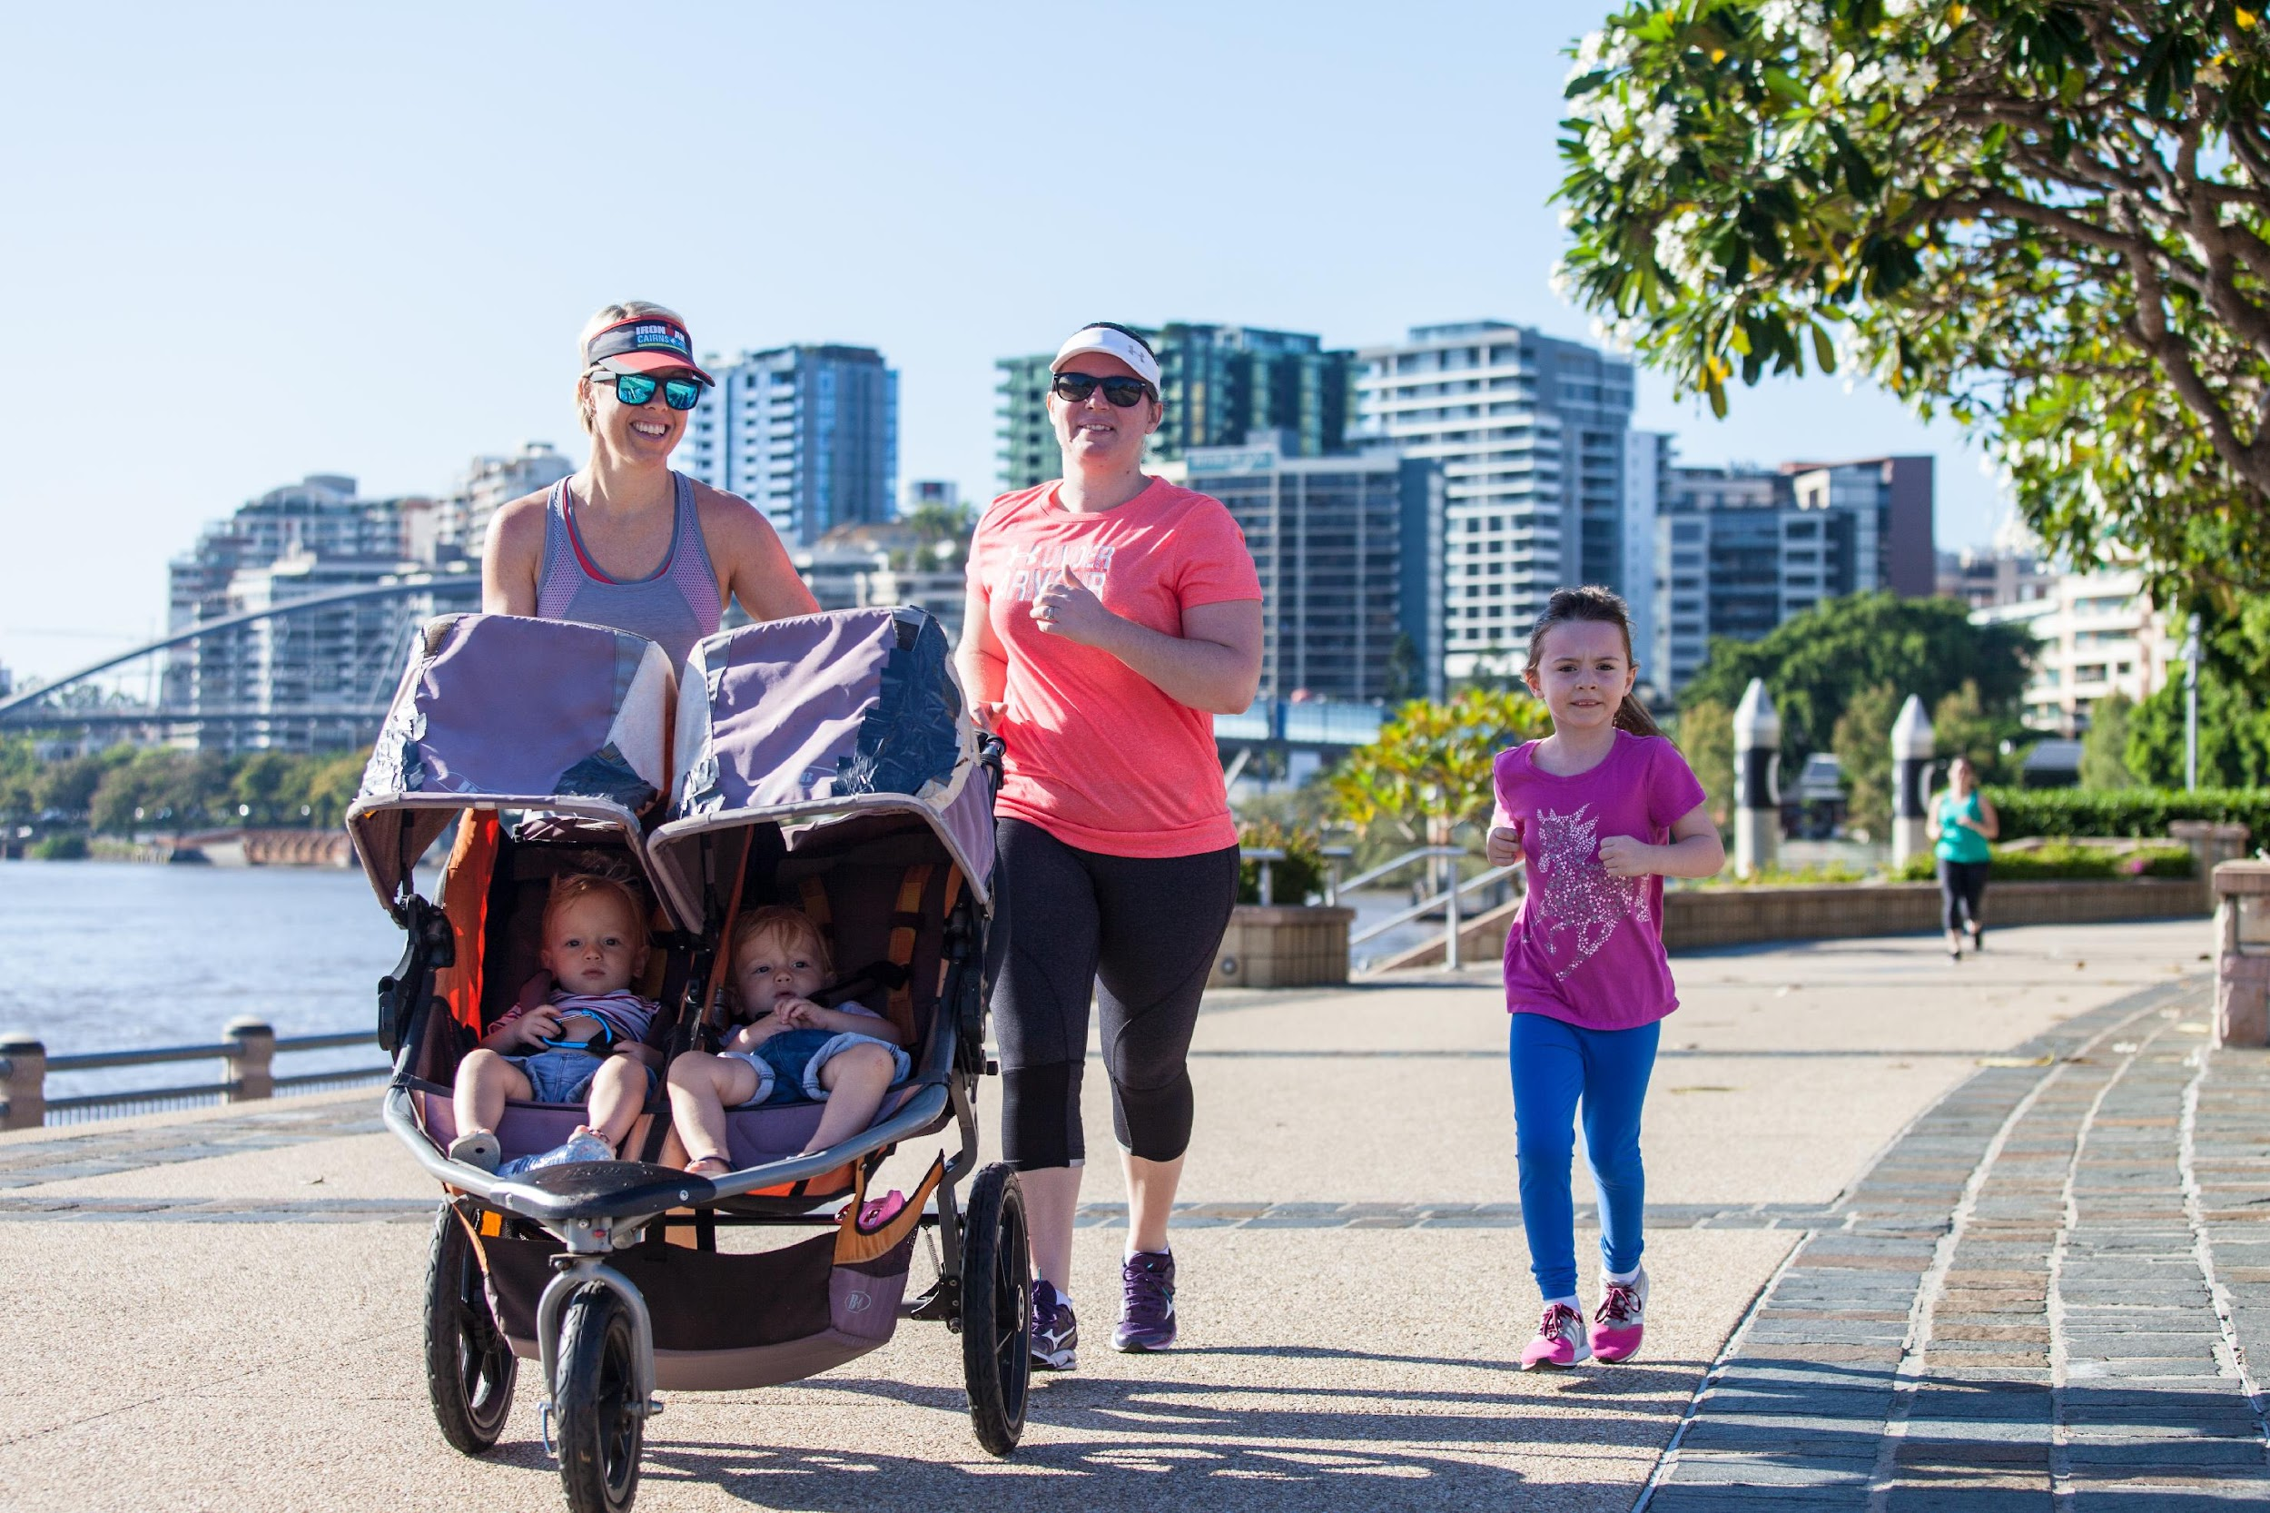
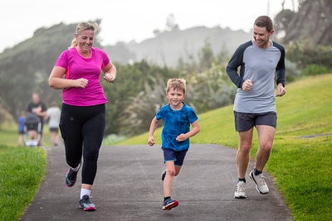
Walk run volunteer spectate
Notes:
You can participate as a walker, runner or volunteer or simply spectate and socialise.

Slide 12
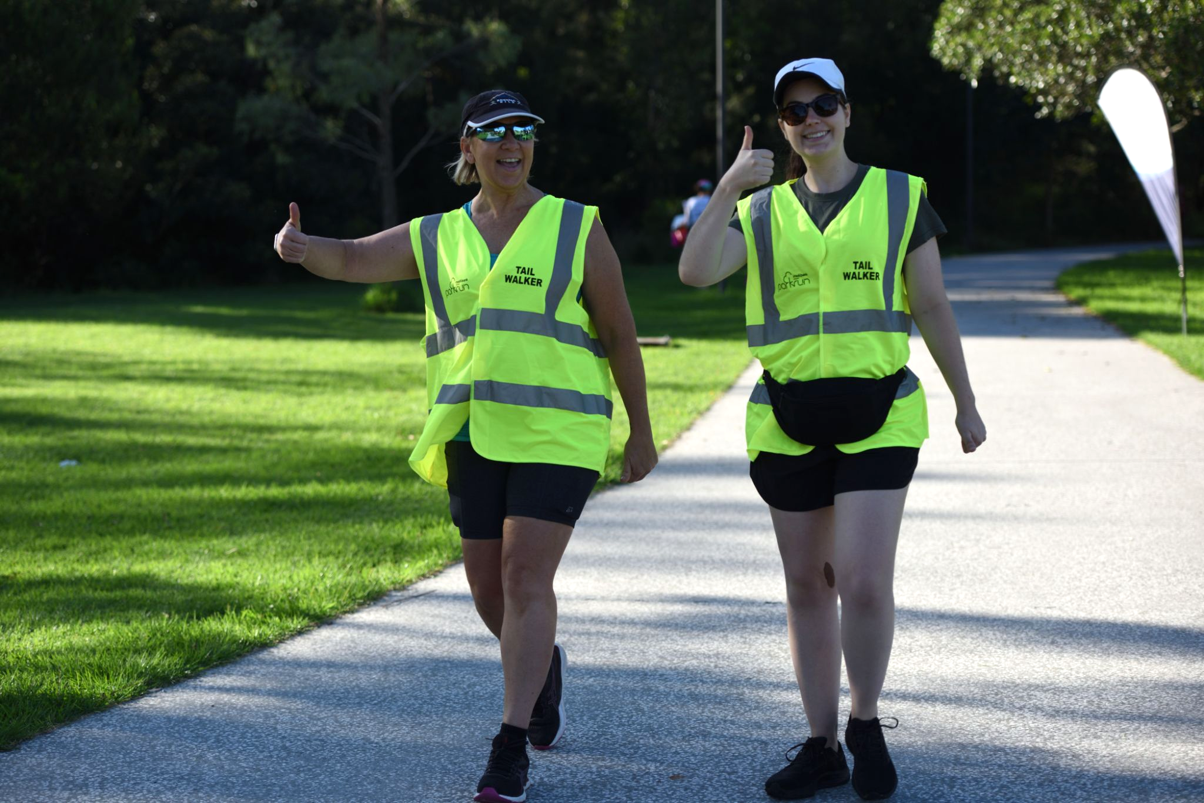
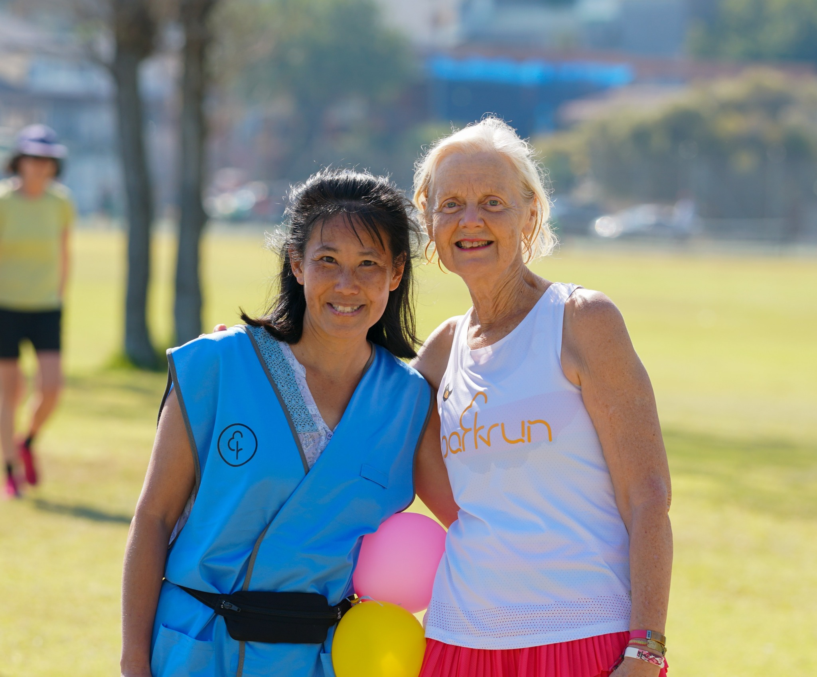
Tailwalkers always finish last!
As a Tailwalker you receive 1 run/walk credit and 1 volunteer credit per event - bonus! Many of our events have a parkwalker too
Notes:
You can’t come last at parkrun. ALL parkruns have volunteer Tail Walkers that provide support and encouragement and they are the final person to cross the finish line.
The parkwalker role extends this friendly support along the parkrun course ensuring support and encouragement is there for everyone who walks at parkrun. They are positioned ahead of the Tail Walker but behind those who are running to ensure everyone who is walking feels a part of the parkrun community. The bright blue parkwalker vest is also a great conversation starter and re-emphasises that walkers are celebrated at parkrun.

Slide 13
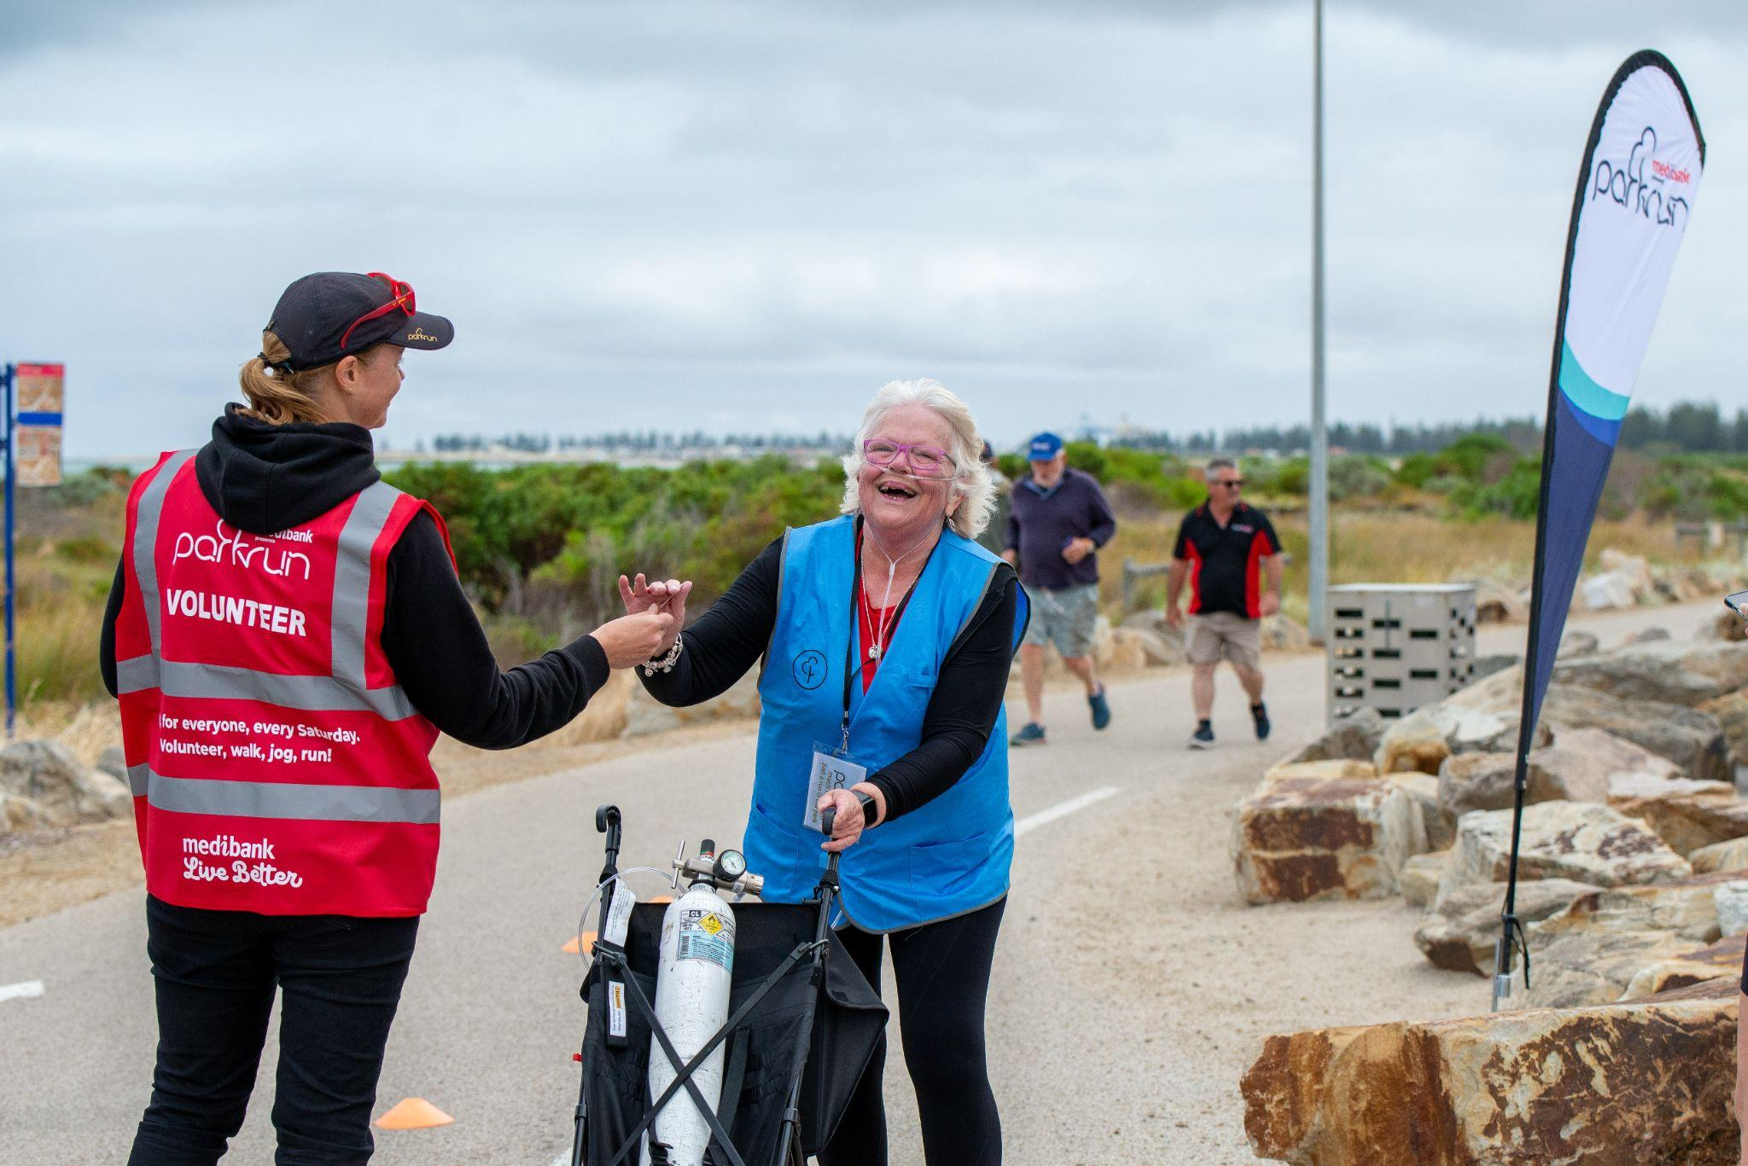
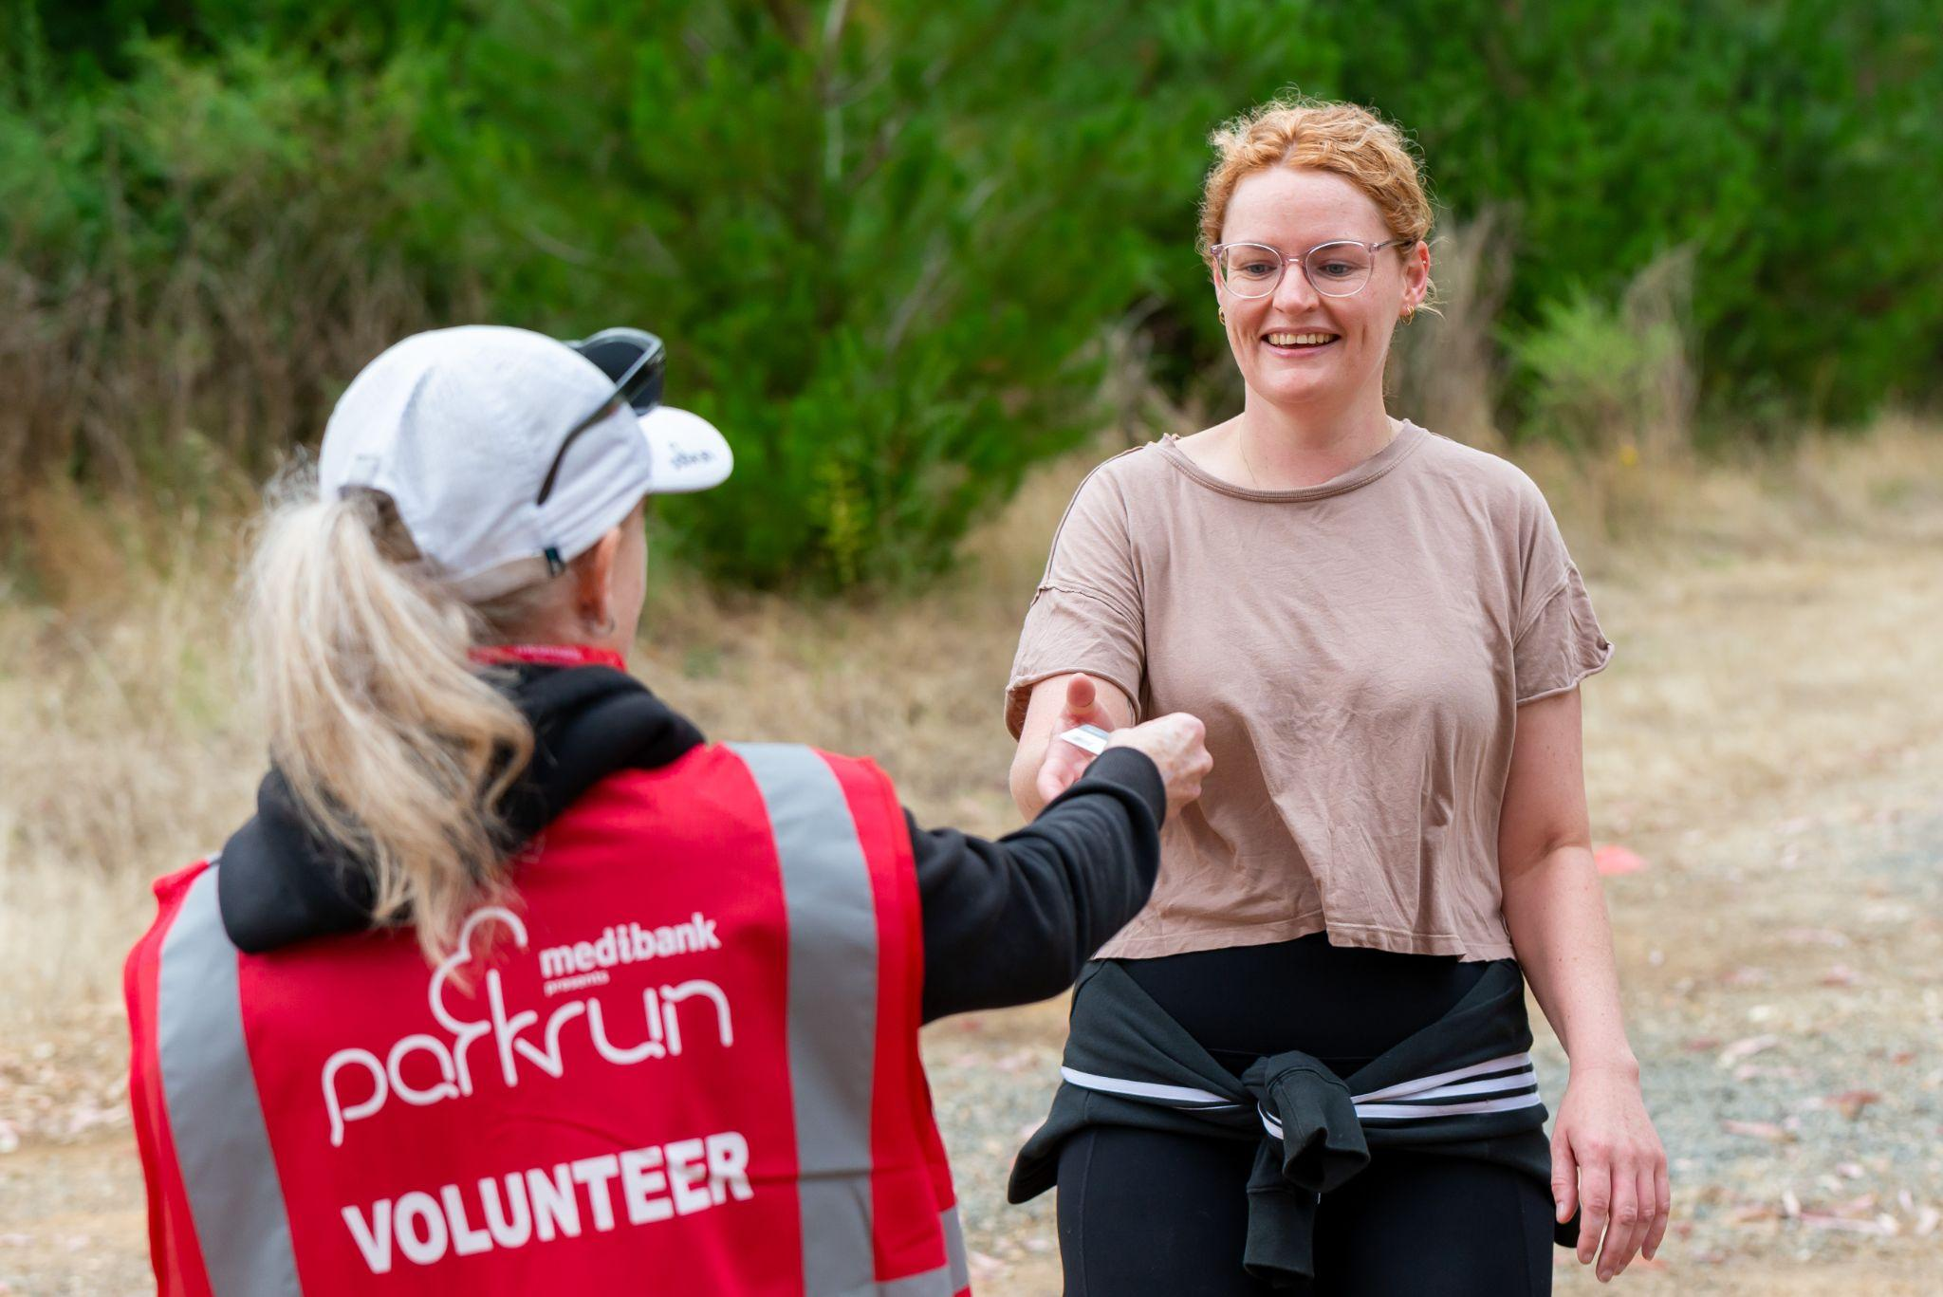
At the finish…
Notes:
parkrun guarantees everyone will have at least two personal interactions at each event. When you cross the line you’ll be handed a finish token by a volunteer, and then another volunteer will scan your token and your personal barcode.

Slide 14
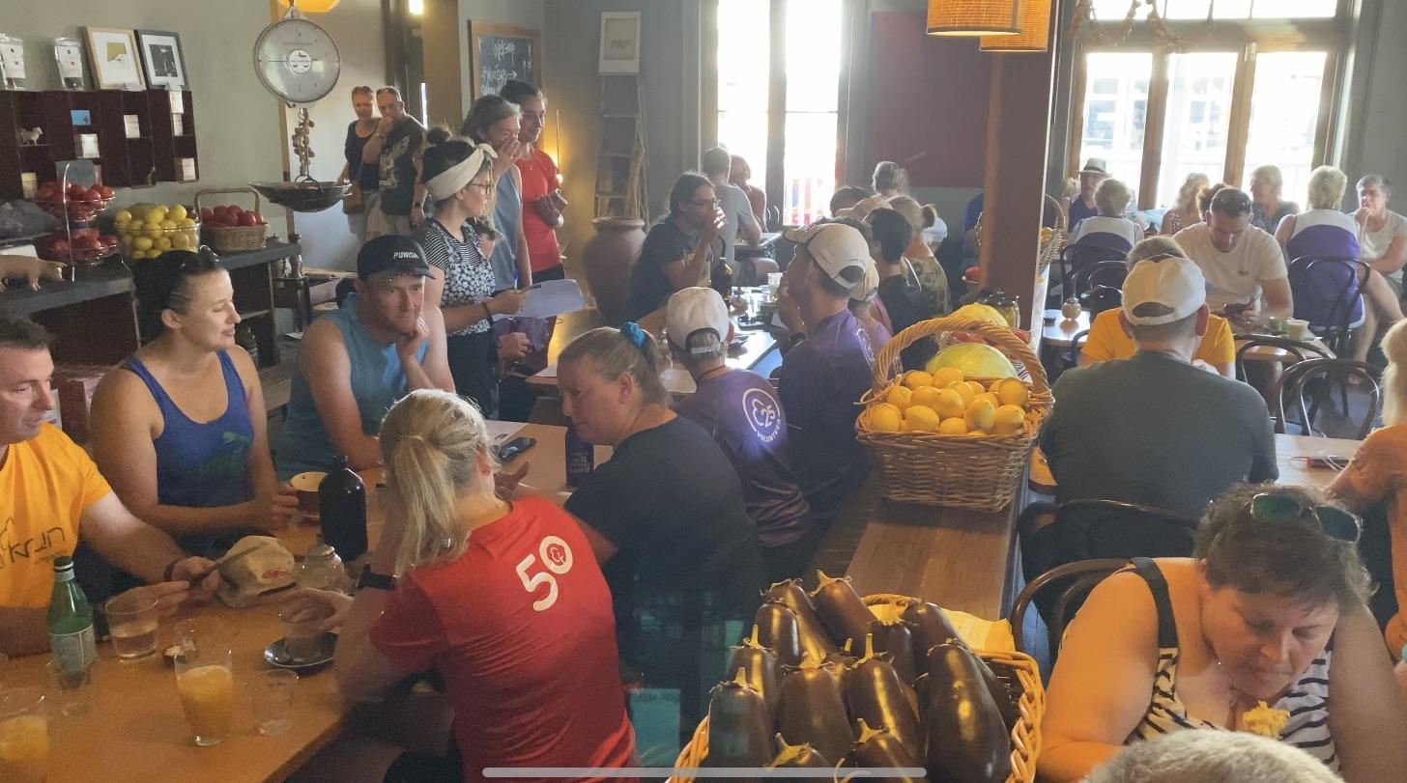
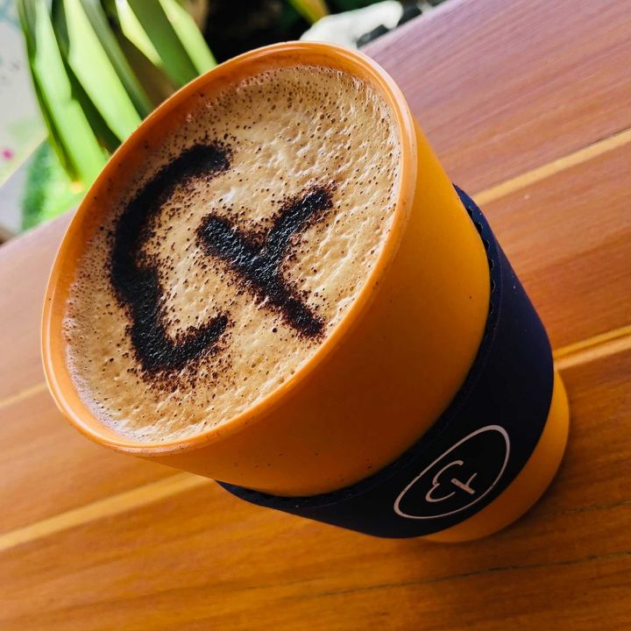
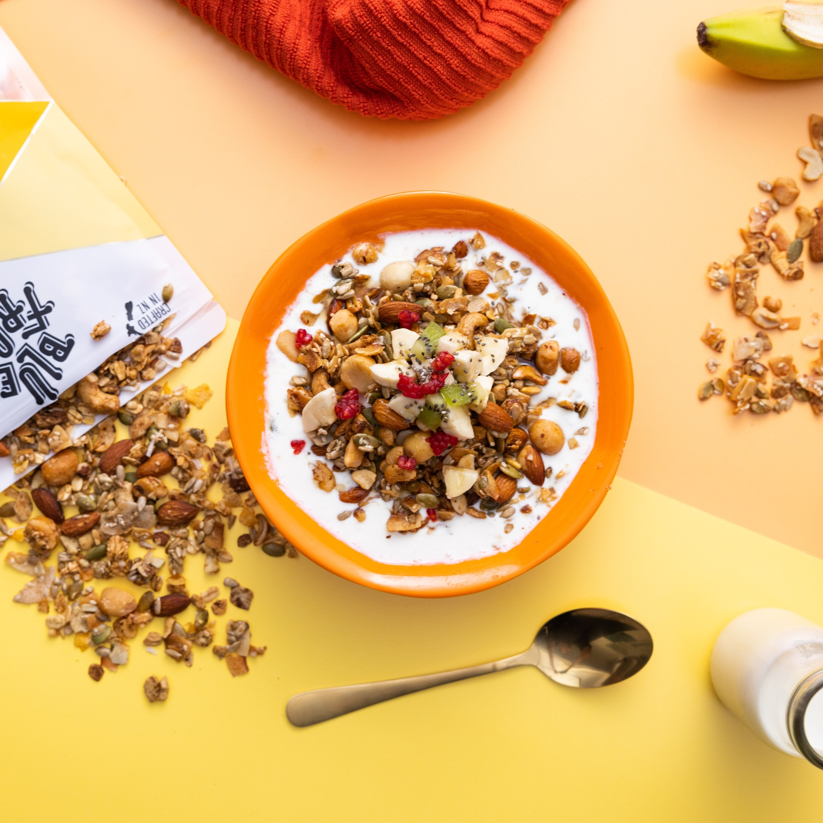
Enjoy breakfast afterwards with the parkrun crew
Notes:
Just like the very first event in 2004, every parkrun finishes with a coffee and a chat!

Slide 15
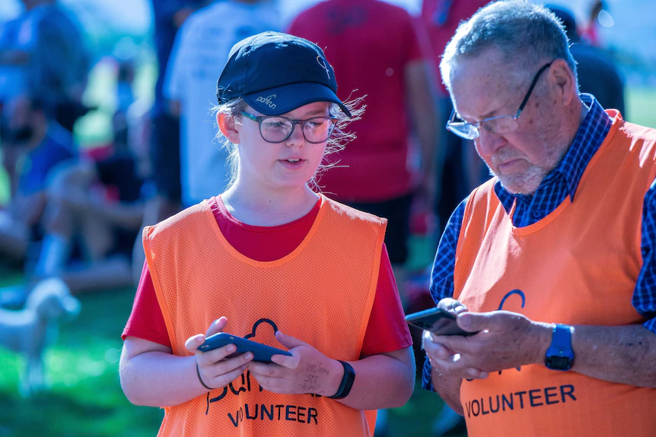
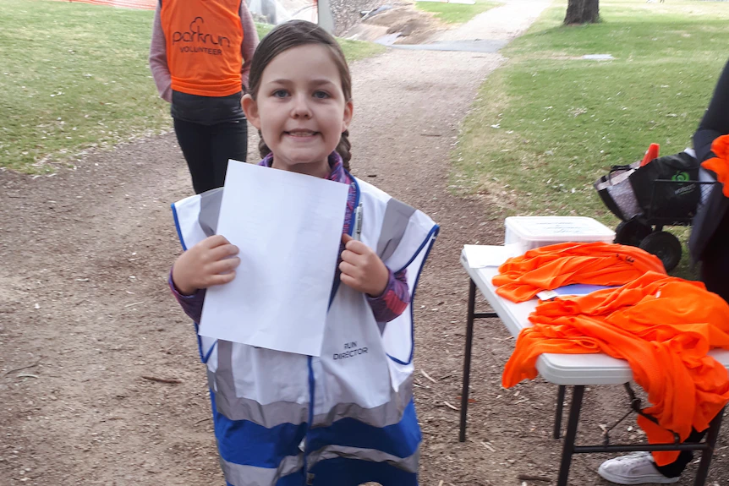
Meet Isobel, one of our amazing volunteers
Notes:
Isobel McKeown is blunt about why she loves volunteering at parkrun.
"That's obvious, I don't have to run!," she said.
The 11-year-old has now volunteered more than 30 times. Isobel wants people to know that everyone can stuff up and it's not the end of the world. "I have seen a marshal send lots of people in the wrong direction," Isobel said.
"I have seen a finish token volunteer drop all the tokens in the middle of an event but everyone helped and things turned out ok."
The other bonus for Isobel is being with adults that aren't her teachers or family. "I see how they do stuff and I like to meet new people and hear their conversations," she said.
It's been a massive learning experience for Isobel who was a parkrun director for the first time, in charge of a Saturday event declared as a 'kids in charge day' at the age of nine.

Slide 16
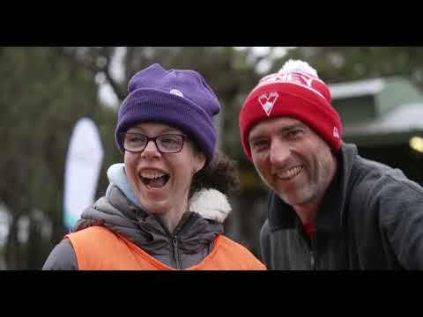
Meet Emma: a parkrun personality
Notes:
Emma lives with Williams Syndrome, which means she has some intellectual and spatial awareness challenges. But it also gives her some special qualities too, including the ability to recognise new parkrunners and to put them at ease.

Slide 17
Why parkrun?

Slide 18
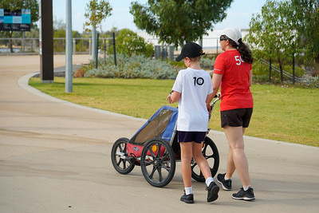
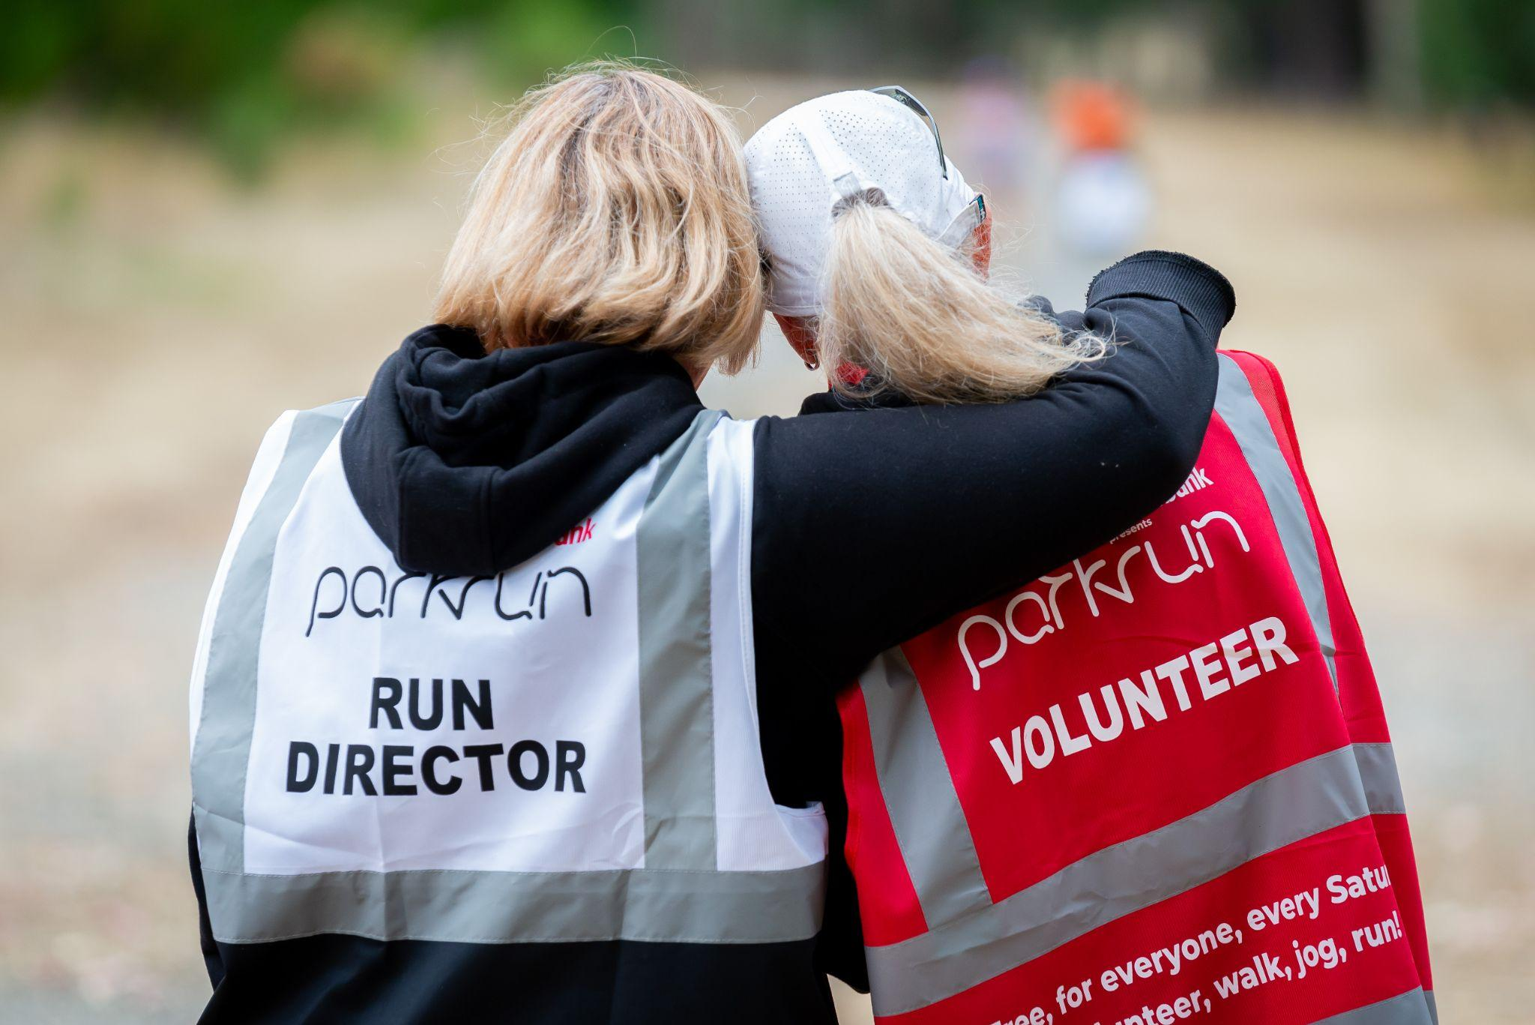
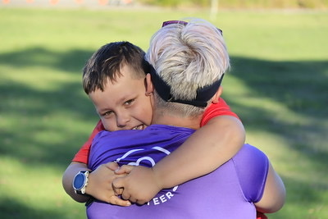
Notes:
Free
Every Saturday
No commitment
No specialist clothing
Variety of ways to get involved
Promotes family participation
Non competitive
Encourages and celebrates regular participation

Slide 19
Rewarding participation, not performance
parkrun is not a race
You can go at your own pace
You can do 5km or build up slowly
You can earn credits towards volunteer or run/walk milestone shirts (starting with a “10” shirt for juniors)
Notes:
Milestone shirts can be earned through participation at parkrun, buth volunteering and walk/running. These range from 10 for juniors, right through to 500 shirts (see next slide)

Slide 20
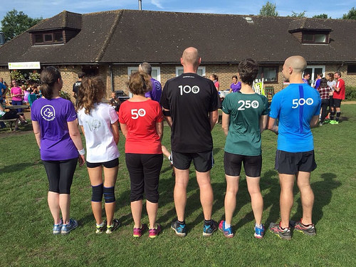
Notes:
Milestone shirts: Participation, not performance, has always been the focus of parkrun. These coveted shirts cannot be purchased - they can only be earned by turning up and walking, running and volunteering (explain the different shirts). Currently more than 2000 people around the world earn a milestone shirt every weekend.

Slide 21
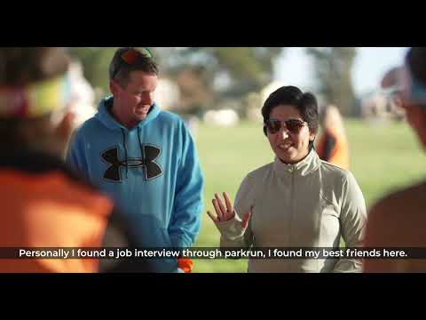
Meet Hanieh: My parkrun family
Notes:
Hanieh moved from Iran to Australia in 2014 and discovered parkrun almost immediately.
In this two-minute video, Hanieh explains how parkrun helped her improve her English and her fitness while expanding her social circle. Oh, and there was another reason too, but you'll need to watch to the end to find out!

Slide 22
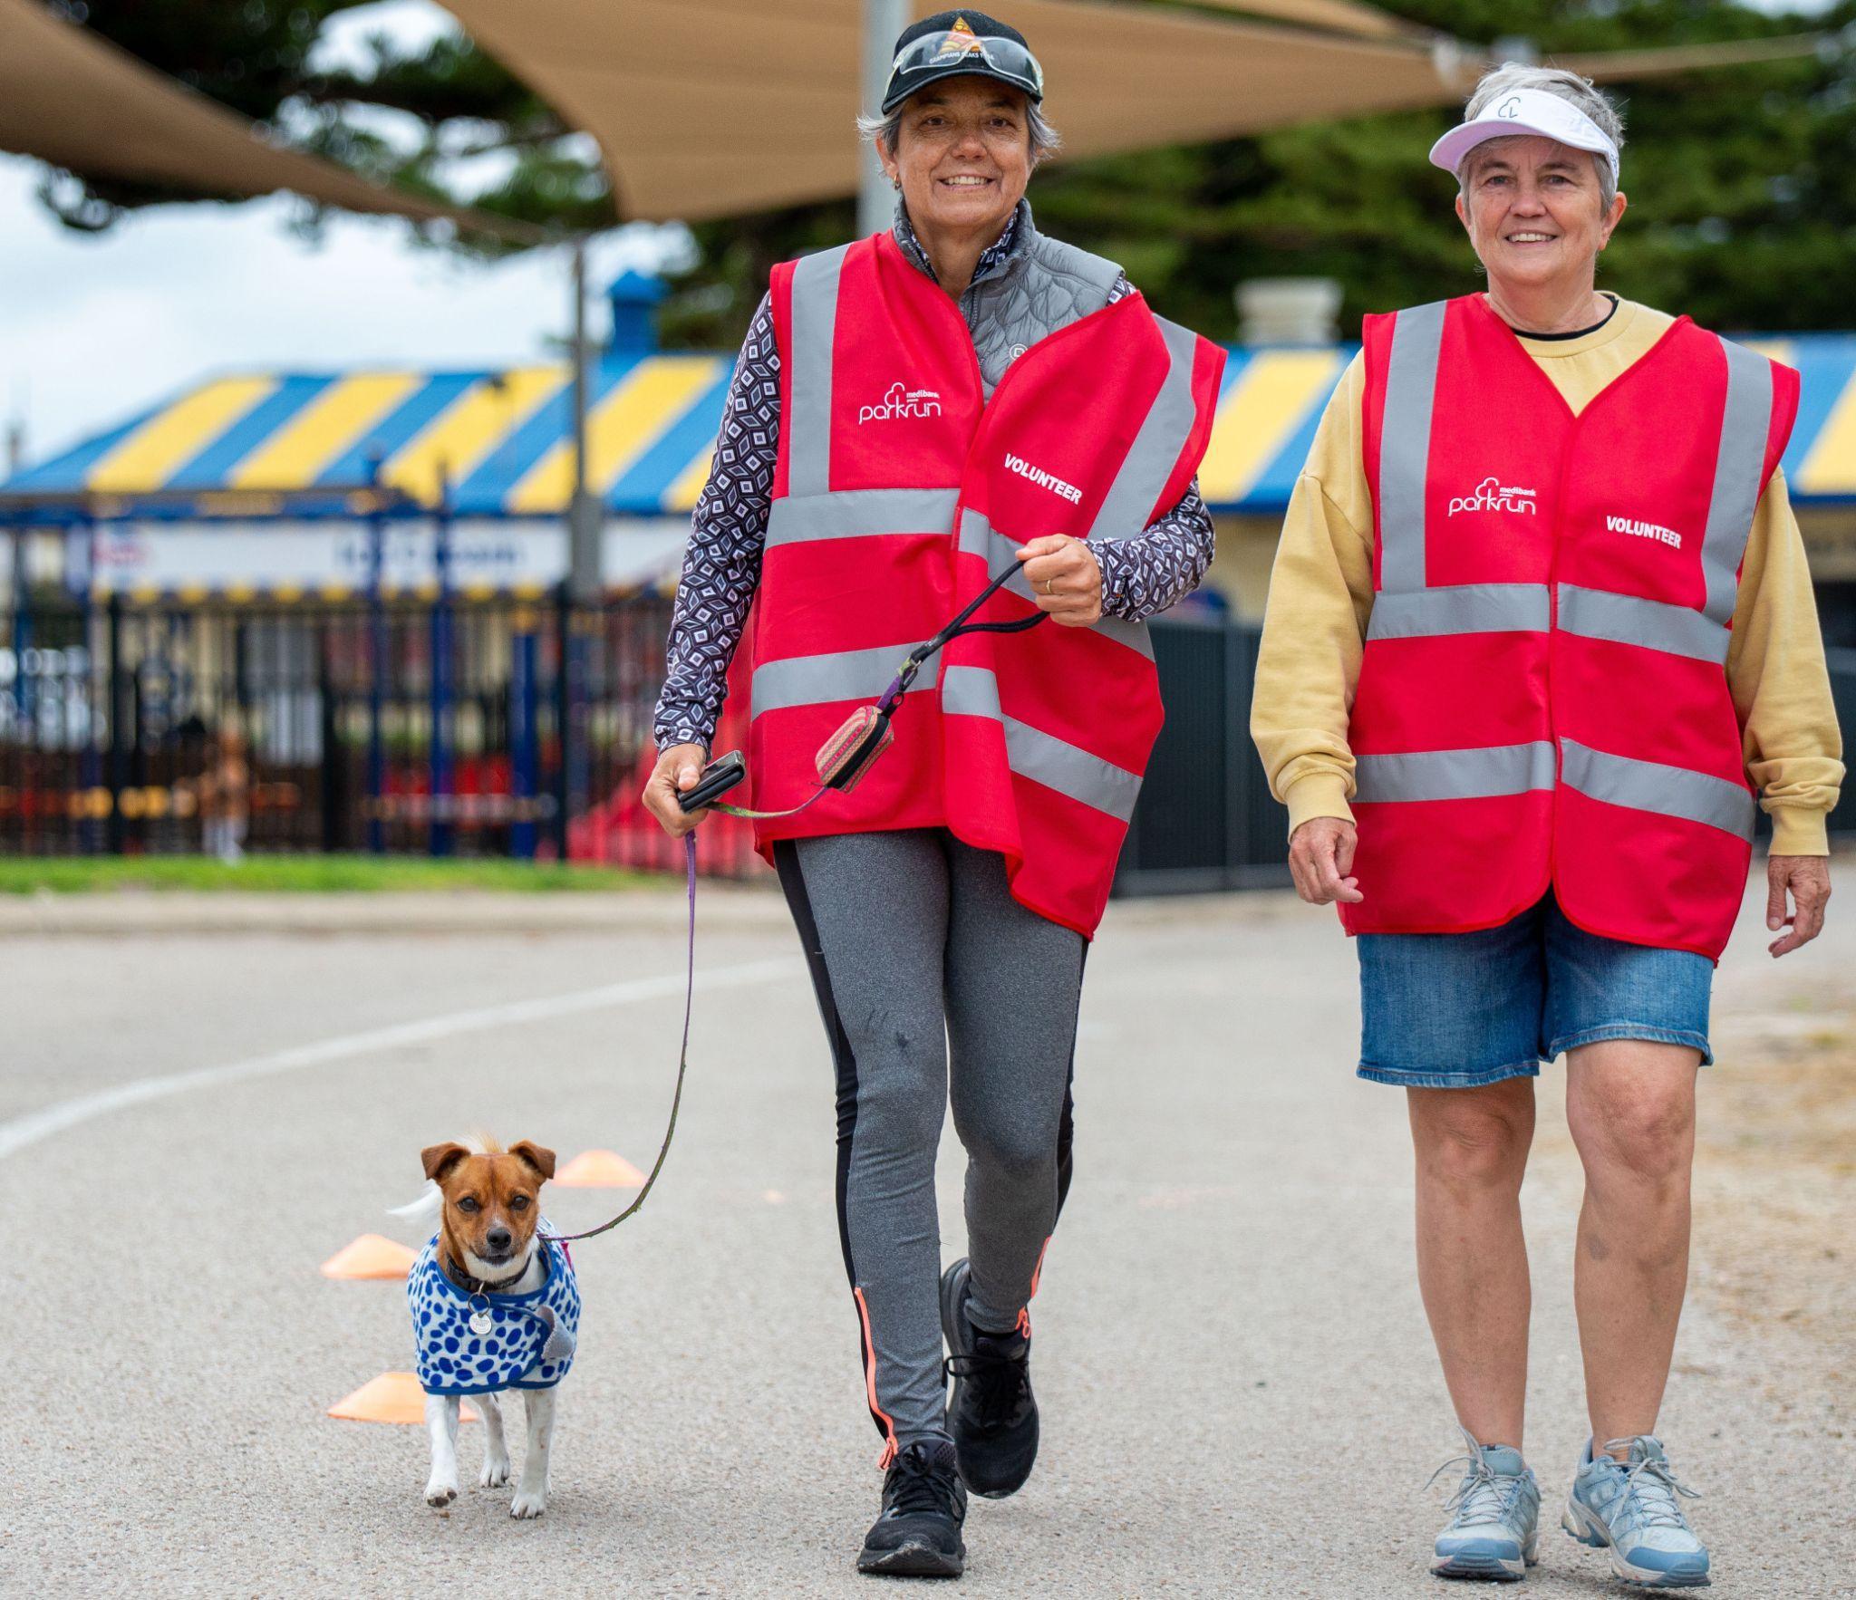
parkrun Australia’s growth
• More than 460 events every Saturday morning
• 850,000 individuals walking and running including 140,000 people volunteering
• 55,000+ walkers and runners each week
• 5,000 volunteers each week

Slide 23
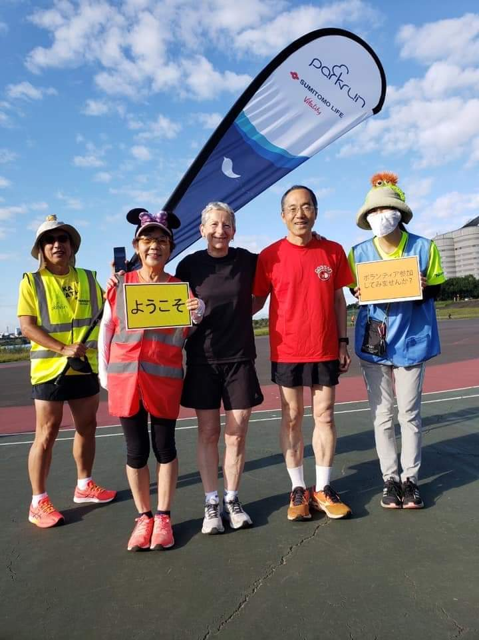
A global phenomenon
• 22 countries
• 2200 weekly events
• 260,000+ weekly participants
• 6 million+ have taken part worldwide
• 350,000 weekly participants
• 5 million+ taking part worldide
• Will double in size by 2023

Slide 24
What are the benefits of parkrun?

Slide 25
parkrun can help with forming regular habits of physical activity including increased movement during the week
No pressure environment - it’s not a race and you will not finish last - that’s the tailwalker’s job!
No ongoing commitment - join in on Saturdays when you would like to
You can bring along your dog, kids, grandparents, neighbours, friends - everyone is welcome at parkrun
Did we mention it’s free?

Slide 26
How parkrun can benefit women and girls…
parkrun is inclusive and accessible
No specialist equipment or clothing required
Ease into physical activity at your own pace
Providing a safe and welcoming atmosphere
Offers a variety of ways to be active (walk, jog, run, volunteer & spectate)

Slide 27
(continued)
Supportive volunteer team at each event to welcome you
Interact with volunteers and other participants as little or as often as you like - no pressure
If interested in volunteering there is opportunity to learn new skills and meet new people - and it’s fun!
You do not have to try it on your own, we’d love you to bring someone with you!

Slide 28
2019 parkrun Health & Wellbeing Survey
After participating at parkrun…
91% of all respondents reported a sense of personal achievement
89% reported improvements to their fitness
85% reported improvements to their physical health
79% reported improvements to their happiness
69% reported improvements to their mental health
Notes:
To really understand the impact of parkrun on people’s health and wellbeing, in 2019 a study was conducted of more than 60,000 parkrunners.

Slide 29
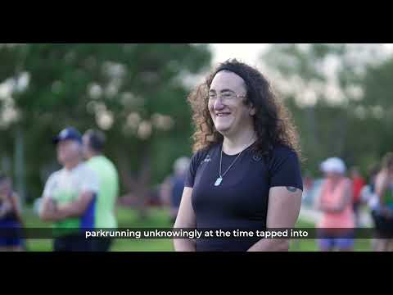
Meet Ada: Living as myself
Notes:
Ada Macey is a transgender parkrunner in Queensland.
In this short video, Ada explains why it is so important for transgender people to be involved in physical activity and connected to their community, and how there is nothing better than being able to live as yourself.

Slide 30
How can I join in the fun?
Visit www.parkrun.com.au to find your nearest event and register for a free barcode - you only need to do this once
Follow a parkrun event’s social media pages
Arrive a few minutes early for the First Timers Welcome
Enjoy the morning!
Notes:
Your barcode is valid at every parkrun in the world. You can print your barcode or download it to your phone

Slide 31
[your contact details]

