Slide 1
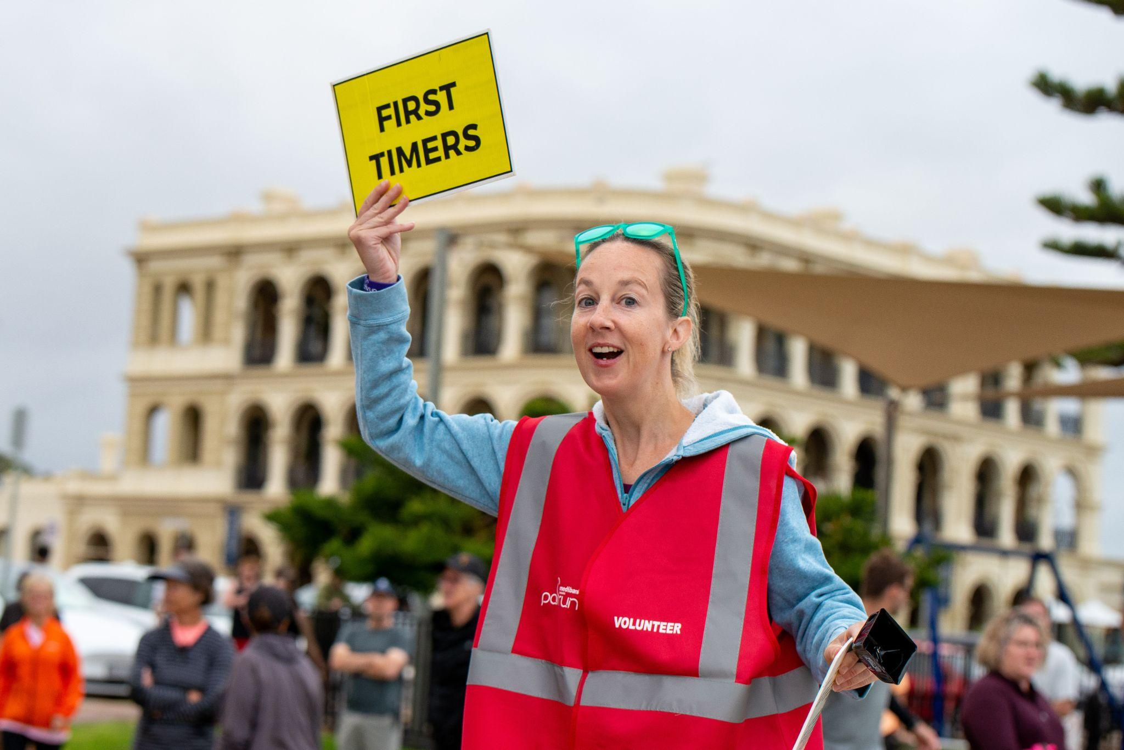

Slide 2
How to use this template presentation:
Save a copy of the entire presentation to your device
Edit using Google Slides, PowerPoint or Keynote
Don’t forget to “delete” “skip” or “hide” this instruction slide

Slide 3
Title and name of presenter
DATE

Slide 4
In the beginning…

Slide 5
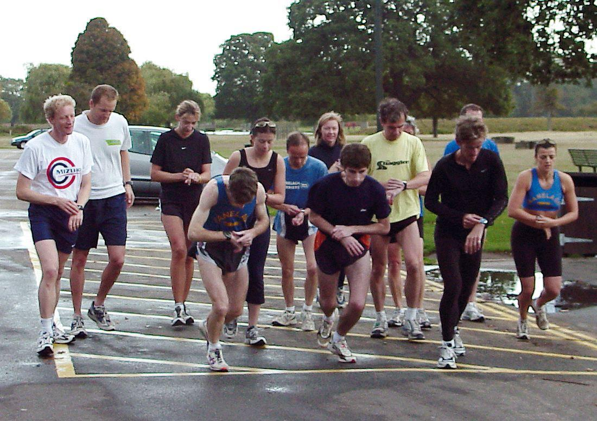
Notes:
This was the start line of the first parkrun in London in 2004: 13 runners supported by five volunteers followed by a coffee in the park cafe. 18 years later the model hasn’t changed.
What also hasn’t changed is the fundamental reason people come to parkrun.
Paul, who conceived the idea, was in his forties and going through a bit of a midlife crisis. He’d been sacked from his job, his marriage had broken down, and he’d suffered an injury that would keep him away from running club competitions for a couple of years. Paul had become disconnected from his neighbourhood and recognised he needed to bring his friends to him. Paul decided to hold a free 5km event, open to everyone, every Saturday at 9am in his local park, with the caveat that people would join him for a coffee afterwards. Nobody could have imagined what happened next though…

Slide 6
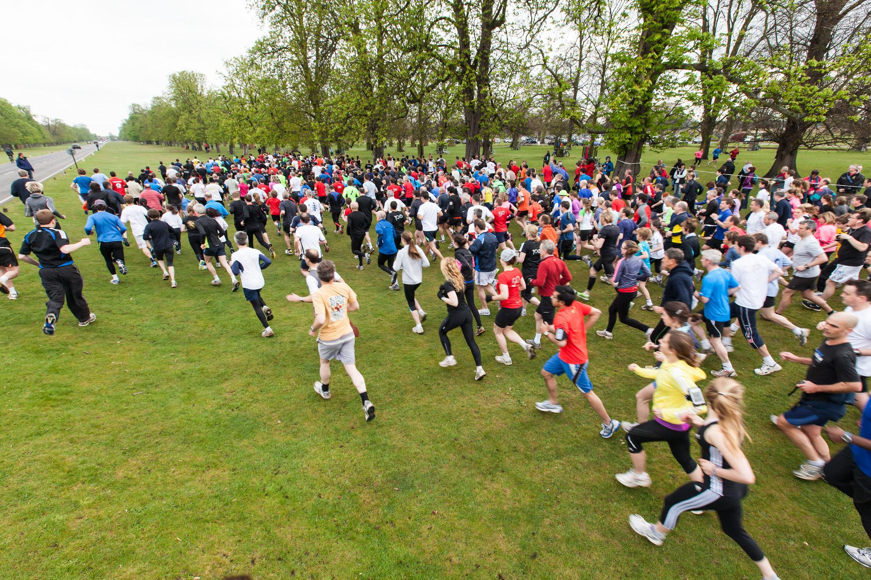
Notes:
Within two years more than 600 people were coming along to this one parkrun event.
Not just locals, but people from around the world who had heard about this simple idea and recognised that it could work in their community.
Paul agreed to support other communities to implement their own parkrun providing it was in line with the ‘parkrun principles’:
Free
5k
Every Saturday morning in a public open space
For everyone
Forever

Slide 7
What does a parkrun look like?

Slide 8
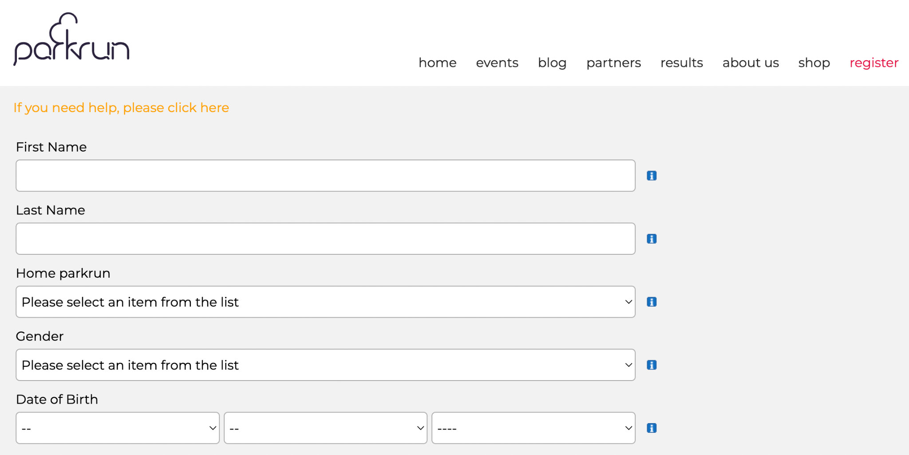
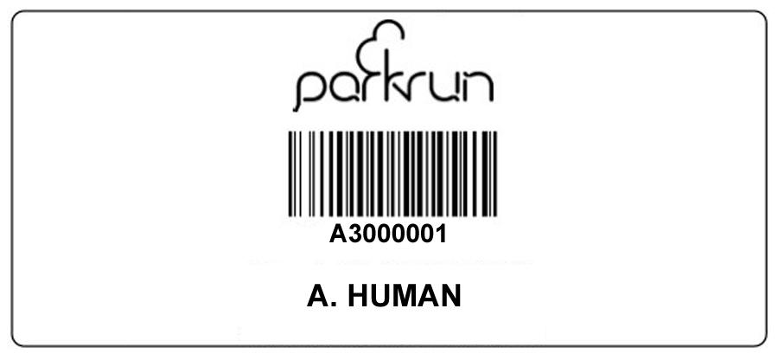
Notes:
Sign up for parkrun before your first visit and then you never need to register again! Your personal parkrun barcode becomes your passport to any parkrun in the world every Saturday morning - just come along whenever you feel like it! You can print your barcode or simply keep it on your phone.

Slide 9
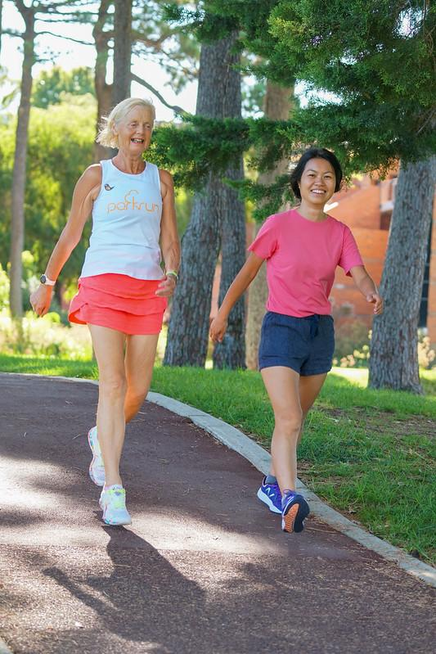
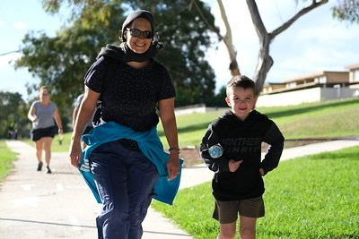
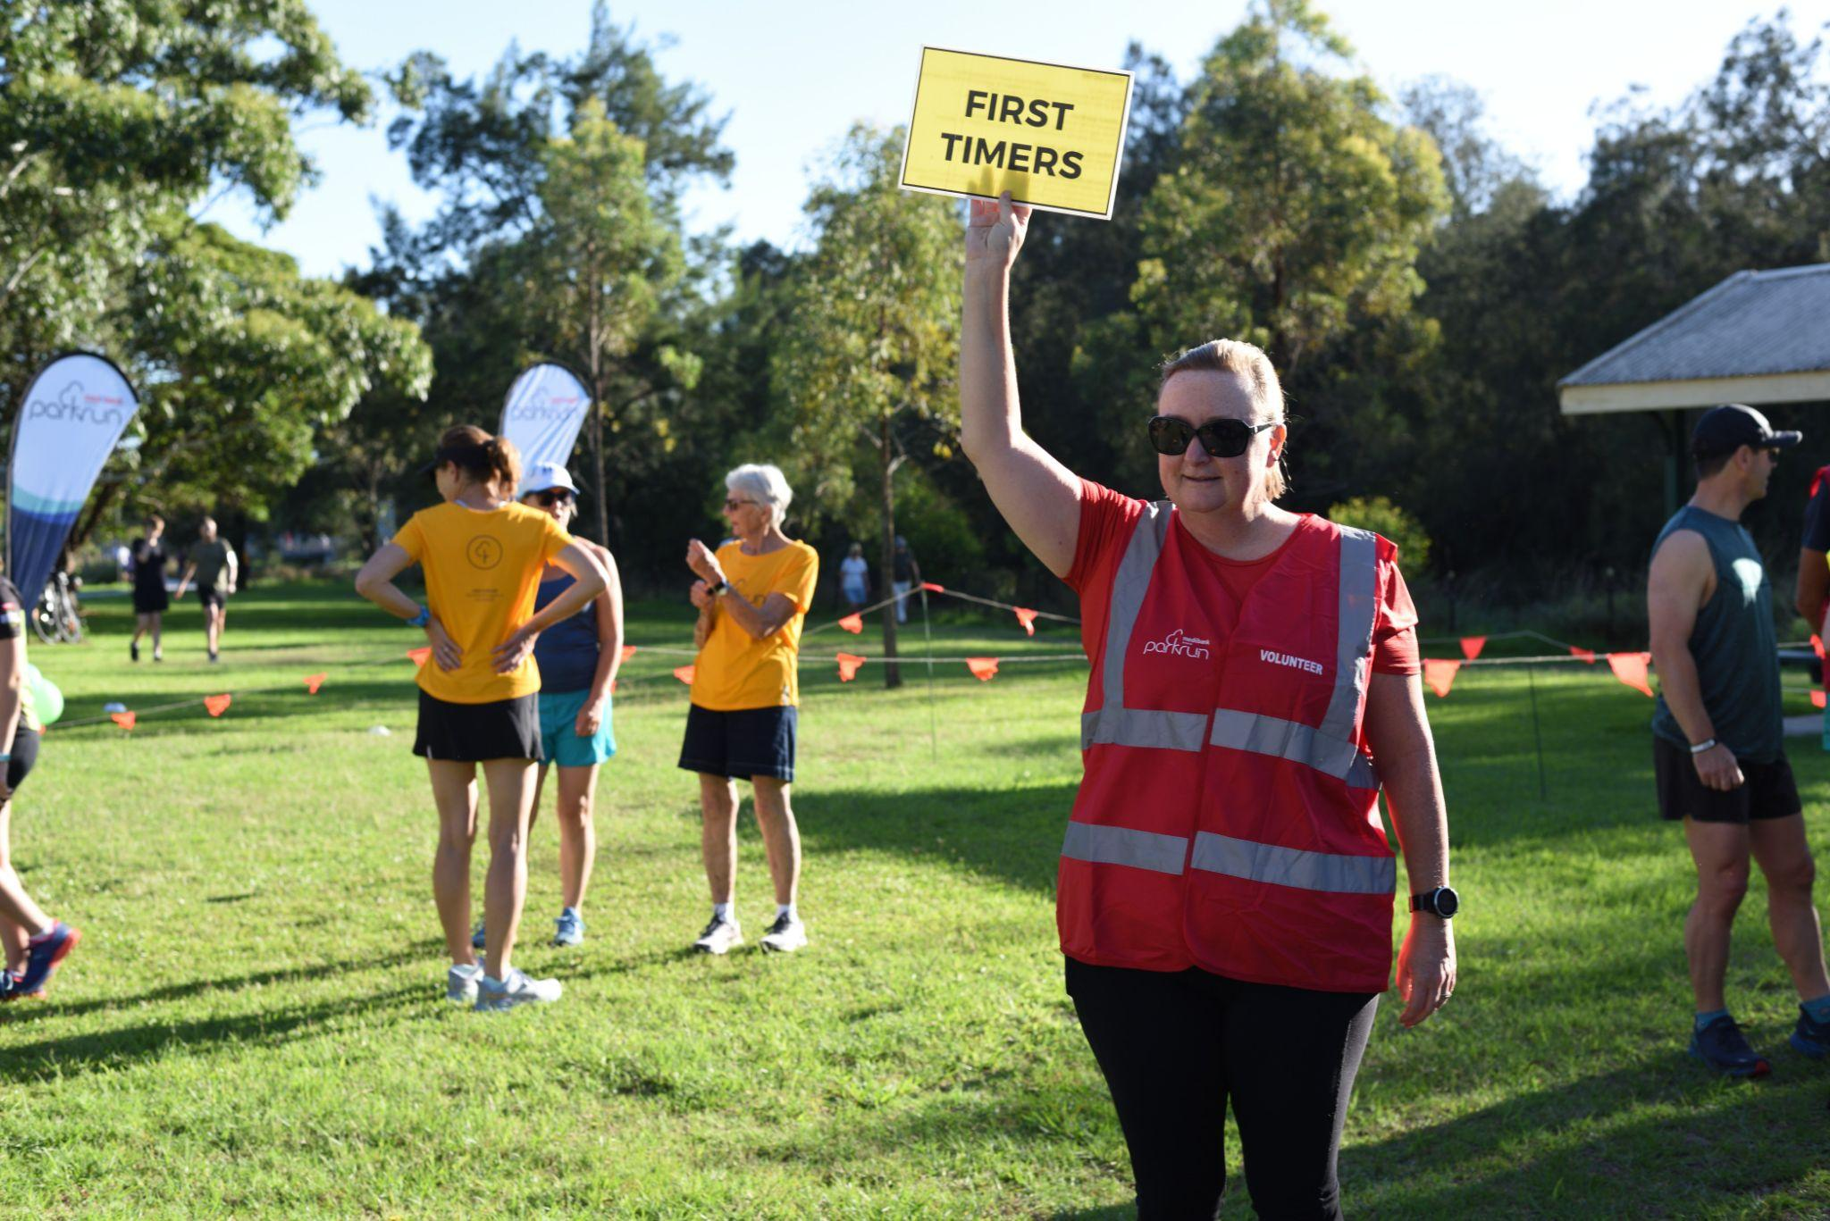
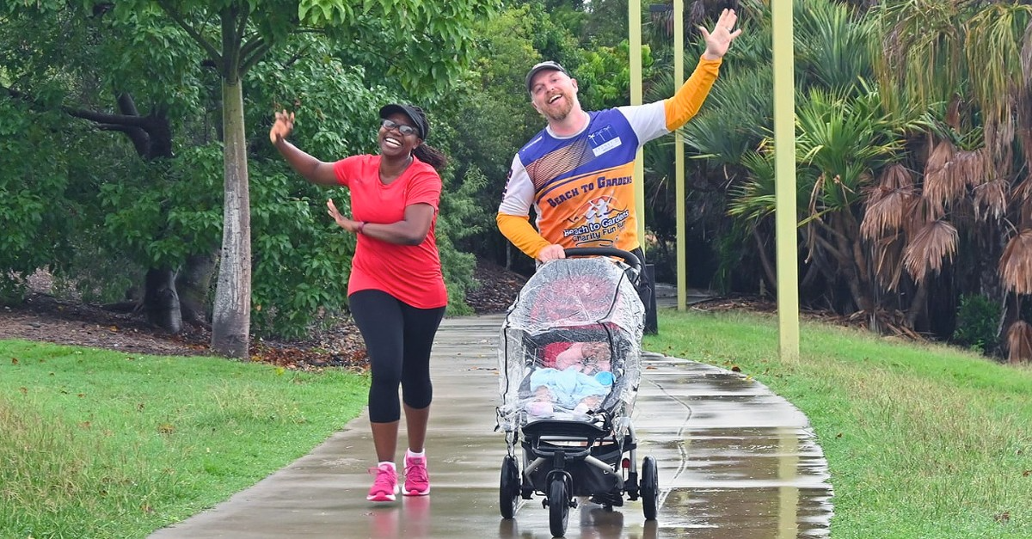
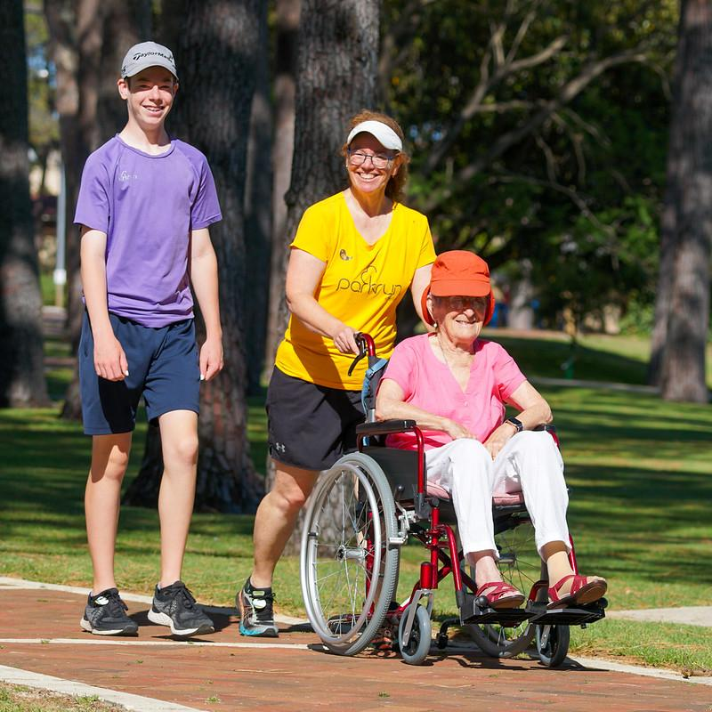
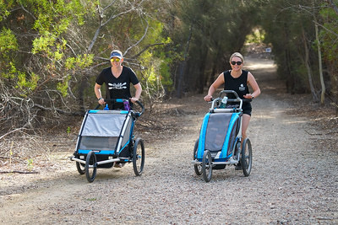
Notes:
Each parkrun has an Event Welcome and many will have a First Timers Welcome too! Look for the volunteer vests and signs. Walkers and runners start at the same time but go at their own pace and you are most welcome to bring the pram or one dog on a short handheld leash.

Slide 10
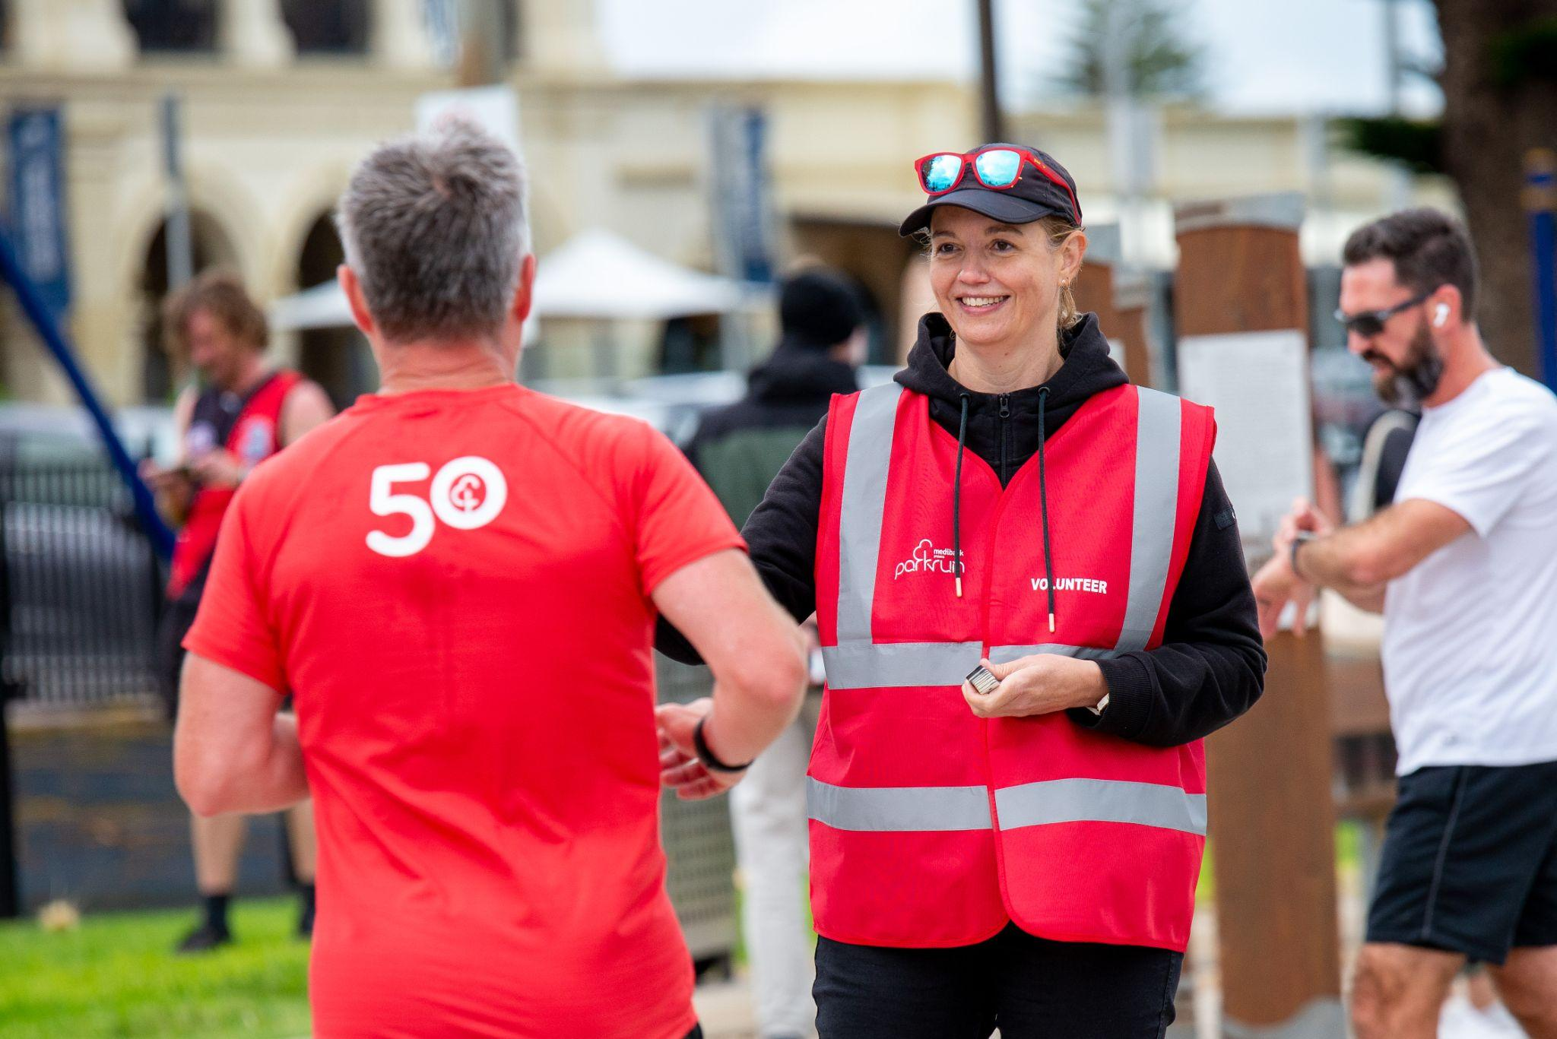
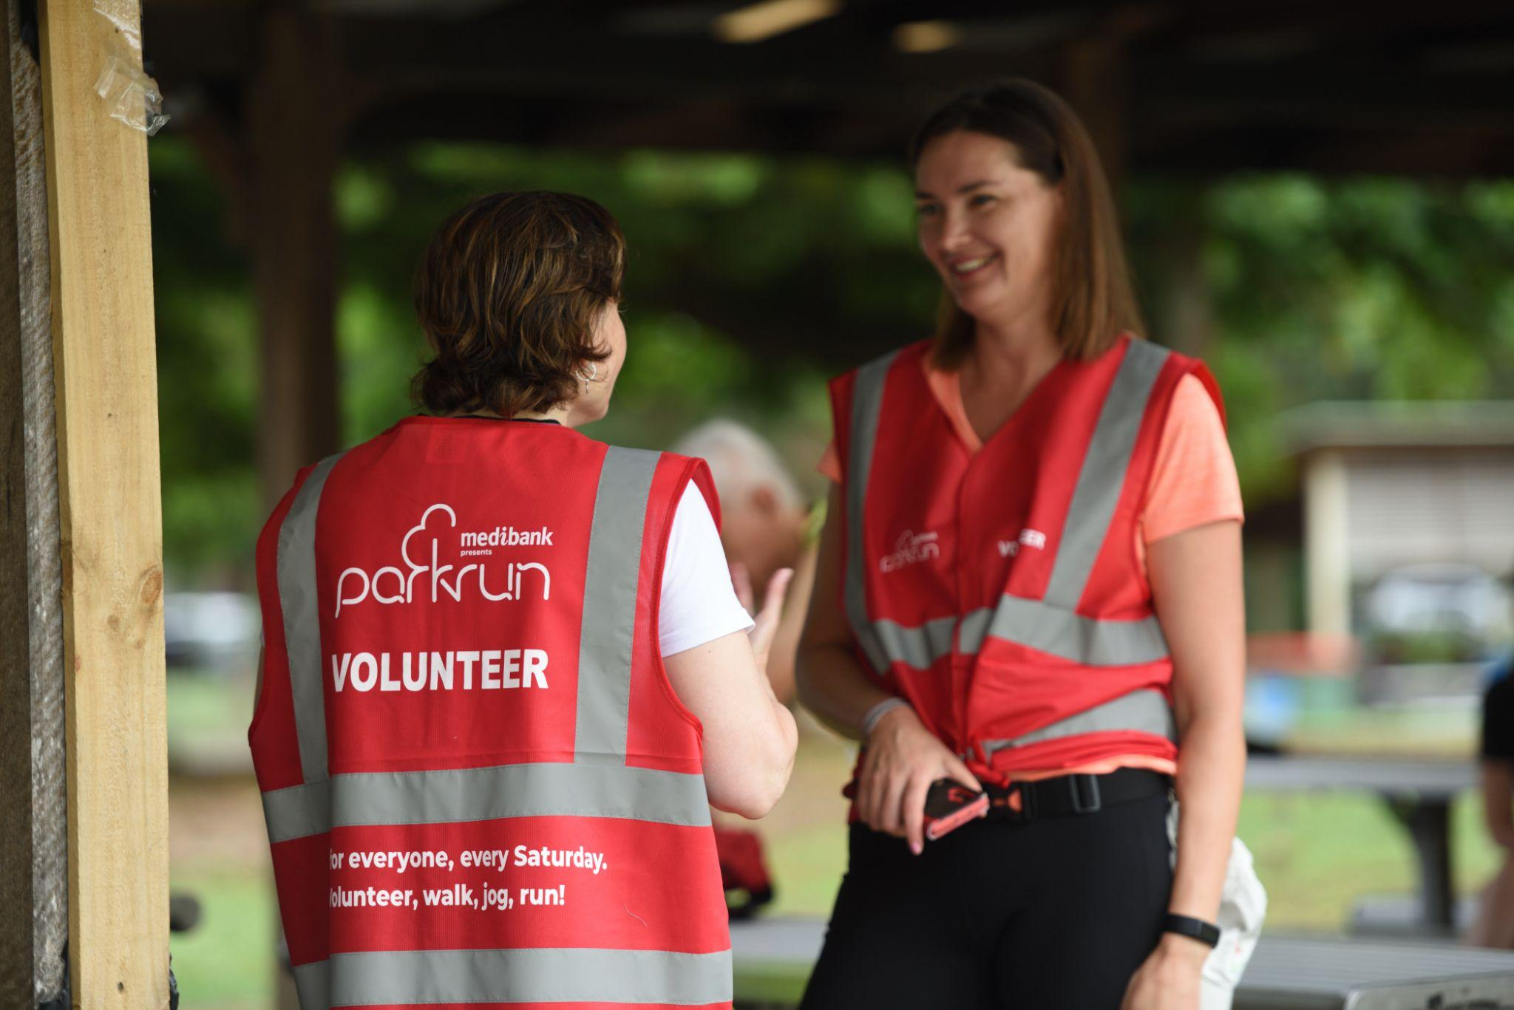
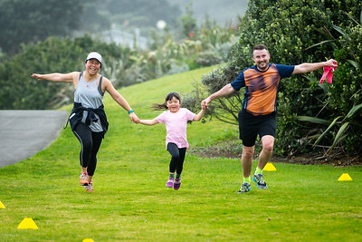
Notes:
parkrun is coordinated each week by volunteers. People of all ages are invited to volunteer and there are a wide variety of roles to try. Speak to a friendly volunteer if you are interested. You can also email the event team directly or respond to their social media posts requesting volunteers. Volunteering is a great way to meet new people, learn new skills, build confidence, have heaps of fun and is one of the best ways to improve your health and happiness.

Slide 11
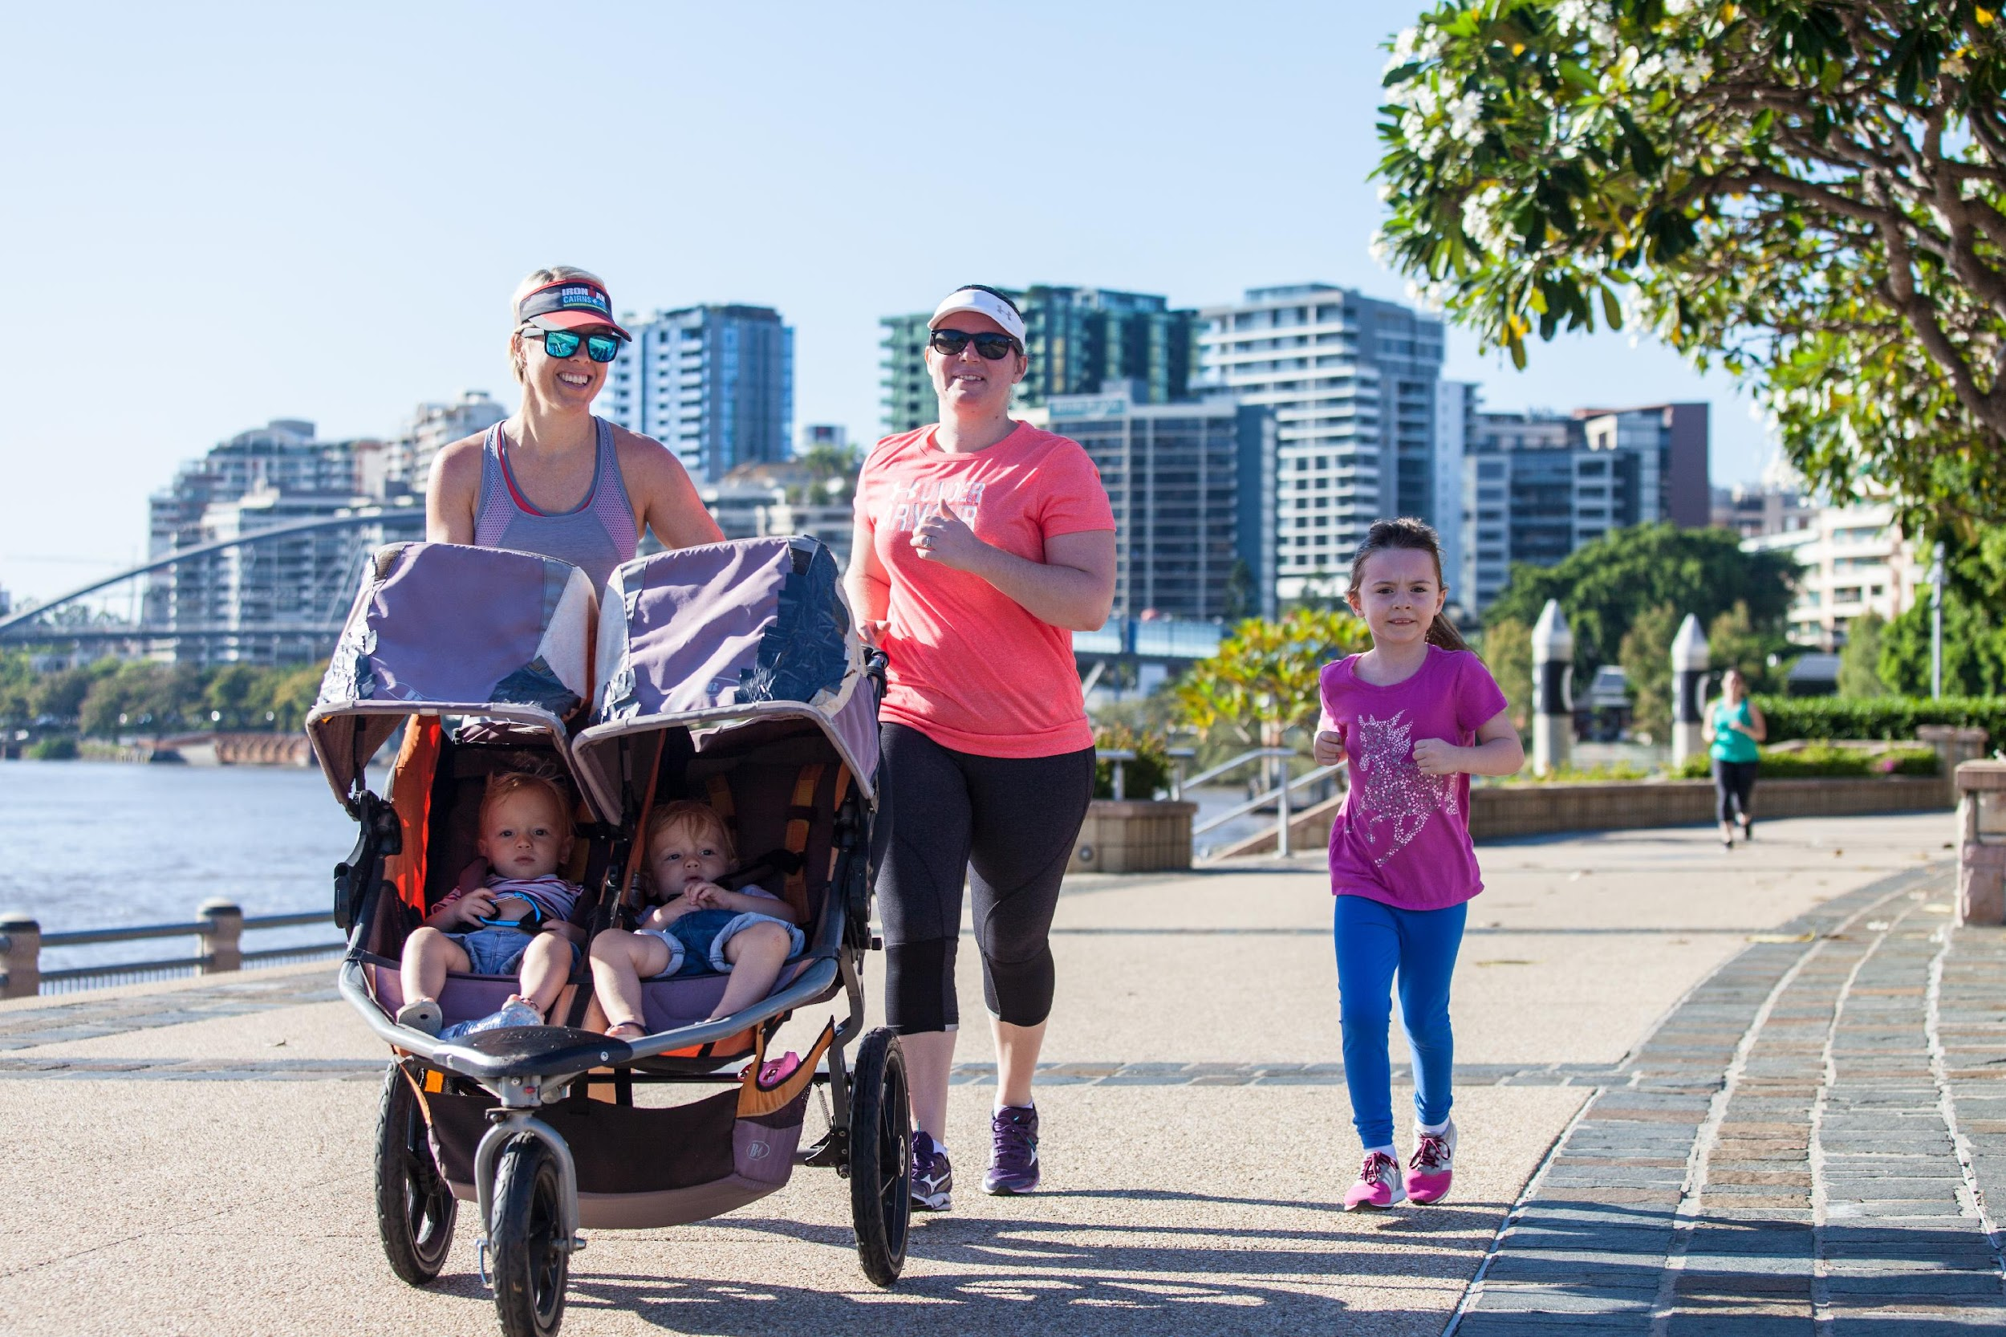
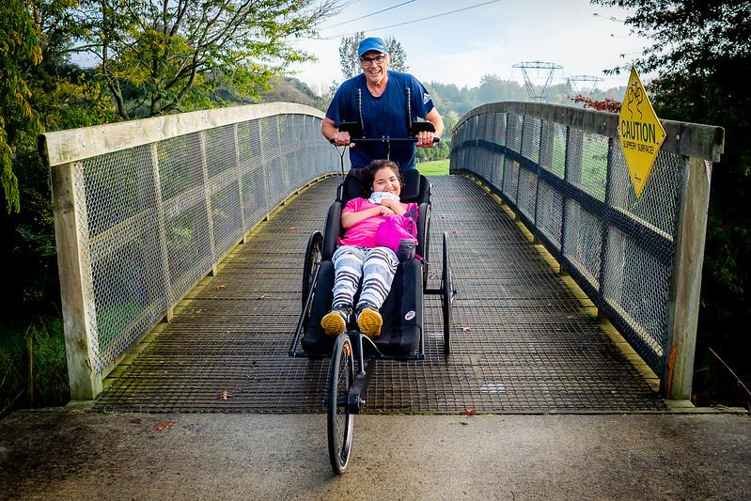
Walk run volunteer spectate
Notes:
You can participate as a walker, runner, wheelie or volunteer or just spectate and socialise

Slide 12
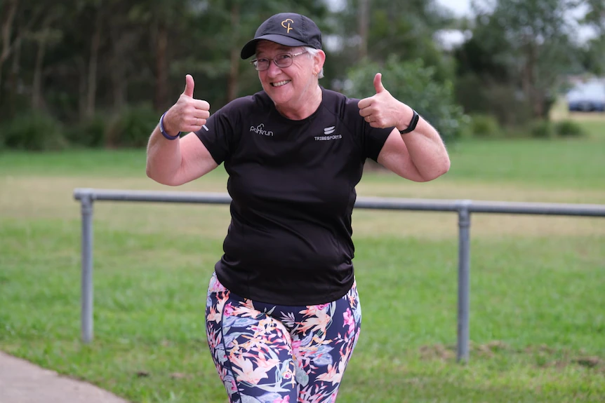
Meet Margaret…
Notes:
Margaret is hearing impaired and said she loved the event from her first Saturday morning run. Her local event didn't have sign language support when she signed up, but that changed quickly thanks to her National Disability Insurance Scheme (NDIS) funding which provided an Auslan interpreter. "My local event has welcomed deaf runners with open arms and created an amazing atmosphere where we can feel comfortable," Margaret said.

Slide 13
Can I parkrun in a wheelchair?
Wheelchair users are more than welcome at parkrun. We pride ourselves on being as inclusive to as many people as possible
The suitability of the course for wheelchairs will be determined by the skill, experience and confidence of the wheelchair user
Event teams can be contacted via email to help determine suitability of each specific course for wheelchair users
Wheelchair users can be self-propelled, motorised or participate with the assistance of carer/s
Notes:
Event team emails can be found through their website and facebook page

Slide 14
(continued)
Mobility scooters are also permitted at parkrun events
This does not include participants with short term/non-disabled conditions such as injuries
Wheelchair users can contact the parkrun Support Team if they wish to have their profile amended to appear in the results as a wheelchair participant (MWC or WWC) (support@parkrun.com)
Hand cycles are not permitted at parkrun events

Slide 15
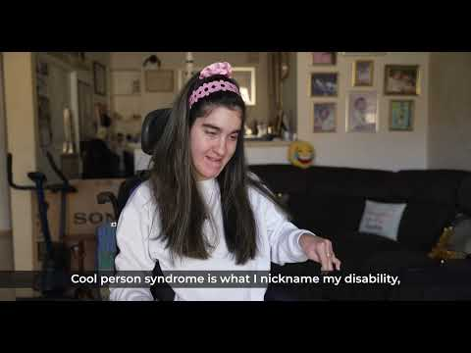
Meet Tayla: She has Cool Person’s Syndrome…
Notes:
Tayla lives with Quadriplegic Cerebral Palsy, which she nicknames 'Cool Person Syndrome'. Tayla hopes her story will inspire other people who live with a disability to give parkrun a try, so please share this short film with someone who might enjoy hearing about Tayla, her Purple Peanut, and how much she enjoys finishing parkrun before her father every Saturday!

Slide 16
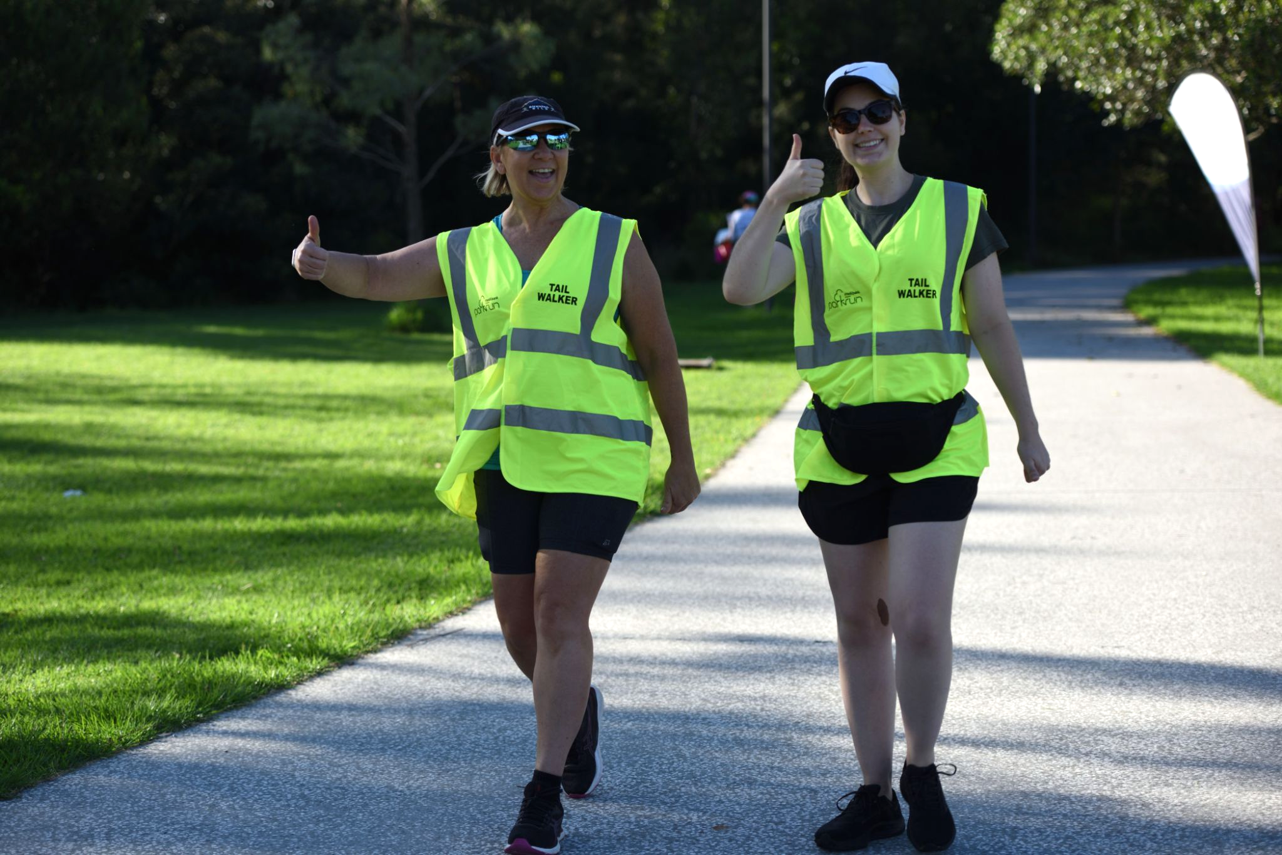
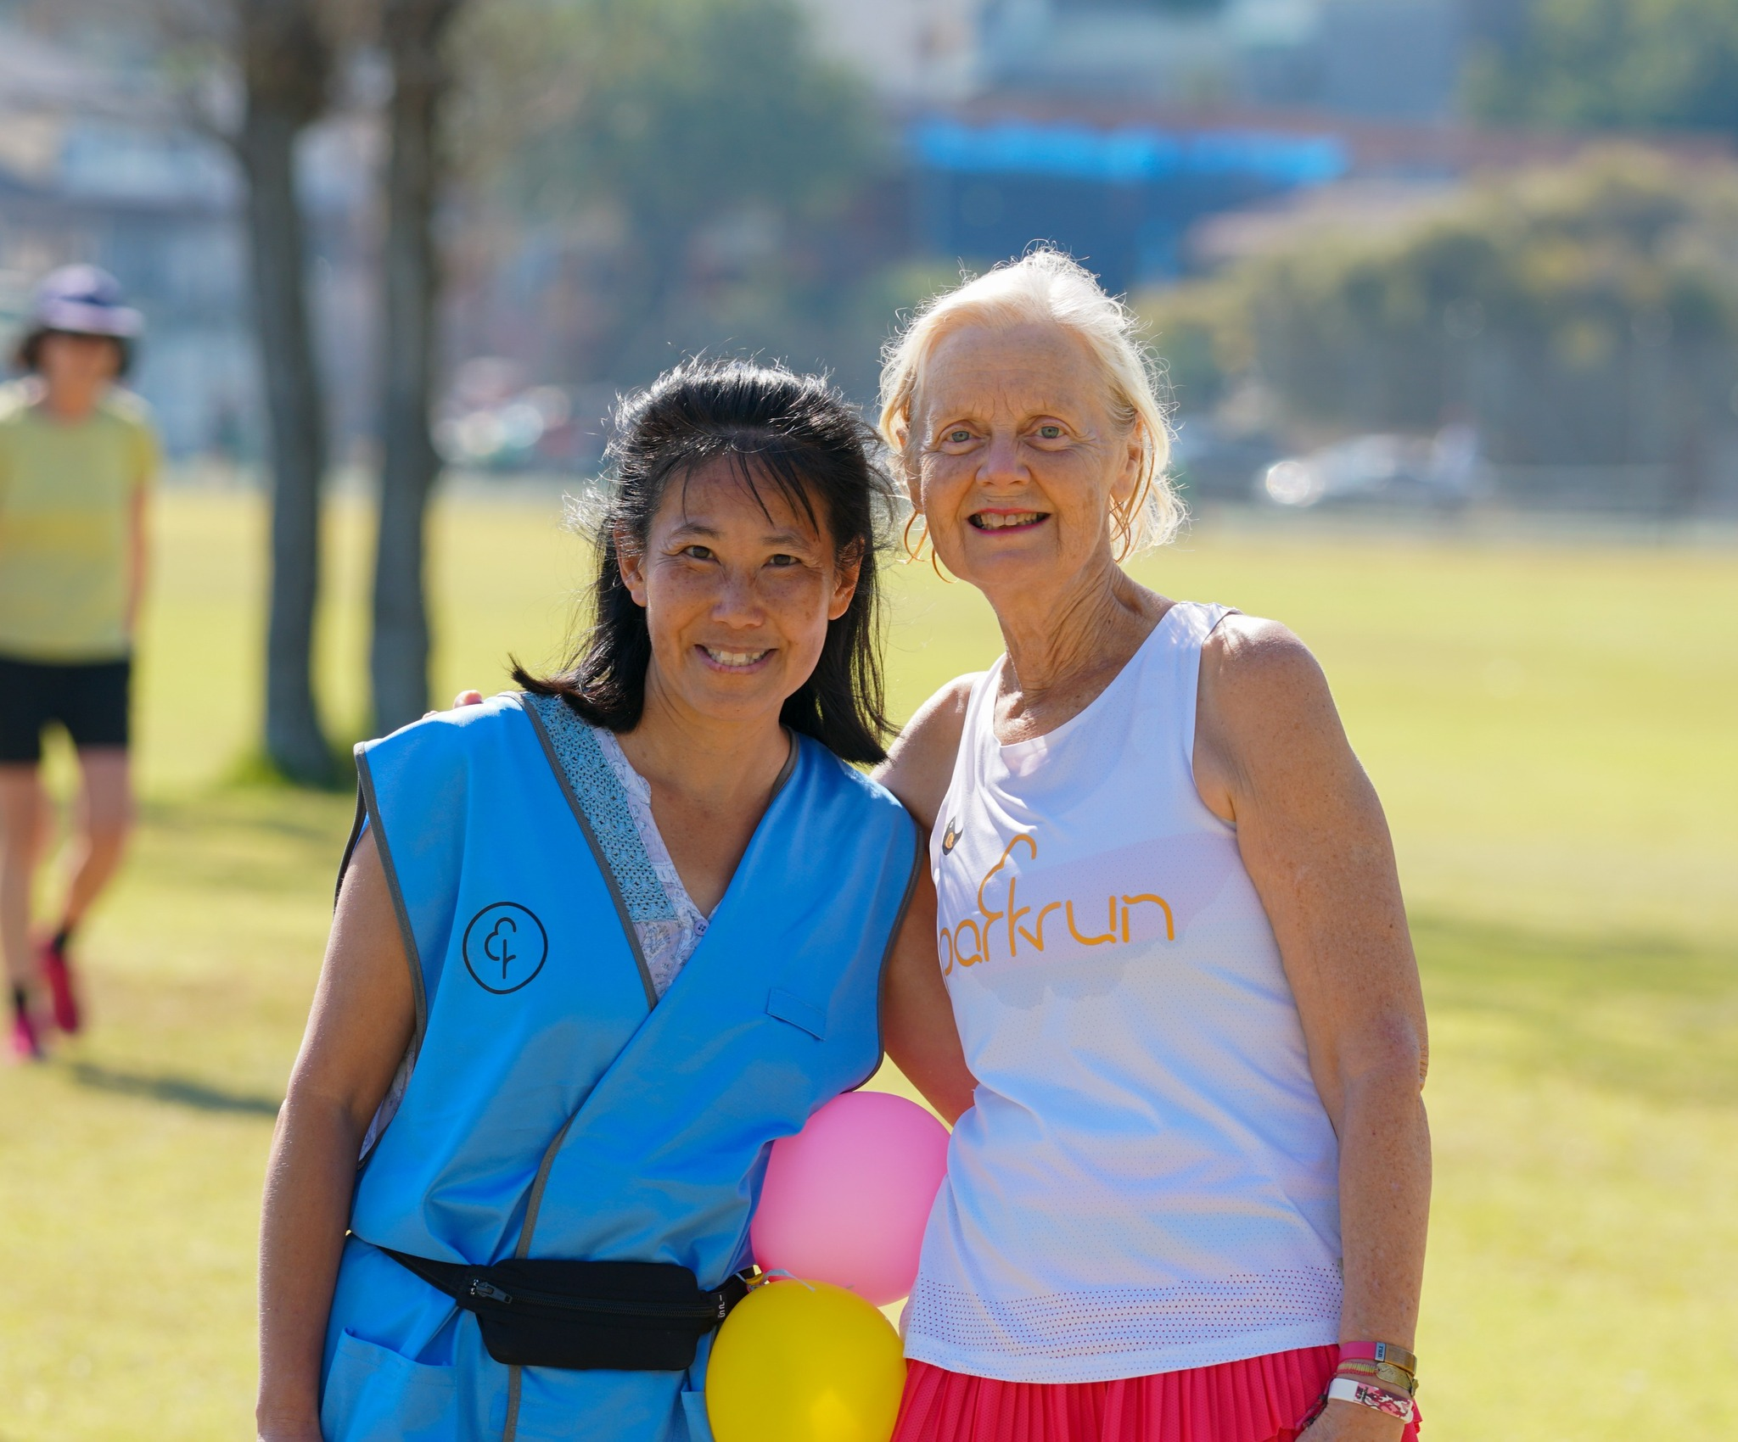
Tailwalkers always finish last!
As a Tailwalker you receive 1 run/walk credit and 1 volunteer credit per event - bonus! Many of our events have a parkwalker too
Notes:
You can’t come last at parkrun. ALL parkruns have volunteer Tail Walkers that provide support and encouragement and they are the final person to cross the finish line.
The parkwalker role extends this friendly support along the parkrun course ensuring support and encouragement is there for everyone who walks at parkrun. They are positioned ahead of the Tail Walker but behind those who are running to ensure everyone who is walking feels a part of the parkrun community. The bright blue parkwalker vest is also a great conversation starter and re-emphasises that walkers are celebrated at parkrun.

Slide 17
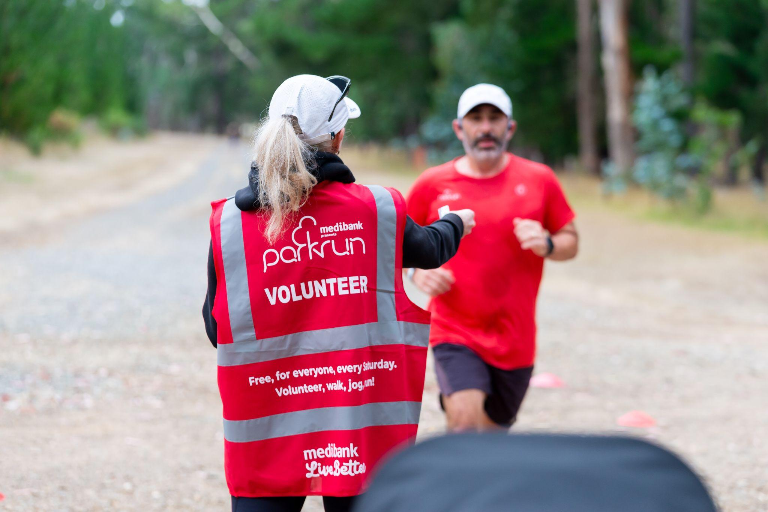
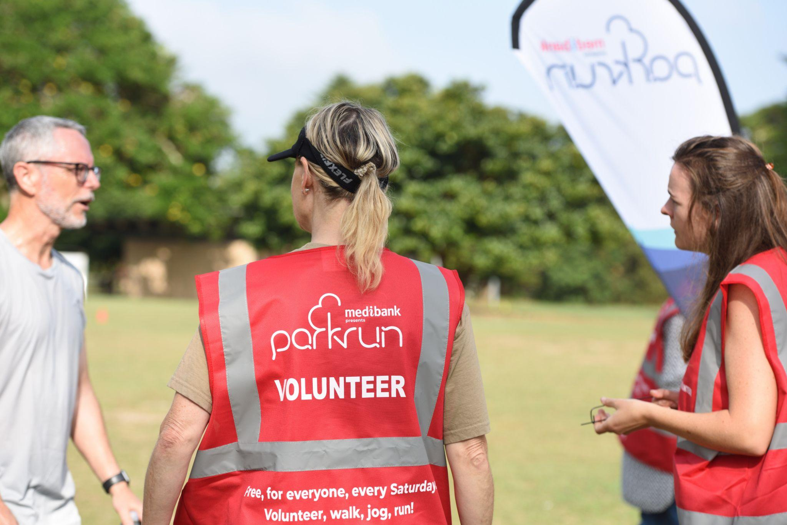
At the finish…
Notes:
parkrun guarantees everyone will have at least two personal interactions at each event. When you cross the line you’ll be handed a finish token by a volunteer, and then another volunteer will scan your token and your personal barcode.

Slide 18
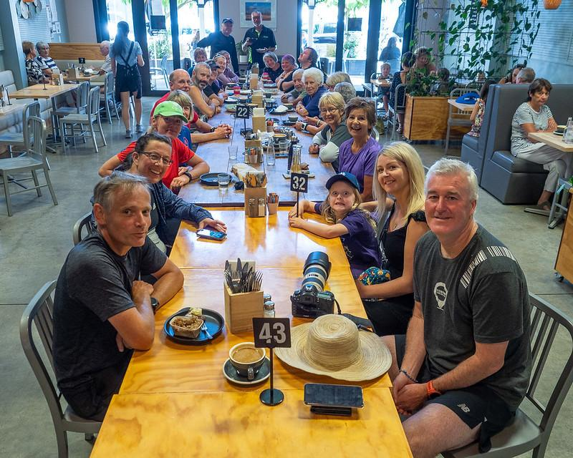
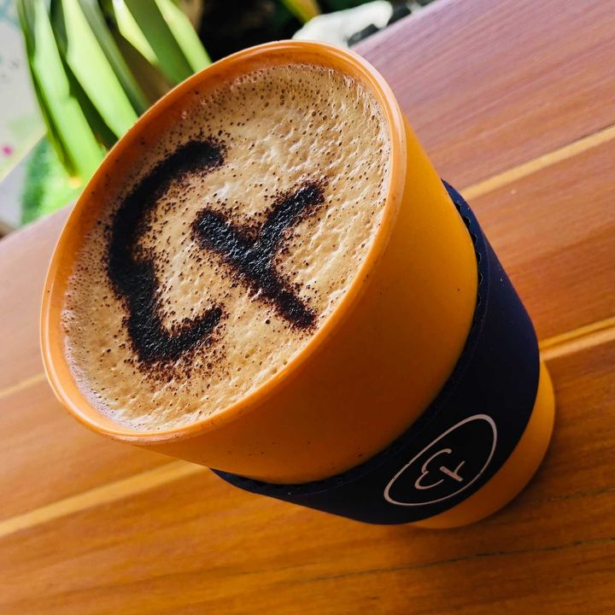
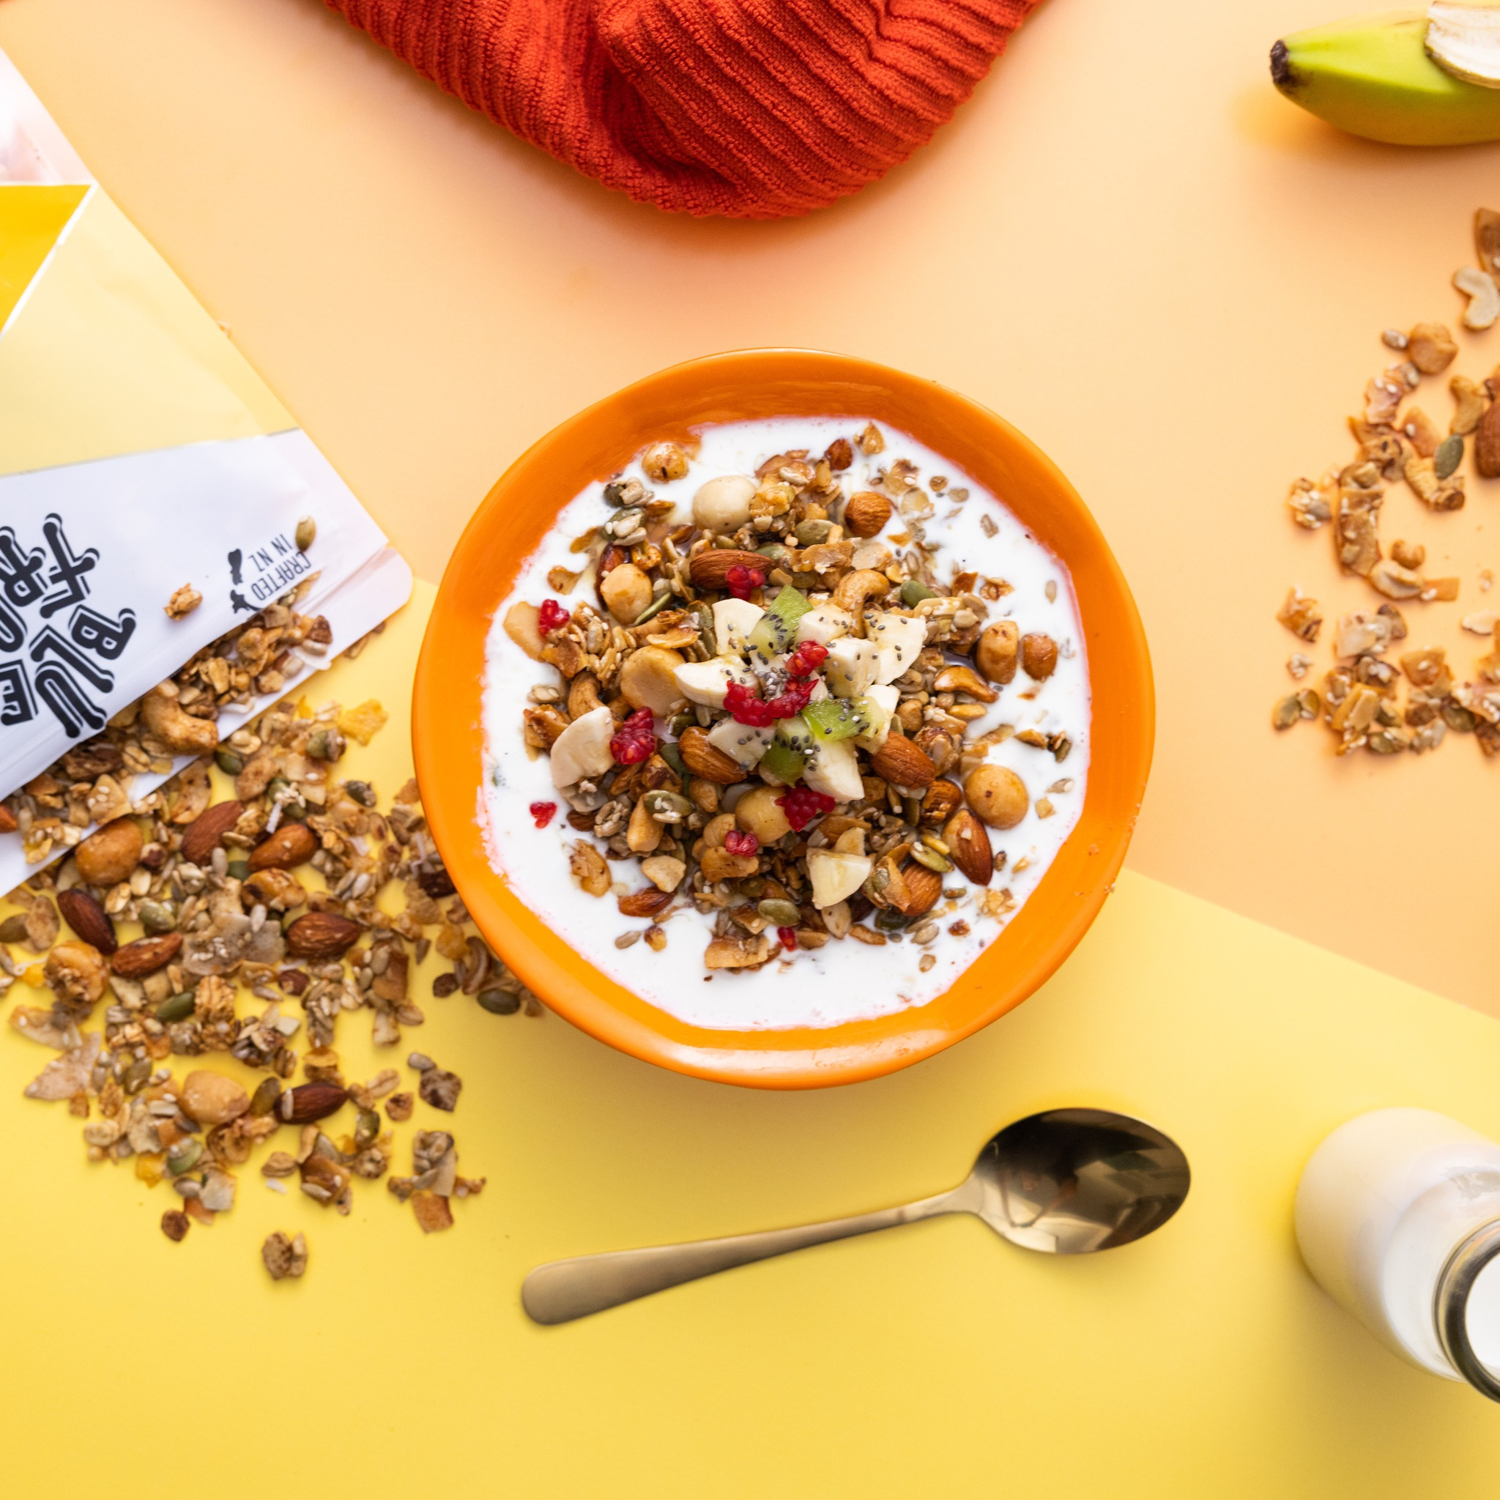
Enjoy breakfast afterwards with the parkrun crew
Notes:
Just like the very first event in 2004, every parkrun finishes with a coffee and a chat!

Slide 19
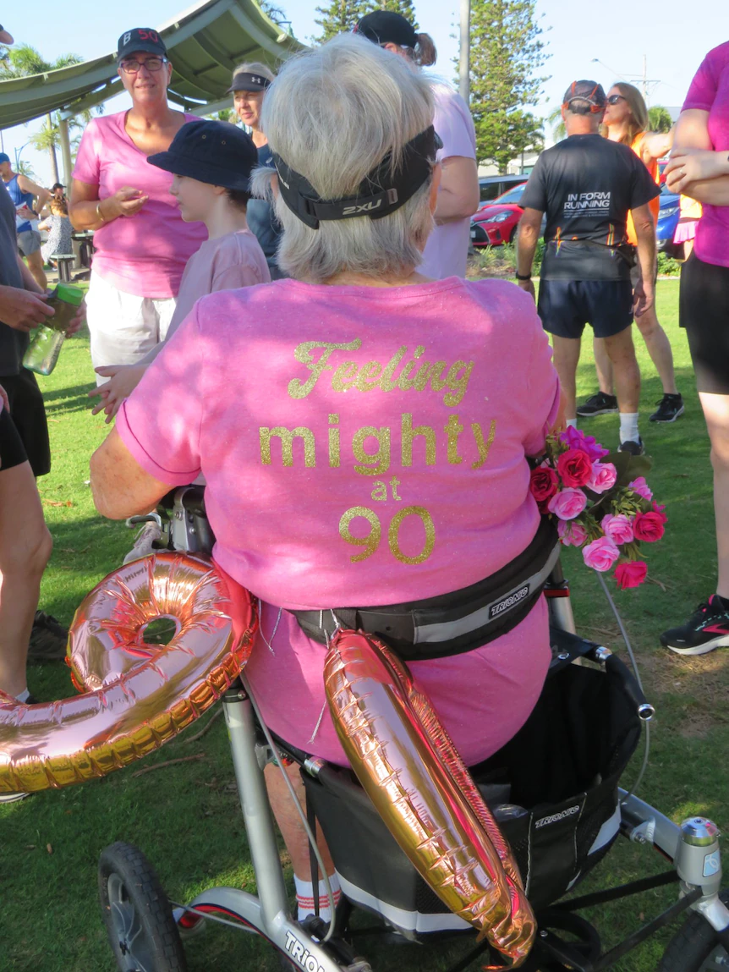
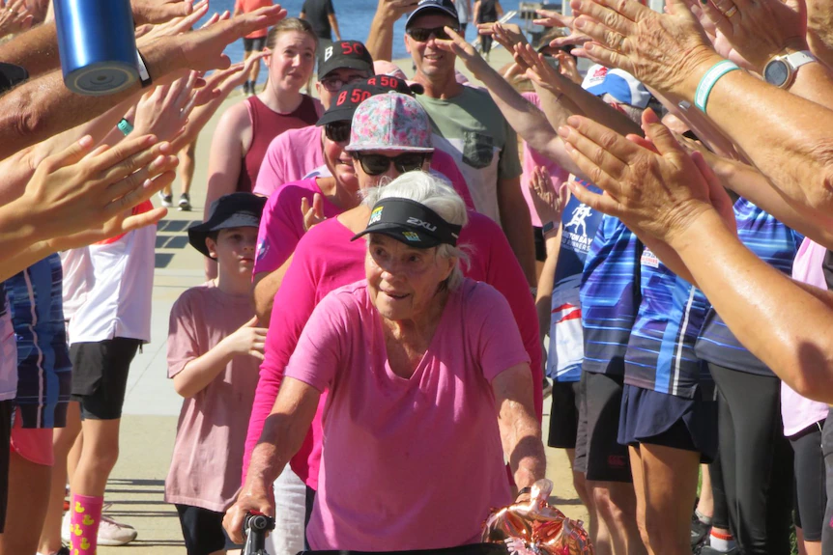
Meet Beryl…
Notes:
Beryl is a regular at her local parkrun,, winning in her age category every week.
She said it's easy to see why — she's the only one in her category.
The mother of ten noticed her local parkrun event didn't feature anyone with a mobility walker, like her.
"So I asked and they were excited for me to join!" she said.
Beryl even celebrated her 90th birthday at her local parkrun, finishing off her walk with a guard of honour.
She said the effort the group went to for her was unexpected.
"They went to so much trouble — I can’t believe how encouraging and lovely everyone is," Beryl said.

Slide 20
Why parkrun?

Slide 21
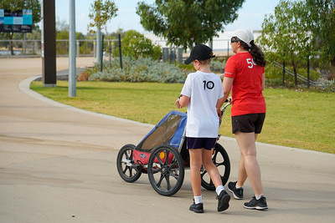
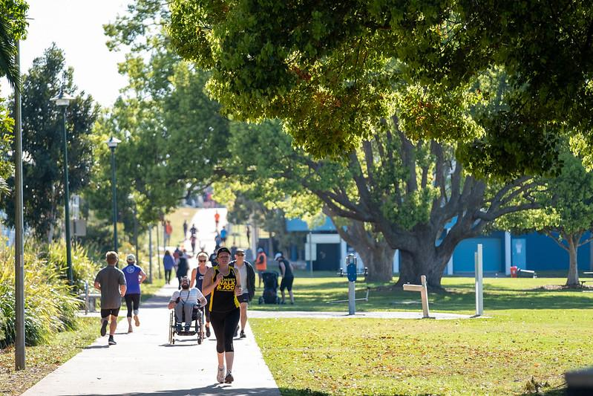
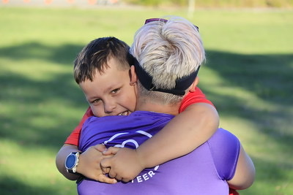
Notes:
Free
Every Saturday
No commitment
No specialist clothing
Variety of ways to get involved
Promotes family participation - friends and carers are always welcome
Non competitive
Encourages and celebrates regular participation

Slide 22
Rewarding participation, not performance
parkrun is not a race
You can go at your own pace
You can do 5km or build up slowly
You can earn credits towards volunteer or run/walk milestone shirts (starting with a “10” shirt for juniors)
Notes:
Milestone shirts can be earned through participation at parkrun, buth volunteering and walk/running. These range from 10 for juniors, right through to 500 shirts (see next slide)

Slide 23
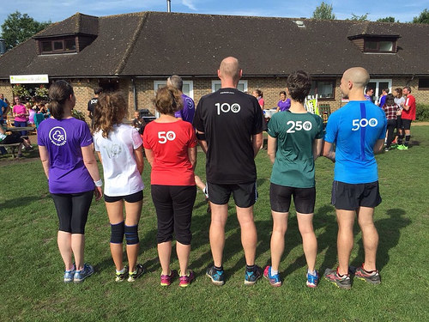
Notes:
Milestone shirts: Participation, not performance, has always been the focus of parkrun. These coveted shirts cannot be purchased - they can only be earned by turning up and walking, running and volunteering (explain the different shirts). Currently more than 2000 people around the world earn a milestone shirt every weekend.

Slide 24
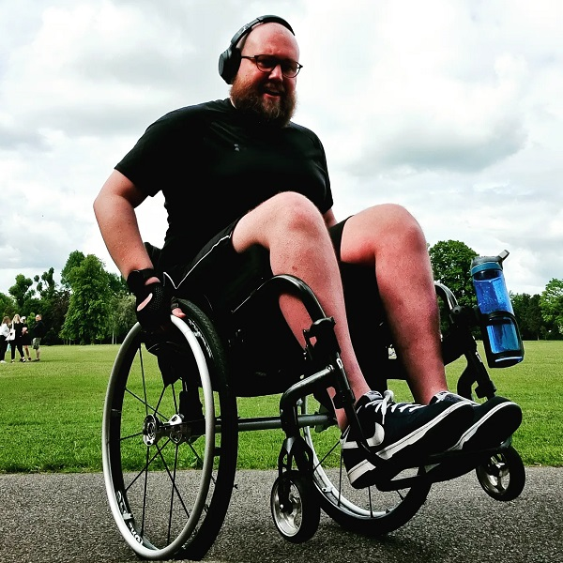
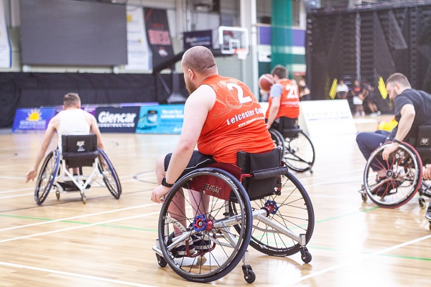
Meet Jono…
Notes:
Wheelchair user Jono Whitehead was recommended parkrun by a good friend and frame runner. Initially hesitant, he arrived to find the volunteer tail walker that day was his former maths teacher so felt instantly at ease! Jono said “He was also one of the volunteer tail walkers, so I knew I could be confident that if something went wrong, I’d at least know someone behind me.”
Jono tells us why he wants to see more people at parkrun who live with disabilities.
I live with a disability and I heard about parkrun from my friend Tully, who completes parkruns using a frame runner (she is also a gold medal winning para-olympic swimmer). We were looking at parkruns near my house which were flat and tarmacked so that I could use my wheelchair and she could use her frame, and found one nearby.
It’s been great to get out into the park and get some exercise. Although I’ve done parkrun on my own, it’s clear that parkrun is a very social activity, and I’m looking forward to seeing people the next time I go.

Slide 25
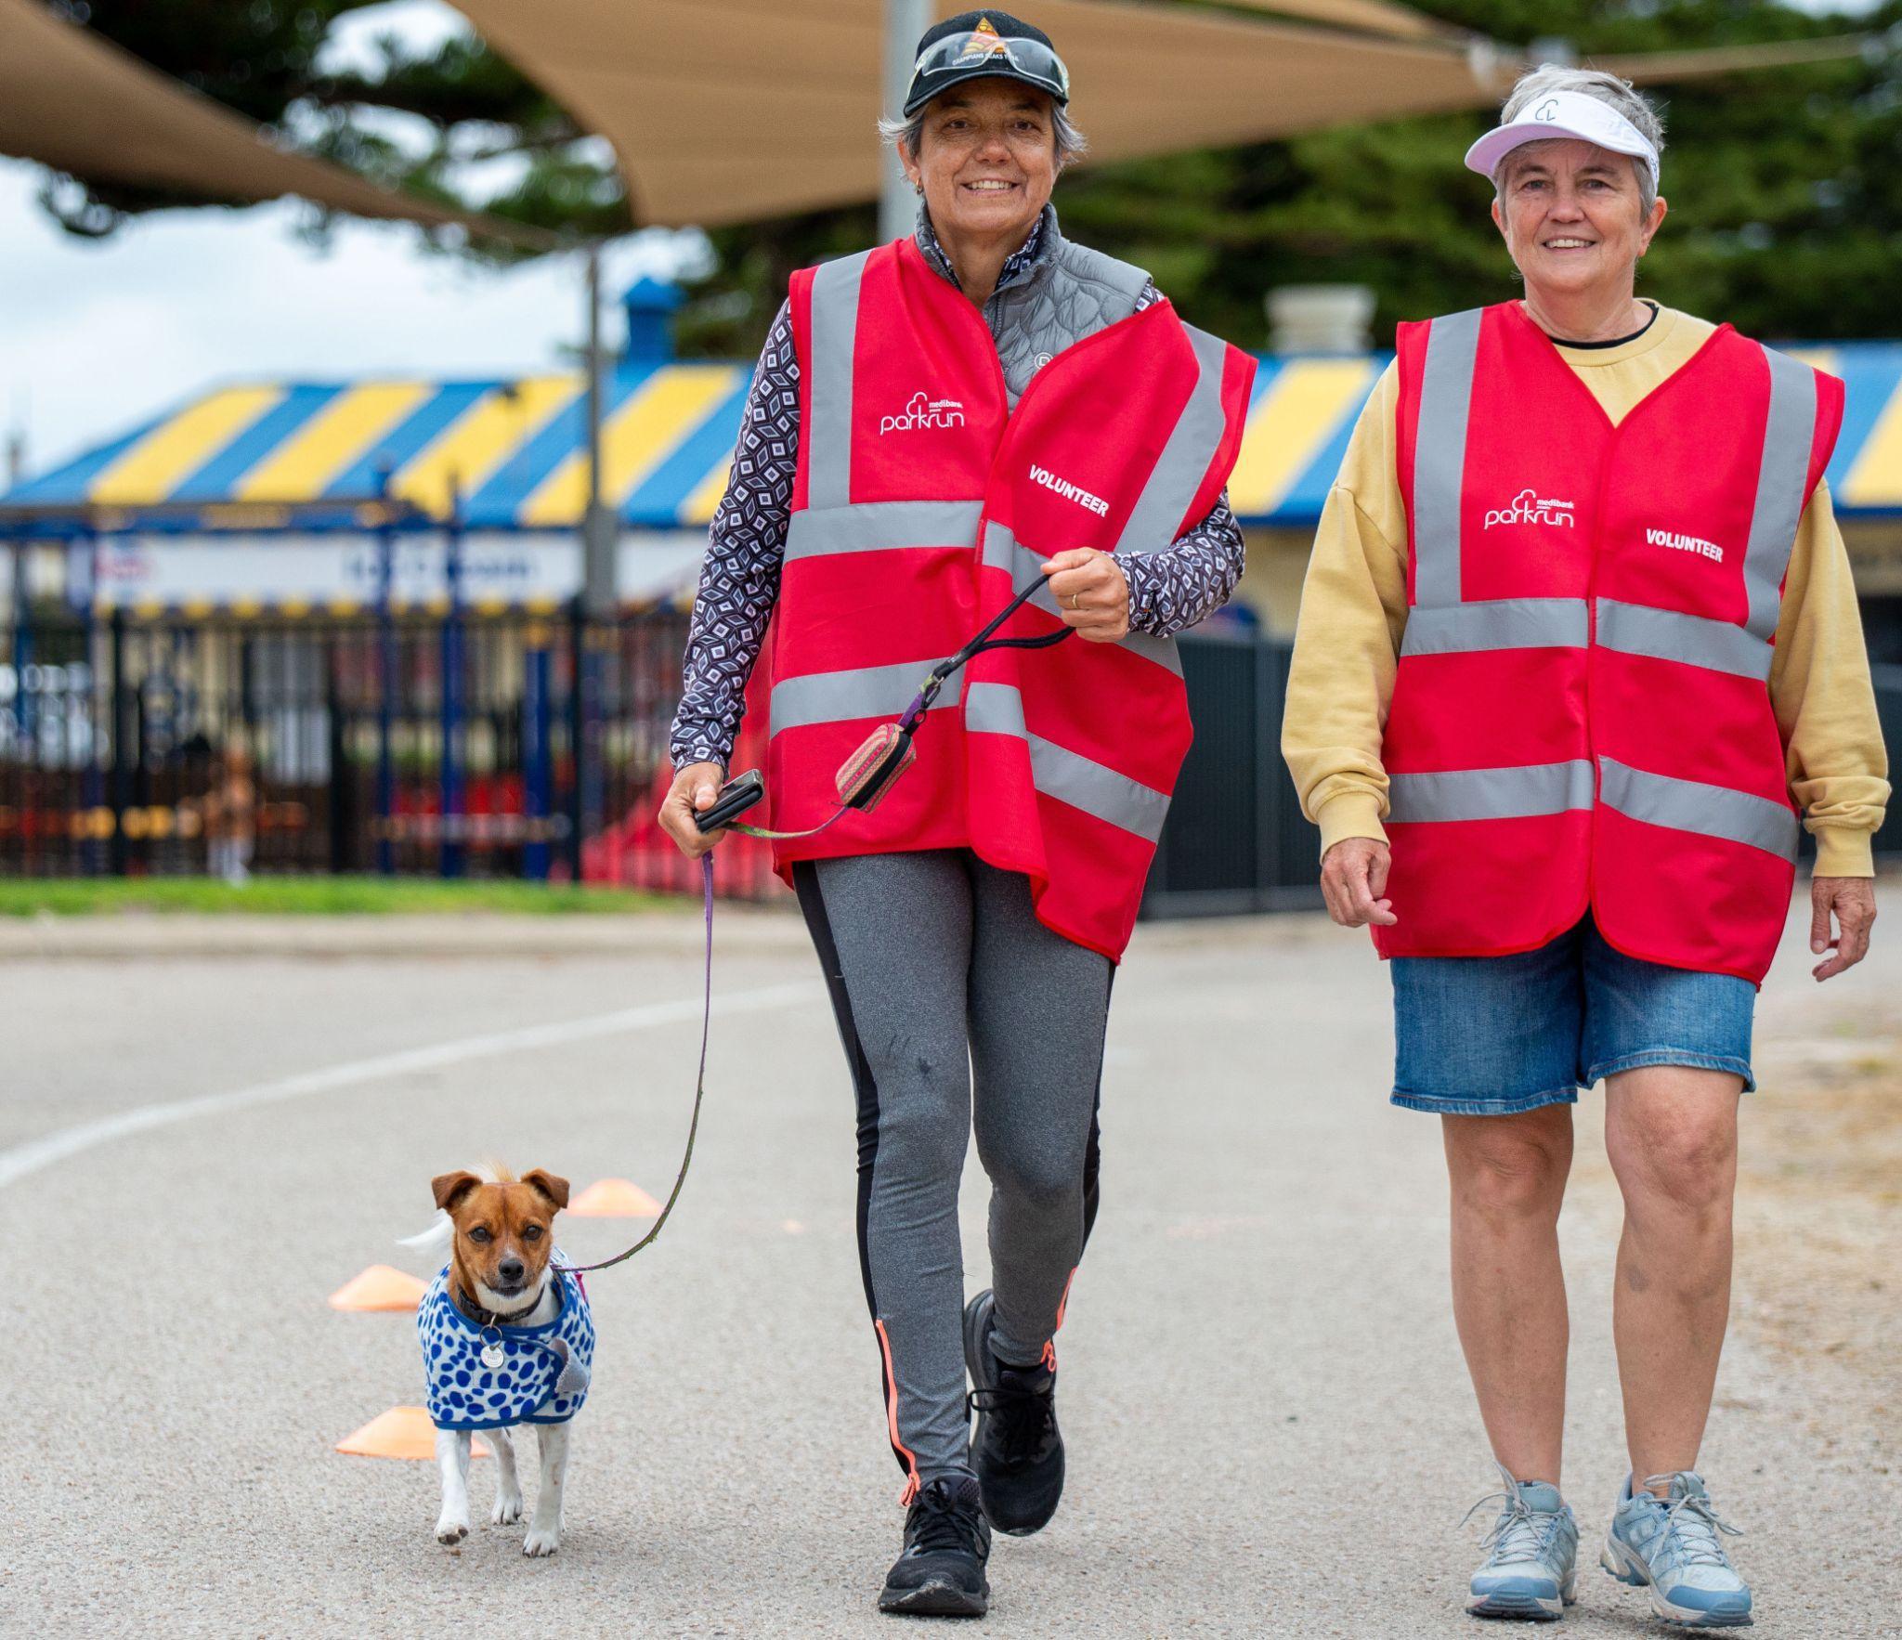
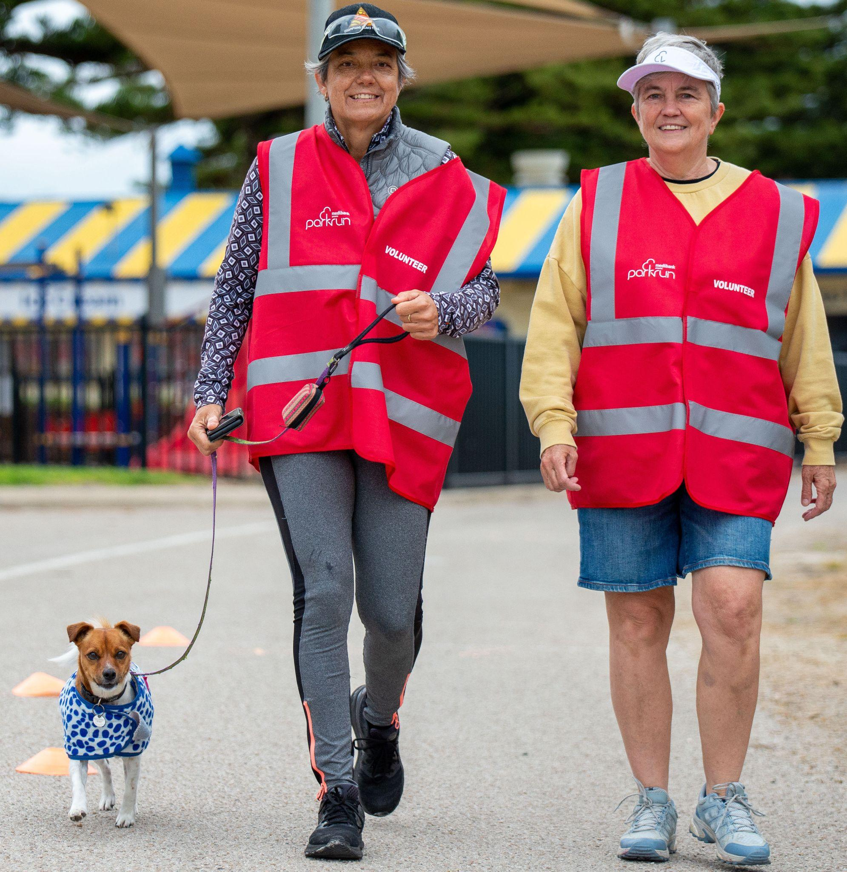
parkrun Australia’s growth
• More than 460 events every Saturday morning
• 850,000 individuals walking and running including 140,000 people volunteering
• 55,000+ walkers and runners each week
• 5,000 volunteers each week

Slide 26
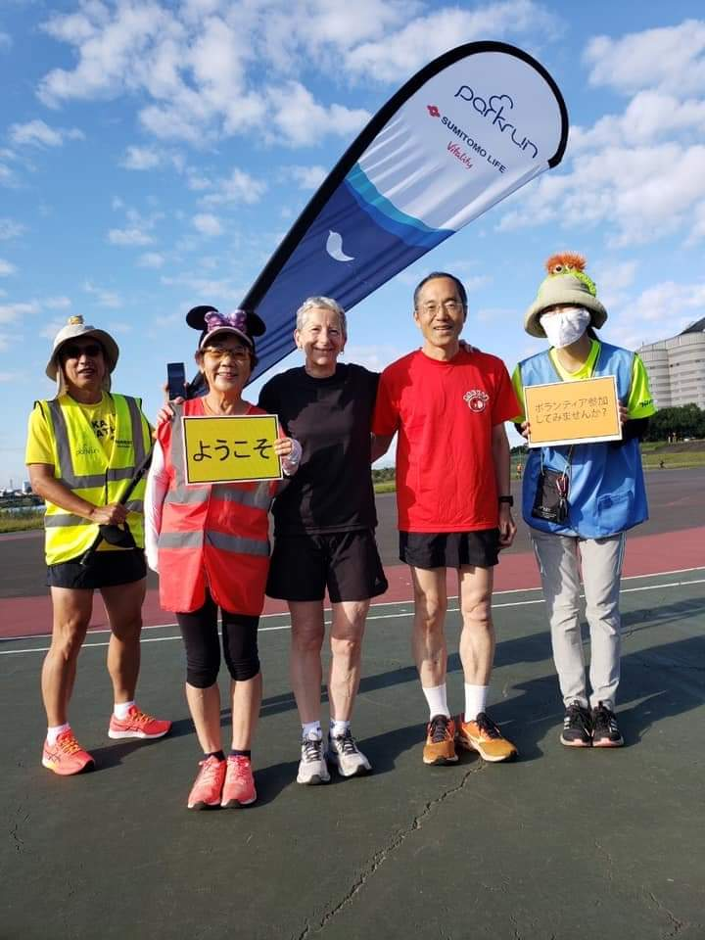
A global phenomenon
• 23 countries
• 2100 weekly events
• 260,000+ weekly participants
• 12 million+ have taken part worldwide
• 350,000 weekly participants
• 5 million+ taking part worldide
• Will double in size by 2023

Slide 27
What are the benefits of parkrun?

Slide 28
parkrun can help with forming regular habits of physical activity including increased movement during the week
No pressure environment - it’s not a race and you will not finish last - that’s the tailwalker’s job!
No ongoing commitment - join in on Saturdays when you would like to
You can join in with your dog, kids, grandparents, neighbours, friends - everyone is welcome at parkrun
Did we mention it’s free?

Slide 29
2019 parkrun Health & Wellbeing Survey
After participating at parkrun…
91% of all respondents reported a sense of personal achievement
89% reported improvements to their fitness
85% reported improvements to their physical health
79% reported improvements to their happiness
69% reported improvements to their mental health
Notes:
To really understand the impact of parkrun on people’s health and wellbeing, in 2019 a study was conducted of more than 60,000 parkrunners.

Slide 30
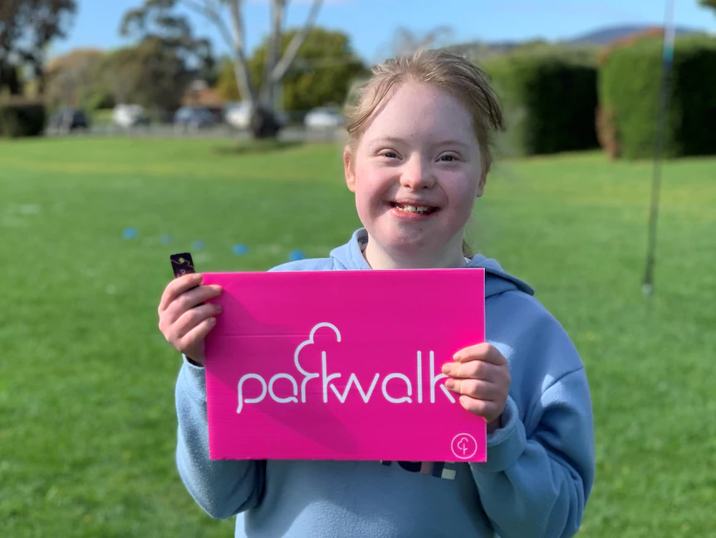
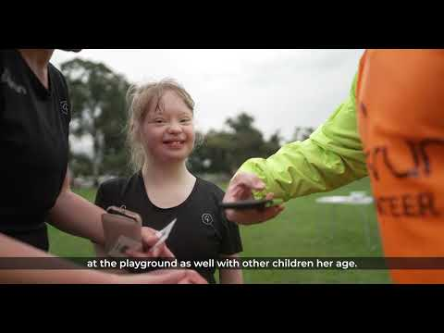
Meet Kylee and Veronika: Living our best lives
Notes:
Veronika was diagnosed with Down's syndrome, cerebral palsy, autism and epilepsy after she was born, and her parents were told she would never walk.
Watch how parkrun has given Veronika social confidence and allows Veronika and mum, Kylee, to live their best lives.

Slide 31
How can I join in the fun?
Visit www.parkrun.com.au to find your nearest event and register for a free barcode - you only need to do this once
Follow a parkrun event’s social media pages
Arrive a few minutes early for the First Timers Welcome
Enjoy the morning!
Notes:
Your barcode is valid at every parkrun in the world. You can print your barcode or download it to your phone

Slide 32
[your contact details]

